Slide 1
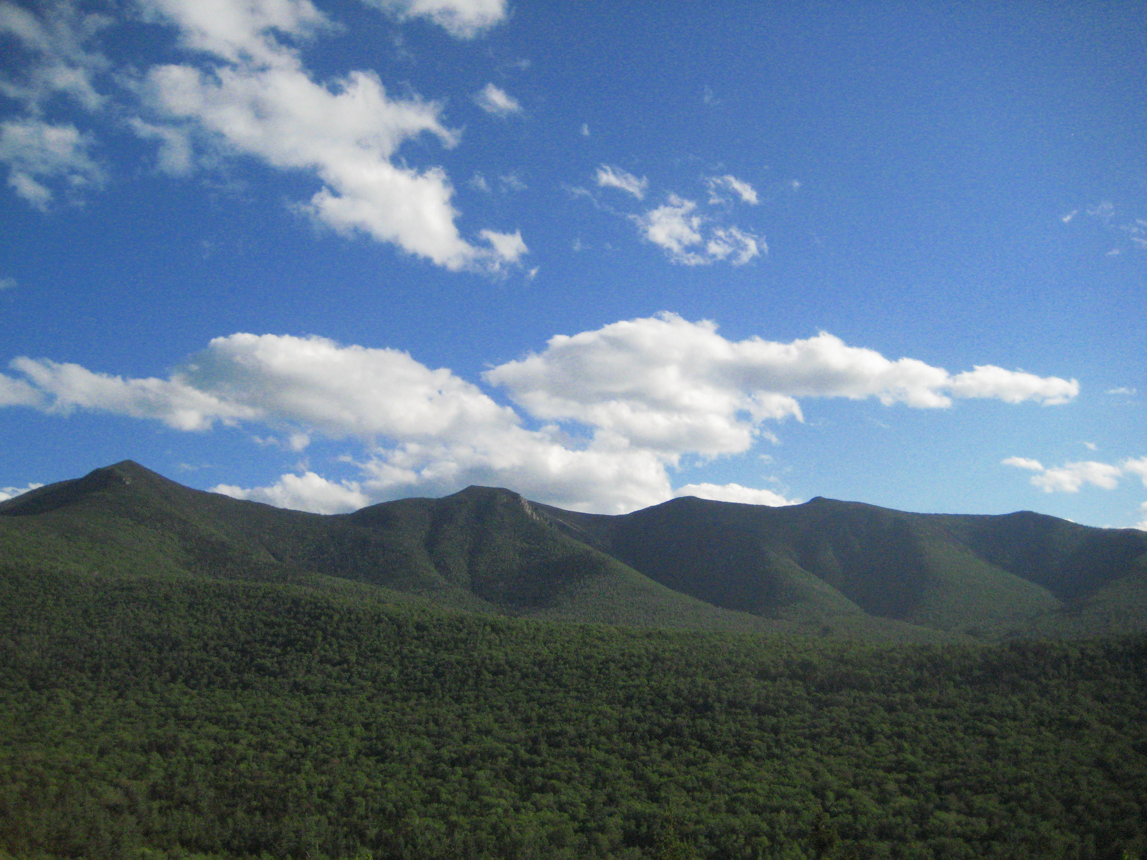
Does climate change alter mercury fluxes in northern hardwood forests
Yang Yang¹, Linghui Meng²,
Mario Montesdeoca², Ruth Yanai¹, Charley Driscoll²
State University of New York-ESF¹, Syracuse University²
Notes:
title

Slide 2
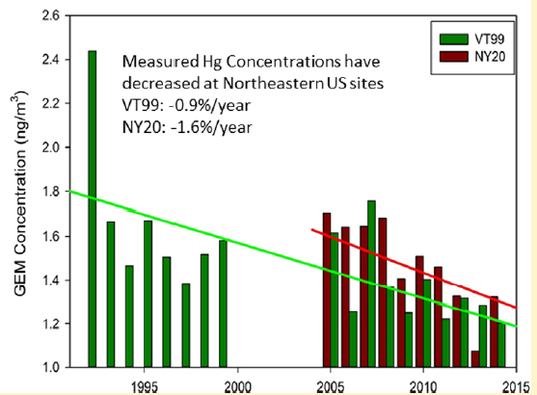
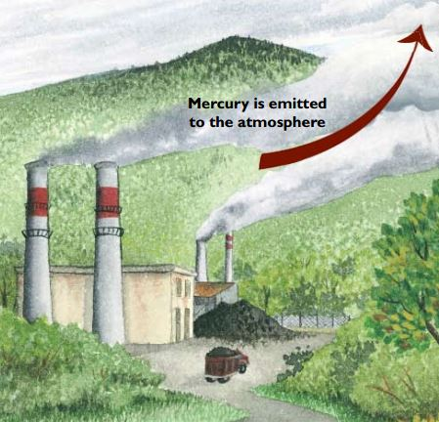
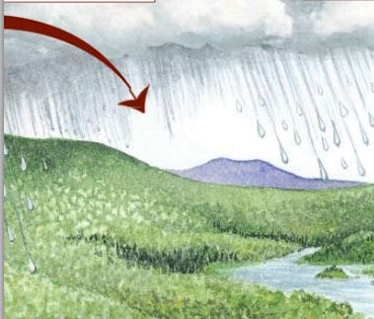
Background
Elemental Hg reactive gaseous Hg particulate Hg
Municipal waste incinerators
Electric utilities
etc.
Forests
Lakes
Zhou et al. 2016
USEPA 2005, NESCAUM 2005.

Slide 3
Wet&dry deposition
Wet&dry deposition
Wet&dry deposition
Hg
Throughfall
Litter
Hg
Hg
Hg
Hg
Soil Hg evasion

Slide 4
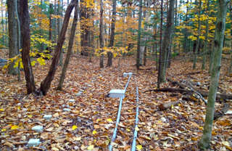
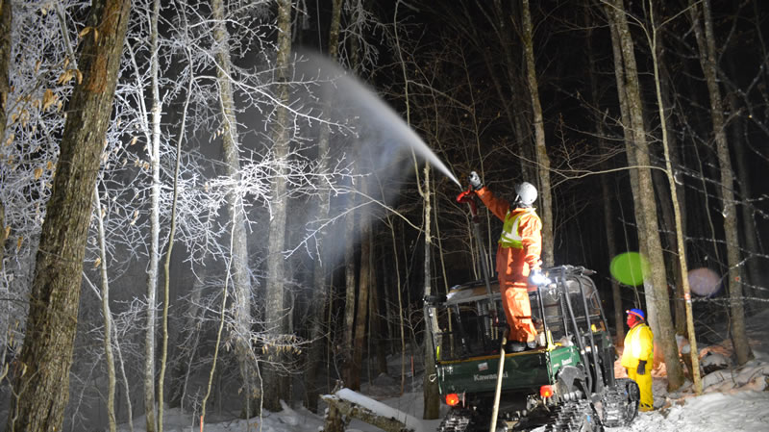
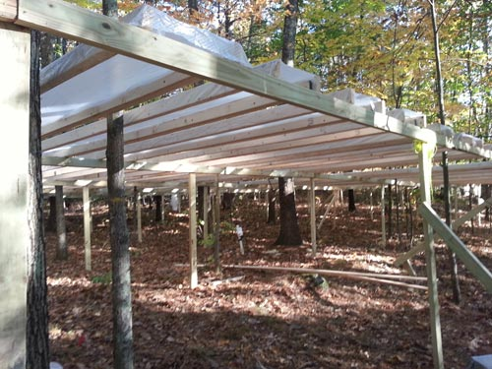
CCASE
Warming
Ice storm
CCASE
Freezing and warming
Drought

Slide 5
CCASE
Wet&dry deposition
Warming
Litterfall
Throughfall
Soil evasion
Freezing and warming

Slide 6
Wet&dry deposition
Litterfall
Ice storm
Throughfall
Soil evasion

Slide 7
Wet&dry deposition
Litterfall
Drought
Throughfall
Soil evasion

Slide 8
Ice storm
Throughfall Hg
Monthly from June to October
Litter Hg
October, by species
Soil Hg evasion
(moisture, temperature and solar radiation)
Plot 4-control plot
Plot 5-high treated plot
June, August, October
Soil Hg
August, by depth

