Slide 1
Level 1 Secondary Data To Sort CRaTER Modes
Mark D. Looper
June 6, 2024
Revised June 12, 2024

Slide 2
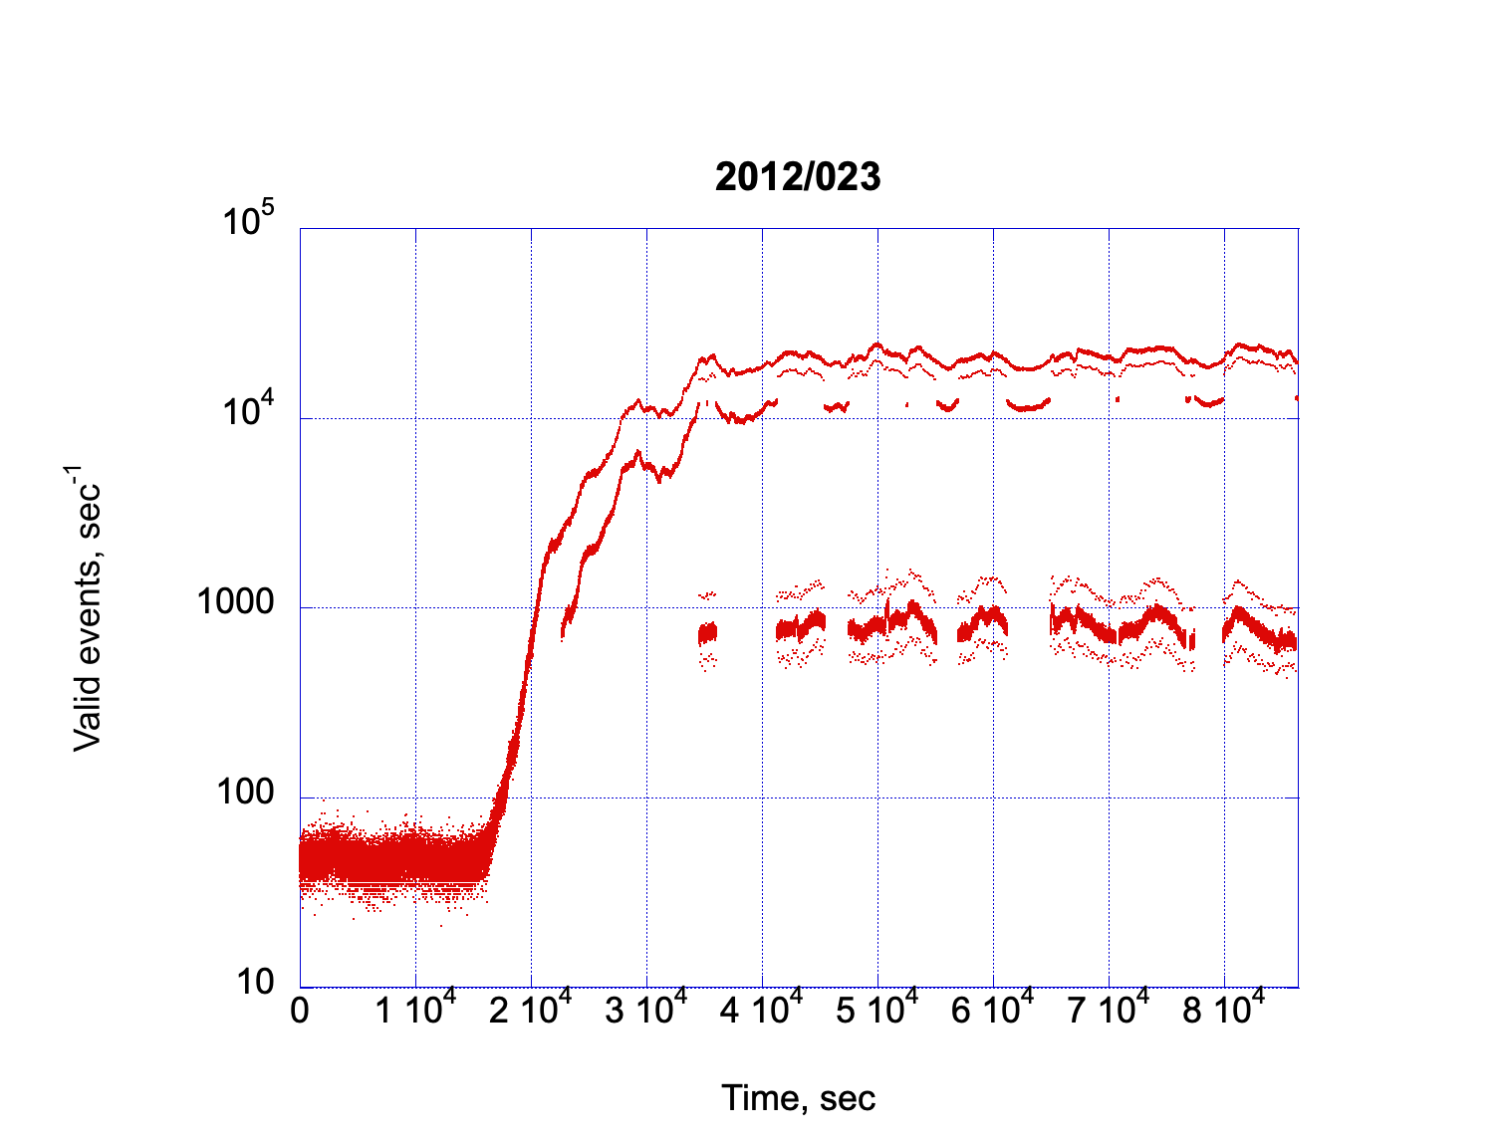
SEP Modes
Nominal
Normal
High Offset
Elevated
Mid Offset
Extreme
Low Offset
Heretofore I have sorted CRaTER modes during large SEP events by eye; I was hoping to find clues in the Level 1 Secondary files that would let me do this automatically, and it almost but not quite worked. The half dozen traces into which the valid events separate include the nominal, elevated, and extreme SEP modes, plus three offset “echoes” with fewer points; these appear to occur on transitions between the three main modes.

Slide 3
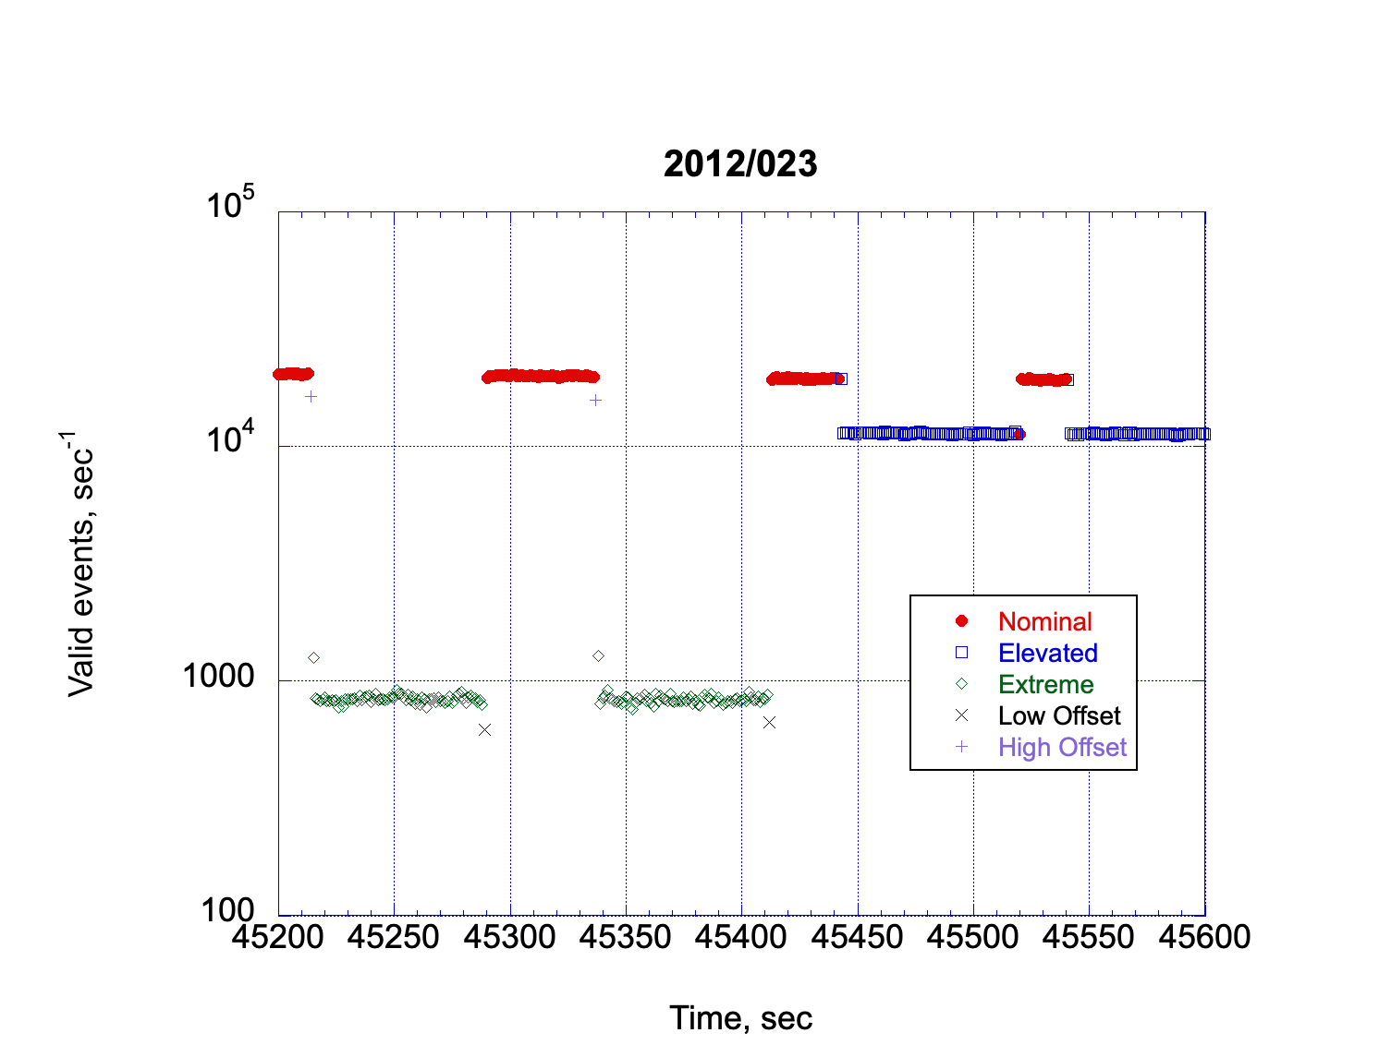
This figure magnifies a 400-second portion of the data from the previous plot; as listed in the table on the next slide, the points are separated by values in the Level 1 Secondary files and coded (colors, symbols) in this plot accordingly. Arrows indicate data where Nominal and Elevated mode flags are present for points at the end of sequences of points of the other type, and for some reason all Mid Offset points have Extreme flags.

Slide 4
 | Nominal | Elevated | Extreme | Low Offset | Mid Offset | High Offset
DiscThin | 72 | 72 | 80 | 80 | 80 | 72
DiscThick | 72 | 72 | 72 | 72 | 72 | 72
Mask[0] | 4294967295 0xFFFFFFFF | 4294967294 0xFFFFFFFE | 858993458 0x33333332 | 4294967295 0xFFFFFFFF | 858993458 0x33333332 | 858993458 0x33333332
Mask[1] | 4294967295 0xFFFFFFFF | 4294901481 0xFFFEFEE9 | 858927649 0x33323221 | 4294967295 0xFFFFFFFF | 858927649 0x33323221 | 858927649 0x33323221
These are the values from the Level 1 Secondary data files that, for the most part, correspond to the different data traces on the previous two plots. (Mask values are given in decimal and hexadecimal.) As noted, when the Nominal and Elevated modes are alternating, for some reason the last point of a sequence in one trace has the values characteristic of the other mode, while the Mid Offset trace has values that are not distinguishable from those in Extreme mode. Note added June 12, 2024: during some SEP events those modes that have DiscThin and/or DiscThick values of 72 can have them replaced by 71 (if two 72s are in the table above, they are always replaced by two 71s, never leaving one of each). The normal mode during quiet times has both set to 71, which amounts to the same modification of Nominal mode in the table. This small difference in discriminator thresholds should make no discernible difference in the data (direct events) itself.

Slide 5
The information in the Level 1 Secondary files can also be used to flag times of calibration, and other non-nominal operating modes.
The CalLow, CalHigh, and CalRate flags are zero during normal or SEP operations; if any of these is nonzero, the Valid Events rate jumps around (not shown) in a way that I have previously used to find calibration-mode times by inspection.
If the DiscThin, DiscThick, and Mask[0,1] values are not among the values on slide 4, this also indicates other than normal (or SEP) operation.
Normal mode doesn’t start until late on day 177 of 2009, so the very earliest mission data must be sorted by hand. After that, though, we can scrub data for normal or SEP modes very well using data in the Level 1 Secondary files.

Slide 6
Summary
Invalid or calibration data is indicated by nonzero values of CalLow, CalHigh, and/or CalRate, or by combinations of values of DiscThin, DiscThick, Mask[0], and/or Mask[1] that are not on slide 4.
While the values in the table on slide 4 generally separate modes (nominal, elevated, extreme, or transitional) during SEP events, the data point right before or after a mode transition may be wrongly labeled, as indicated by a step in the valid-event count rate and exemplified by the plot on slide 3.
This may also apply to the data point right before or after a transition between valid and invalid data.

