Slide 1
CRaTER Response to SEP Event of 2013/142 (May 22, 2013)
Mark Looper
May 29, 2013

Slide 2
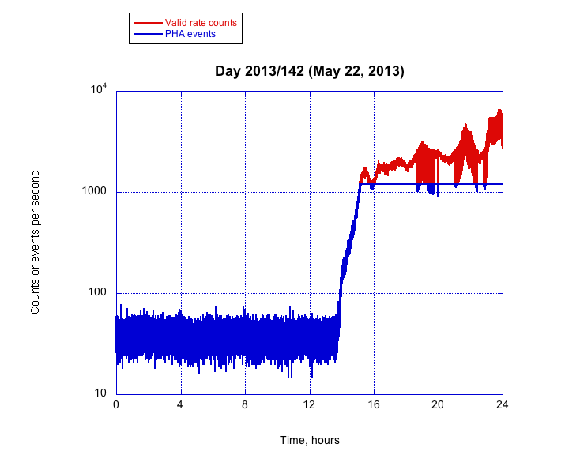
The well-connected SEP event a week ago resulted in substantial CRaTER countrates, unlike the poorly-connected one starting about a week before that. The direct-event buffer quickly maxed out at 1200 events per second (blue curve); the following day, the telemetry stayed at the maximum of 1200 PHA events per second for all 86400 seconds of the day.

Slide 3
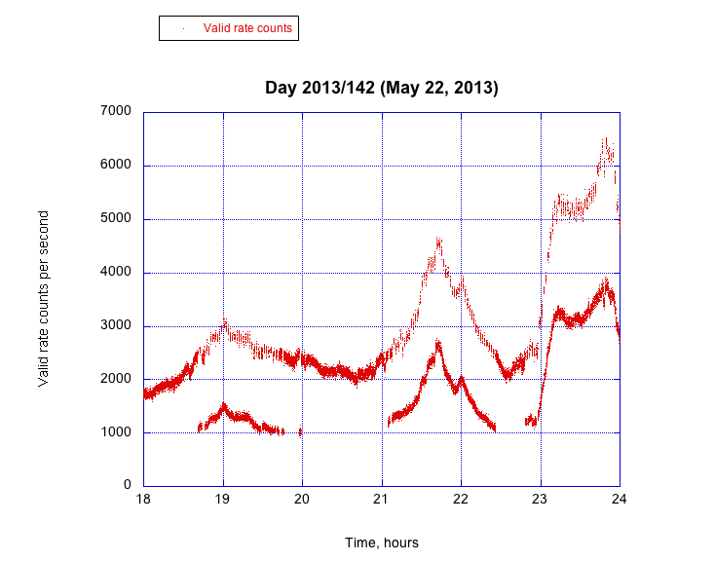
This is a blowup of the “oscillating” part of the red curve on the previous page (linear scale, omitting lines between points), showing activation of high-rate mode at the event peak. The upper curve is the “nominal” mode; during peak periods, cycling occurs with 21 seconds in this mode alternating with 77 seconds in the reduced-count (high rate) mode.

Slide 4
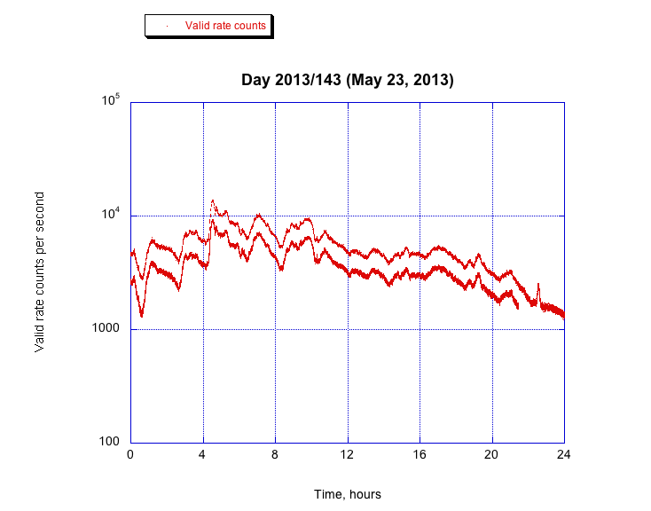
Switching back to a logarithmic rate scale, this plot shows that the oscillation between modes continued through most of the second day of the event, until intensity dropped below the triggering threshold late in the day (about 21:30).

Slide 5
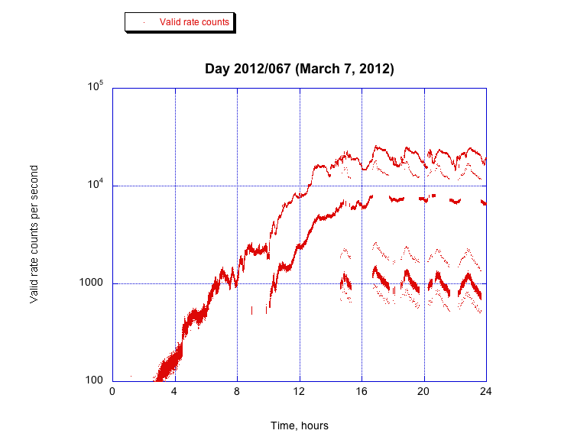
By contrast, the more intense event in March last year resulted in an apparent oscillation among half a dozen or so different levels of “high-rate mode.” I conjecture that the faint traces between and below each pair of intense traces represent one-second periods partly in one of three modes and partly in another, averaging them; I need to look at this further.

Slide 6
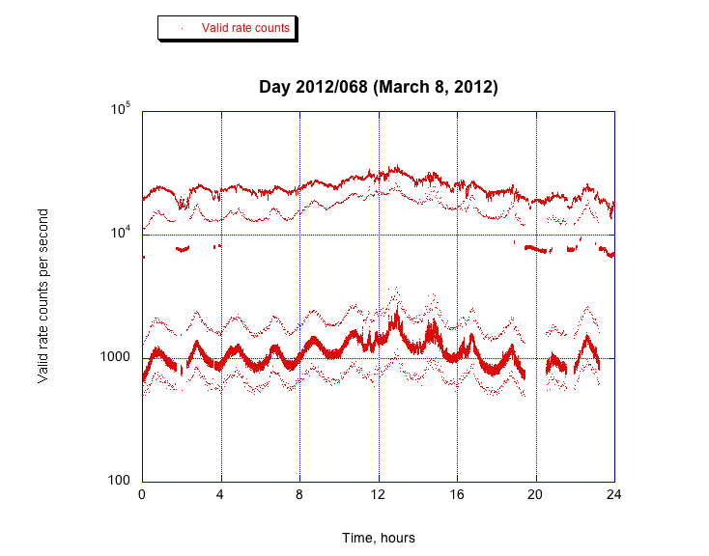
At the event peak the next day, the “first high-rate mode” (trace around several thousand counts per second) disappeared, leaving an apparent alternation between nominal mode (around 20,000 c/s) and “second high-rate mode” ( around 1000 c/s), plus the faint traces presumably partly in one mode and partly in another. (All plots have 1-sec resolution.)

Slide 7
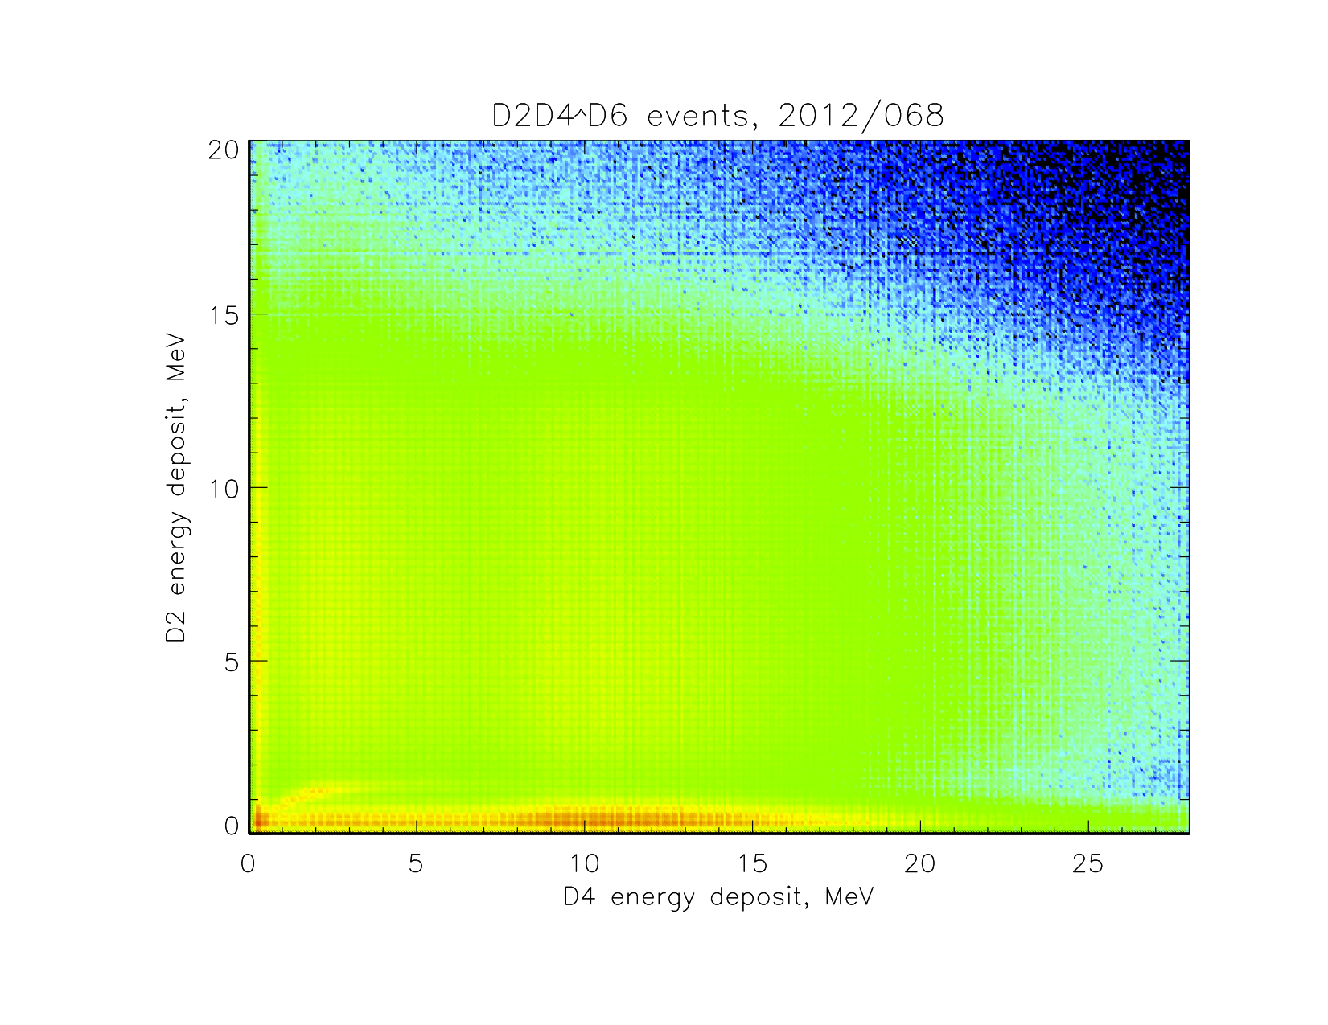
In file “SEP 2012-067.pptx” dated March 14, 2012, I showed a number of PHA crossplots for the more and less intense days of the March 2012 event. This is the plot for D2D4 doubles on the most intense day; it appears to be dominated by “scruff” events along the axes and a rectangular “patch” of apparent spurious coincidences (as discussed in that file), with the nominal forward proton track barely visible. I wondered whether the present less-intense event would show a more trustworthy-looking 2D pulse-height distribution.

Slide 8
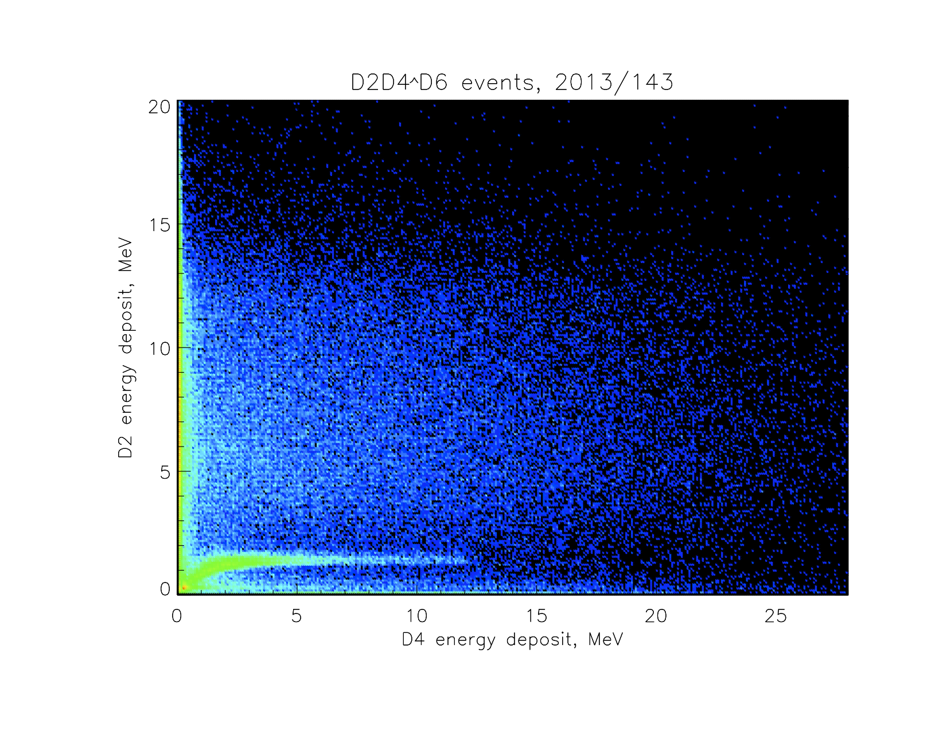
Here is the plot for the most intense day of the present event. It looks like the dubious event populations are present, but less dominant than for the March 2012 SEP event; the nominal proton track is strong here. I need to make “partial” crossplots isolating each of the nominal and high-rate modes, to see if pulse-height distributions in some modes are reasonable or if all of them fall apart when overall countrates get too high. I also want to look at thin-detector crossplots to see if we can get usable high-LET spectra for SEP events.

