Slide 1
Comparison of GLACE And REDMoon Geant4 Simulation Results
Mark D. Looper
April 24, 2024

Slide 2
Energy-angle distributions
The LRO/CRaTER team has been modeling the energy-angle distribution of lunar albedo particles for some years; e.g., you referred to Schwadron et al., Icarus (2016) in your 2021 REDMoon paper.
I am writing a paper on the Geant4 Lunar Albedo Computed Environment (GLACE) model, in which we are encapsulating and releasing those calculations. Since the supplemental material for your 2021 paper is one of the few places we’ve found where energy-angle distributions are tabulated rather than just plotted, I want to compare the two models where they overlap.
I find that we disagree as to how to do the angular normalization of such simulation results, and I wanted to seek your comments before I submit this for publication.

Slide 3
Angular normalization
Consider area $a$ to be a segment of a ring with polar angle width $dθ$ (I will redo the diagram later, as an appendix to the paper in preparation), in which we tabulate simulated particles coming from production area $A$. If $dN$ particles are counted in a simulation run, we might expect to normalize to a fluence $J$ in particles per (cm² sr) using the solid angle of the ring containing $a$ and the area of target $A$: that is, $dN=2πJA\sin{θ}dθ$. This appears
$$a$$
$$θ$$
$$r$$
$$A$$
to be what was done in REDMoon. However, we find that the appropriate area is that of the dotted rectangle normal to the radius vector $r$, which is $A\cos{θ}$: that is, $dN=2πJA\sin{θ}\cos{θ}dθ$. Imagine the flat surface $A$ giving off a uniform glow: if you zoom in on a fraction of the surface, you will always receive the same number of photons regardless of $θ$, but if you view the whole area $A$ from a distance, the light will diminish as you look at it closer to edge-on ($θ=90°$). This is how we converted the counts of simulated particles to fluences in GLACE (then, independently, we normalize by energy bin width and time to obtain fluxes).

Slide 4
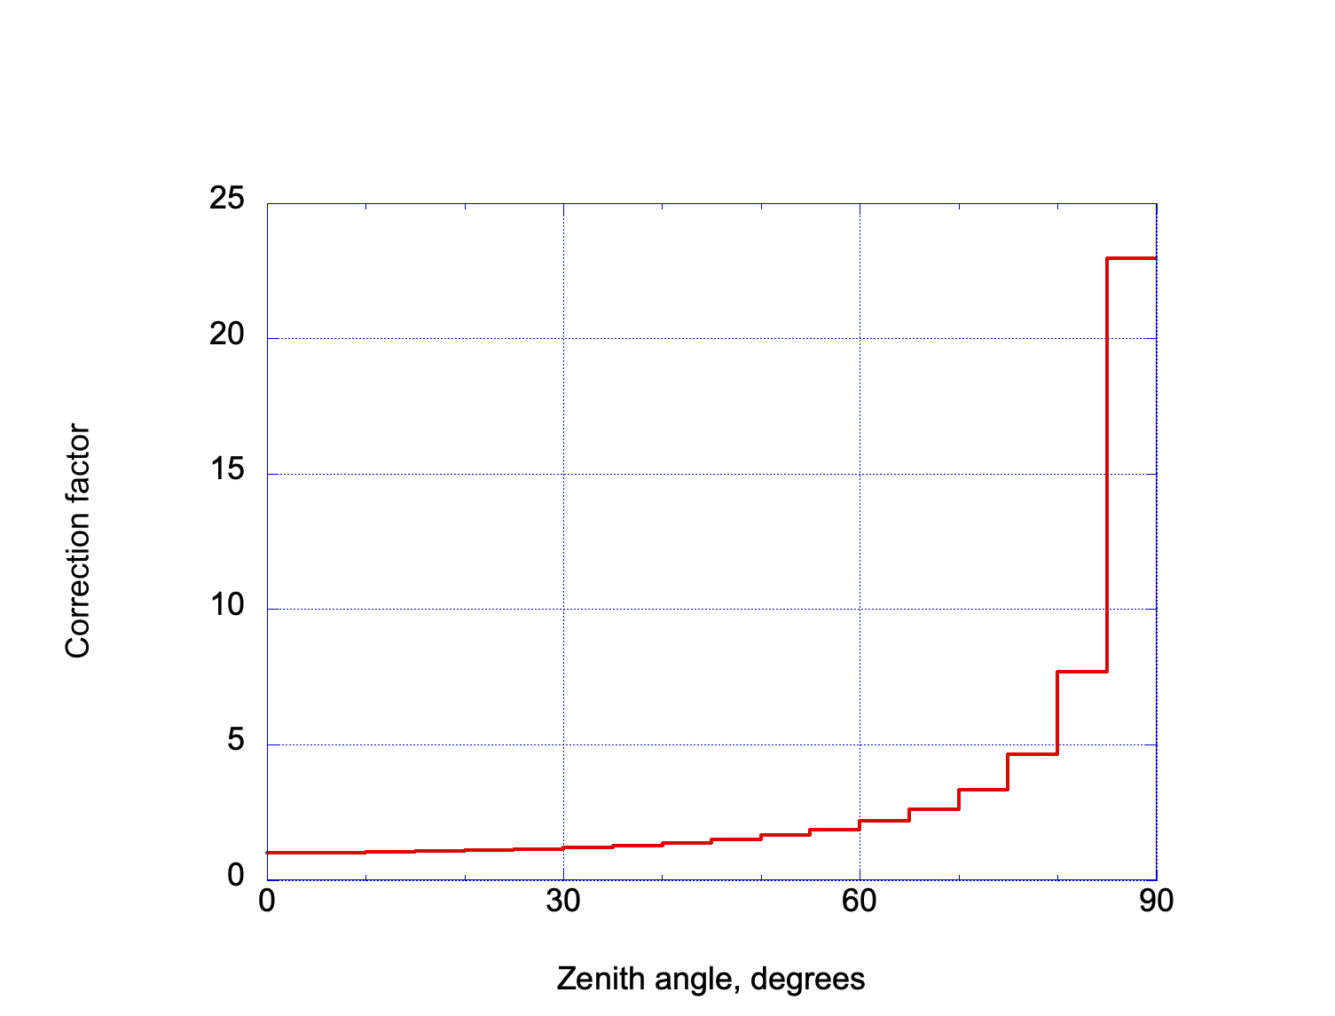
Correction factor
If we calculate fluxes $J(θ)$ from simulation counts $N$ between polar angles of $θ_{0}$ and $θ_{1}$, integrating the two expressions for $dN$ over the 5° bins of REDMoon, the ratio is the correction factor plotted above: $K=2{\left(\cos{θ_{0}−\cos{θ_{1}}}\right)}/{\left(\sin^{2}{θ_{1}−\sin^{2}{θ_{0}}}\right)}$.

Slide 5
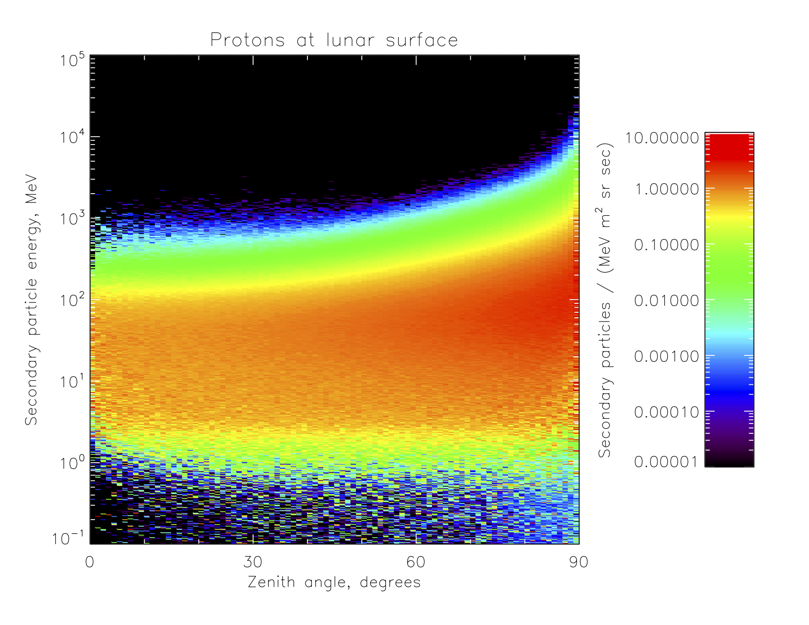
GLACE albedo protons
This is the plot of albedo protons for solar-minimum GCR input from the GLACE model, very similar to our earlier results, like that to which you referred from Schwadron et al. (2016).

Slide 6
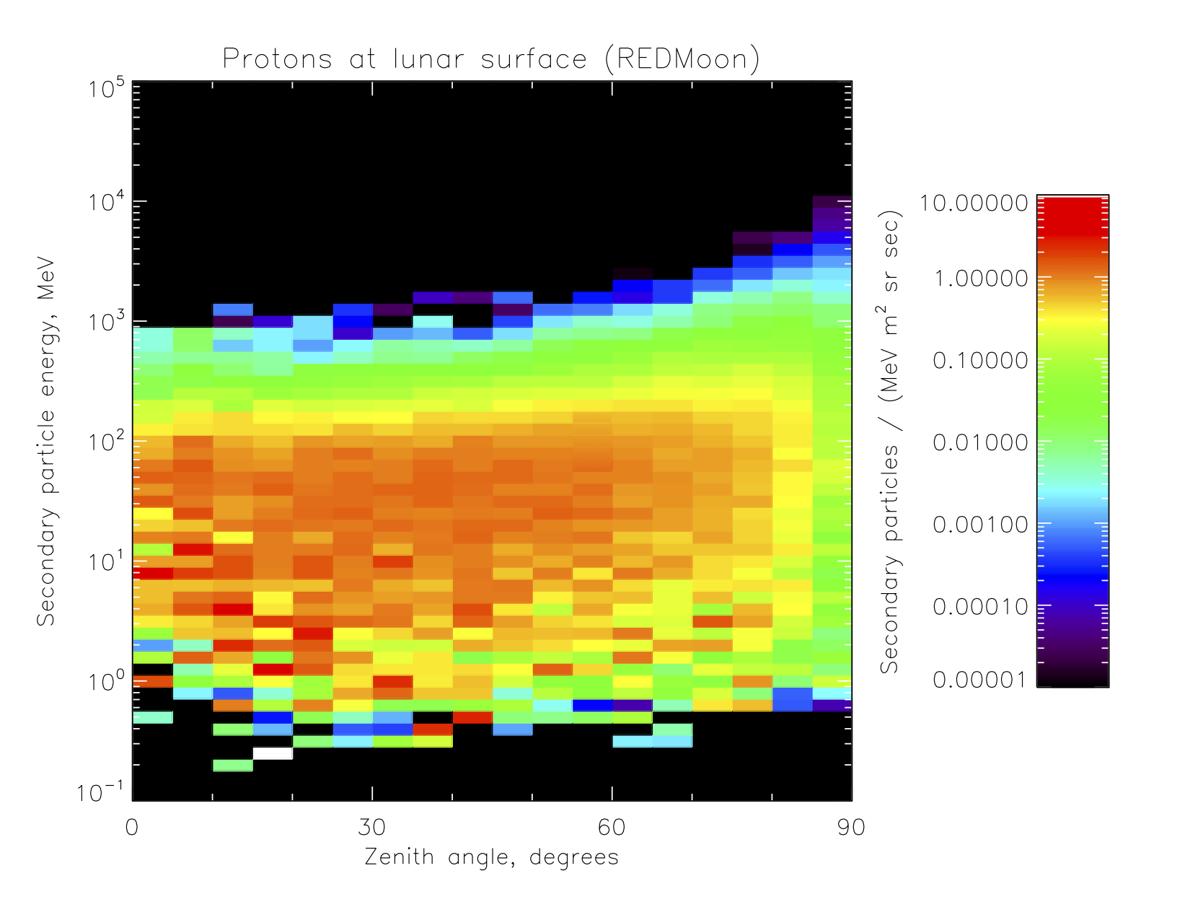
REDMoon albedo protons
These are the albedo (surface) protons from REDMoon, taken from file fig3a.txt in the supplemental material from your 2021 paper. This is the upper (upgoing) half of Figure 4a in the paper, rotated into the orientation in which the CRaTER team have been plotting and presenting our results. Note falloff toward the horizon (90° zenith angle).

Slide 7
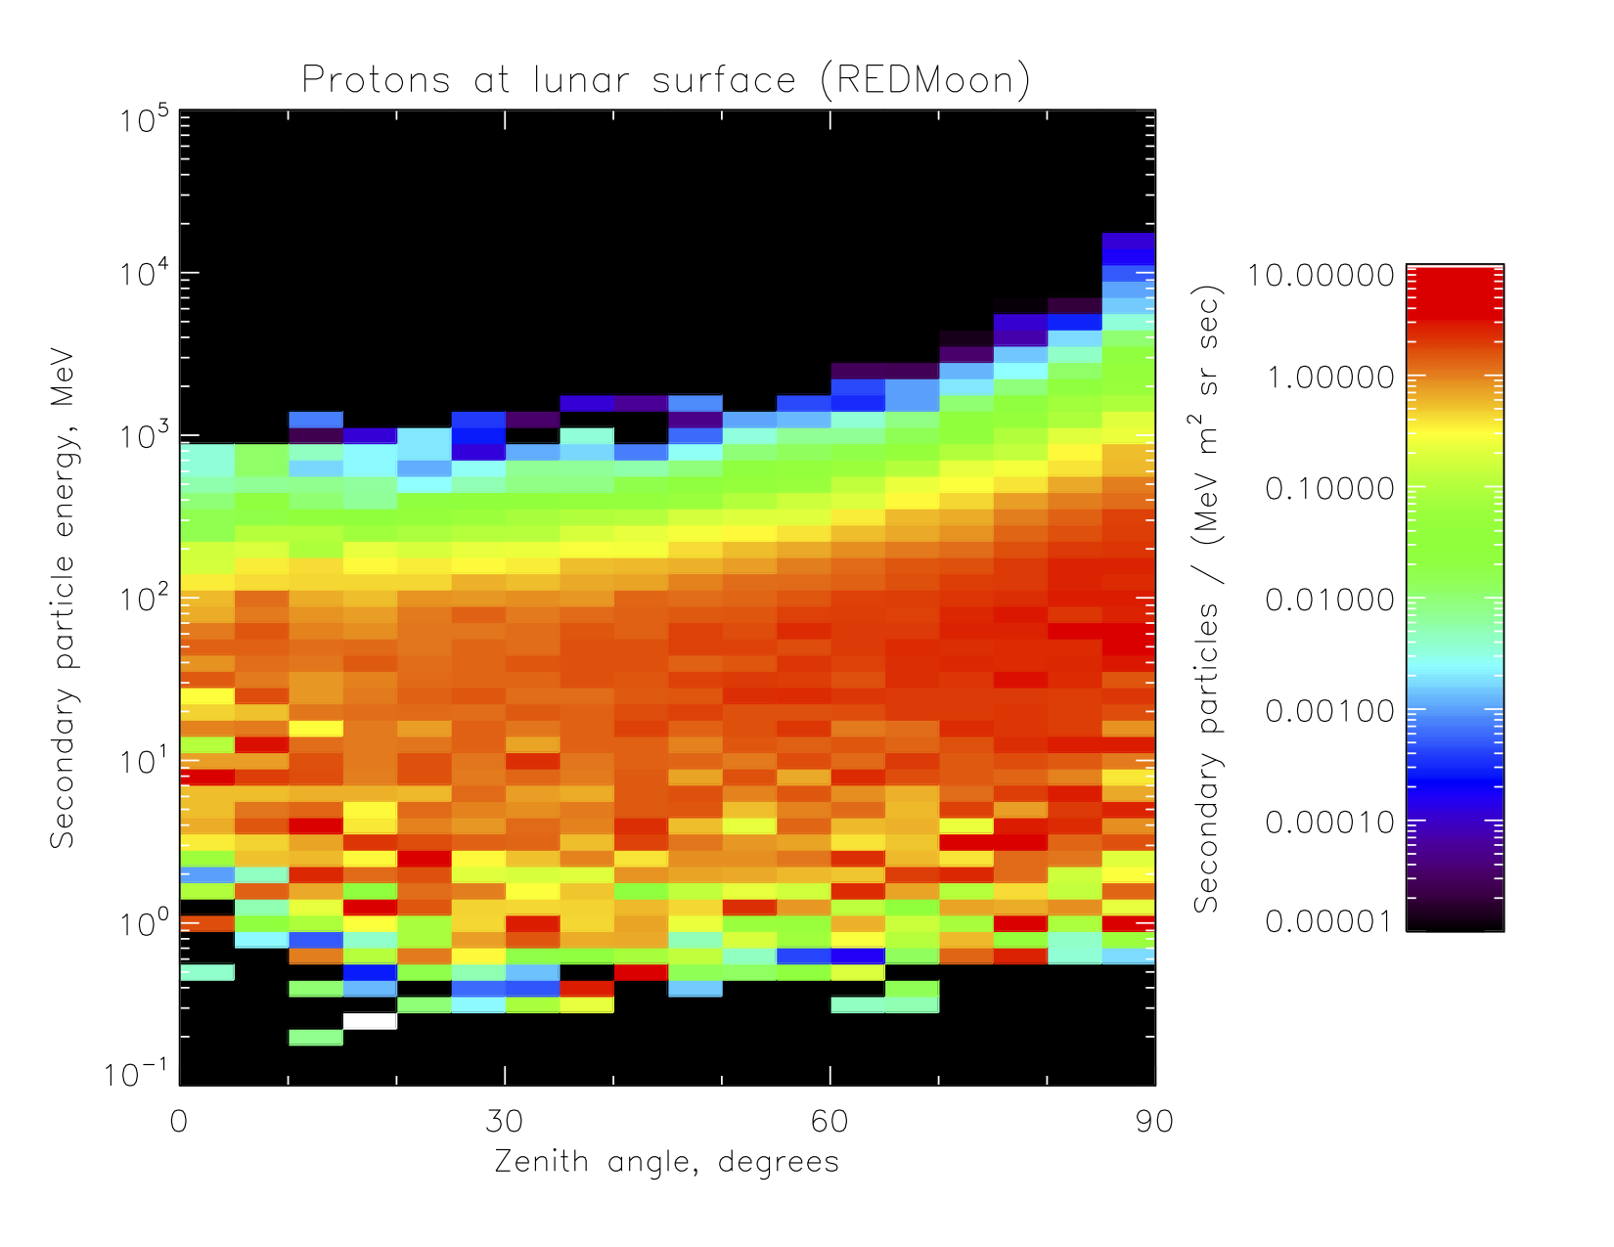
REDMoon albedo p+, corrected
These are the albedo protons from REDMoon, with the angular correction on slide 4 of the present PPTX applied. Note the similarity to the GLACE plot on slide 5: flux drops off below about 1 MeV, and intensifies and hardens toward the horizon.

Slide 8
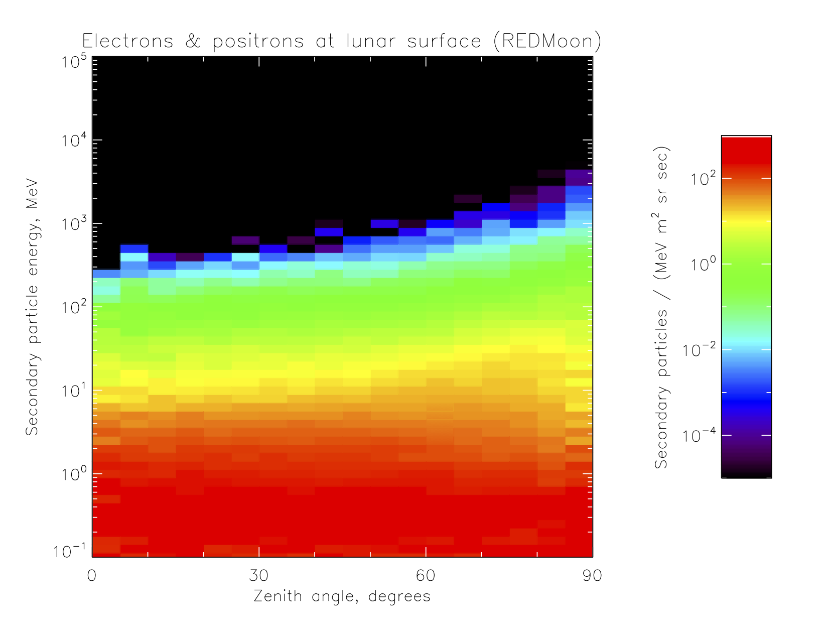
REDMoon albedo e-/e+, corrected
It is also of interest to compare the energy/angle distributions of electrons and positrons between the two models. These are the albedo fluxes from your Figure 4e, with the correction factor applied; note that boosting the calculated fluxes toward the horizon using the factor on slide 4 does not entirely suppress the fall-off toward 90°.

Slide 9
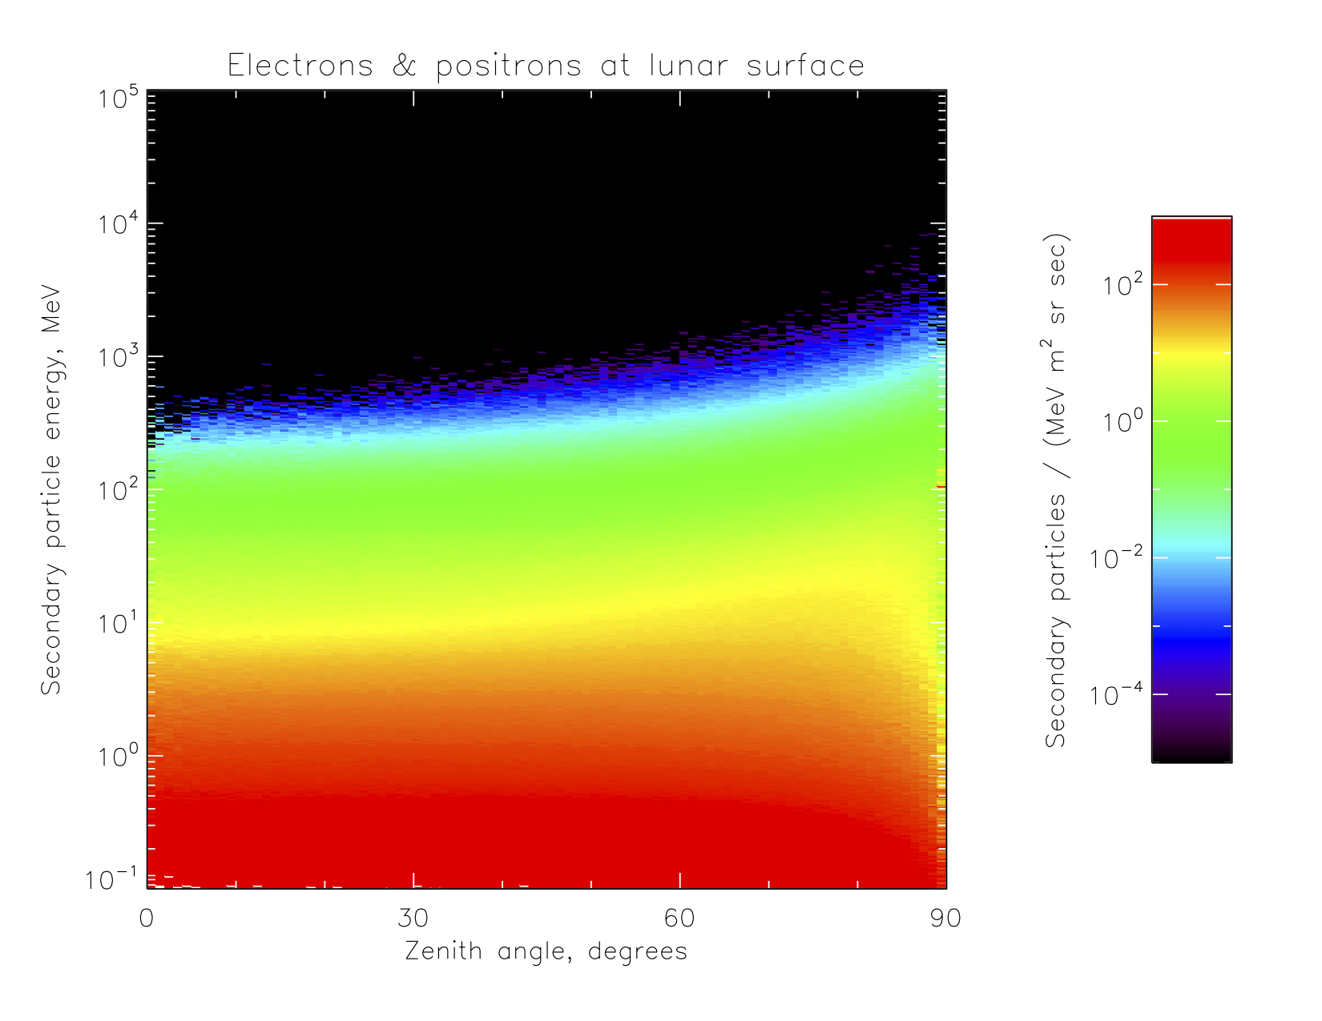
GLACE albedo e-/e+
This plot from GLACE also shows a fall-off in the last few degrees toward the horizon. This suggests that the correction factor on slide 4 is properly calculated to convert between our two methods of normalizing the angular distributions, and thus that the cause of the difference between the two is correctly identified on slide 3.

Slide 10
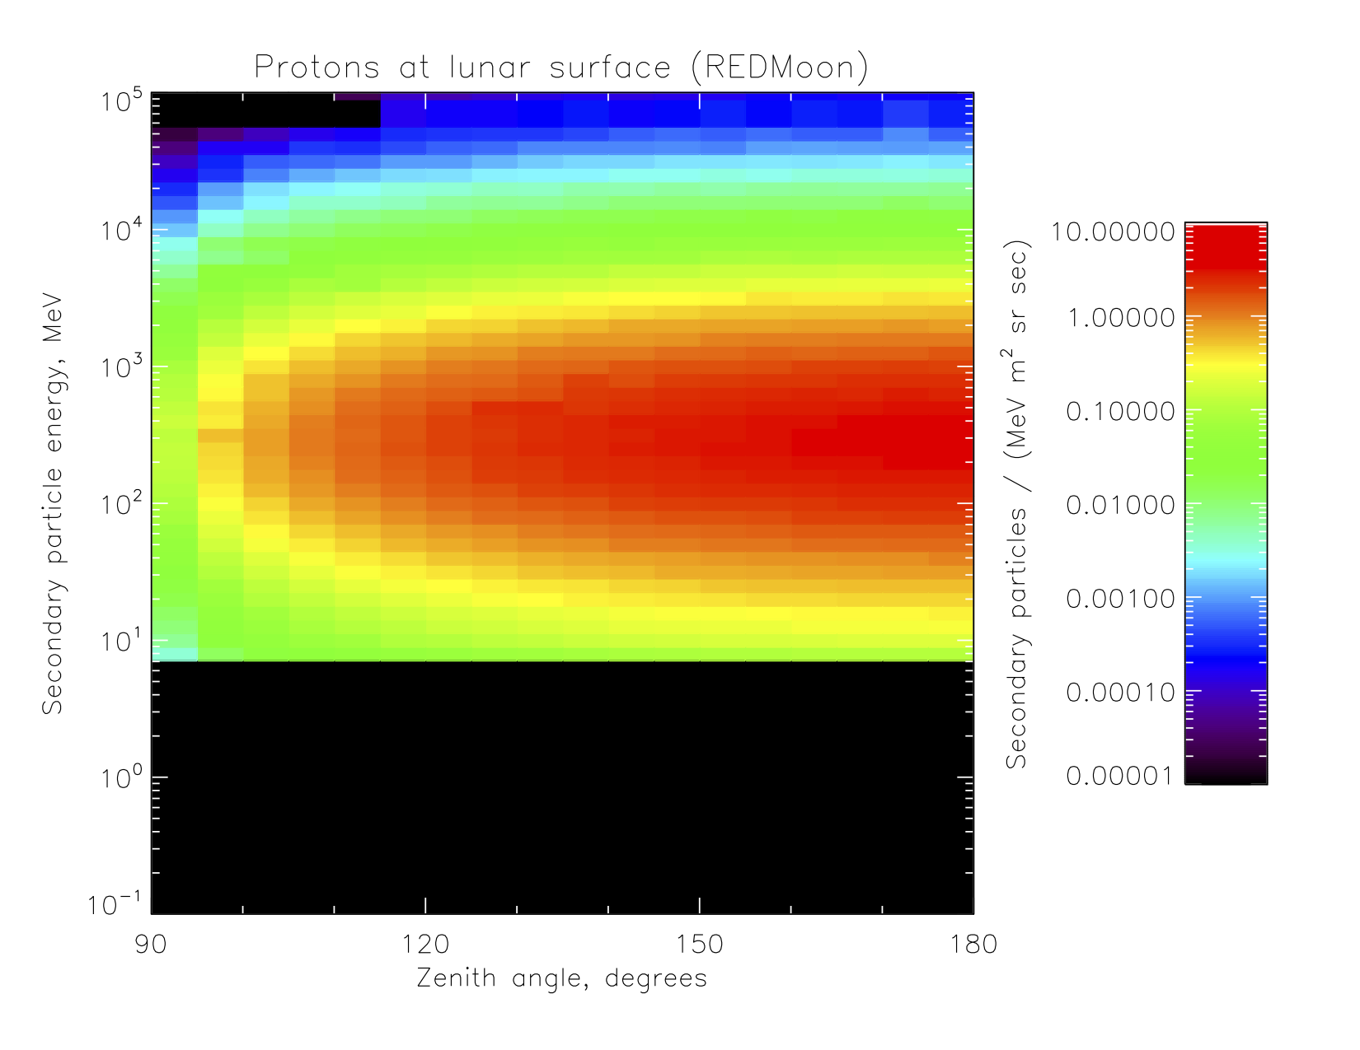
REDMoon incident protons
The preceding suggests that the description of our two angular calculations on slide 3, and the resulting correction factor on slide 4, explain the differences, but it does not show which one is correct. However, consider this plot of the incident (downgoing) protons, taken from the same REDMoon file to show the lower half of your Figure 4a. Note that the flux falls off toward 90° despite the simulation having isotropic incidence.

Slide 11
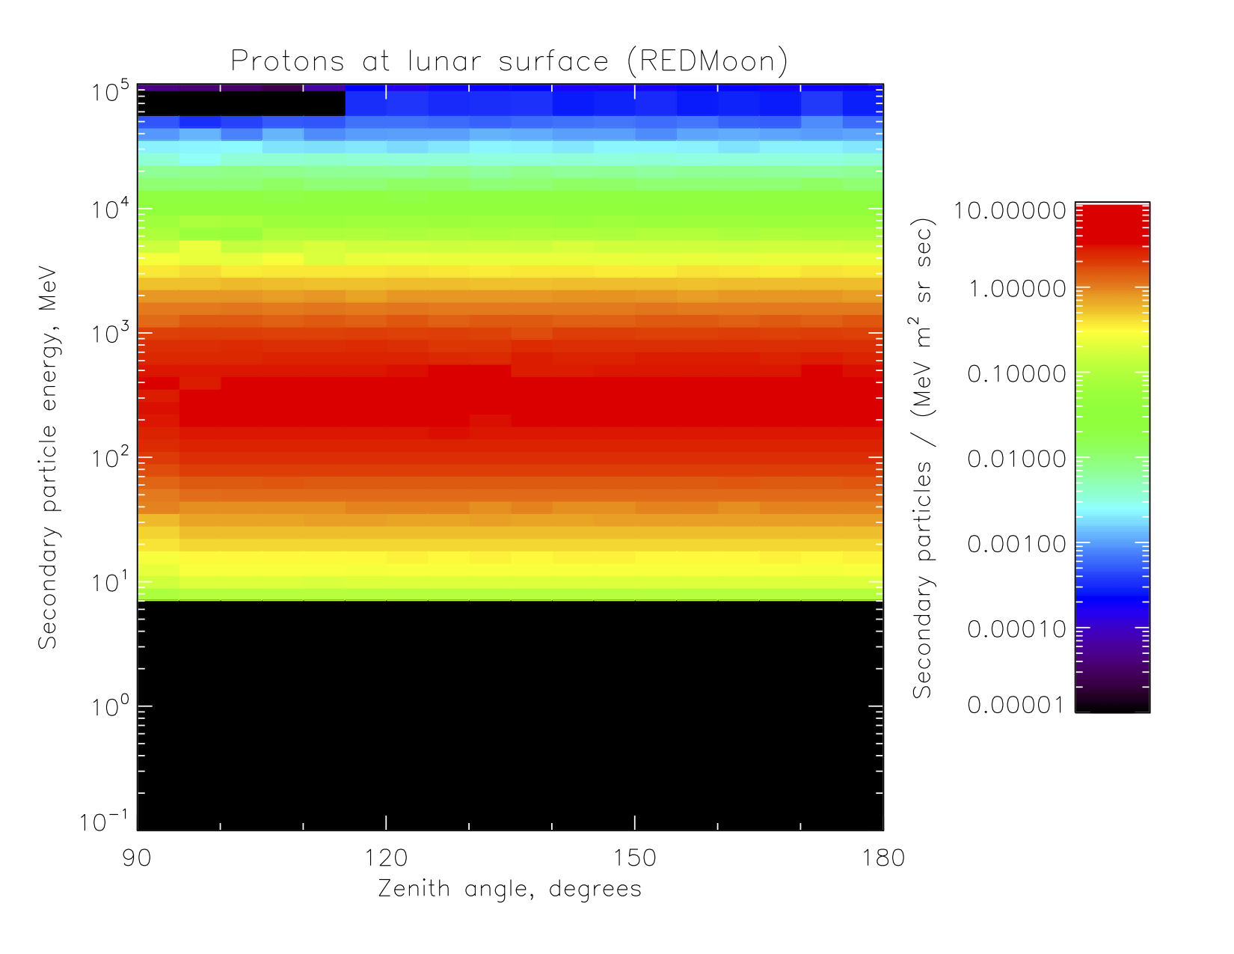
REDMoon incident p+, corrected
Applying the correction factor on slide 4, we recover the isotropic angular distribution of the incident protons in the simulation (horizontal color bands, indicating no variation of flux with zenith angle), within statistical fluctuations. In our paper, I will include an appendix with some further (artificial) test cases, using a spherical target and source vs. point (recovering spherical geometry via symmetry) and with isotropic albedo flux.

