Slide 1
Comparison of GLACE And REDMoon Results
Mark Looper
February 27, 2024

Slide 2
Energy-angle distributions
The REDMoon model (Dobynde & Guo, JGR Planets 2021) uses Geant4 to model fluxes of several particle species at and below the lunar surface under GCR bombardment, and a Zenodo dataset provides tabulated energy/angle distributions that I can compare with GLACE’s.
I find that they omitted a cosine factor in the flux normalization of simulation results.
Should I send this to them before I put it in the GLACE paper(s)…?

Slide 3
Angular normalization
I addressed this in angular_normalization.pptx dated October 3, 2018 after our meeting with the LEND team, who also omitted the cosine factor in their energy/angle distributions from simulations; the sketch at left is from that PPTX. Consider area $a$ to be a segment of a ring with polar angle width $dθ$ (I will redo the diagram later), in which we tabulate simulated particles coming from production area $A$. If $dN$ particles are counted in a simulation run, we
$$a$$
$$θ$$
$$r$$
$$A$$
might expect to normalize to a fluence $J$ in particles per (cm² sr) using the solid angle of the ring containing $a$ and the area of target $A$: that is, $dN=2πJA\sin{θ}dθ$. This is what the LEND and REDMoon folks did. However, the appropriate area is that of the dotted rectangle normal to the radius $r$, which is $A\cos{θ}$: that is, $dN=2πJA\sin{θ}\cos{θ}dθ$. Imagine the flat surface $A$ giving off a uniform glow: if you zoom in on a fraction of the surface, you will always receive the same number of photons regardless of $θ$, but if you view the whole area from a distance, the light will diminish as you look at it closer to edge-on ($θ=90°$). This is the appropriate way to tabulate a simulation’s particles.

Slide 4
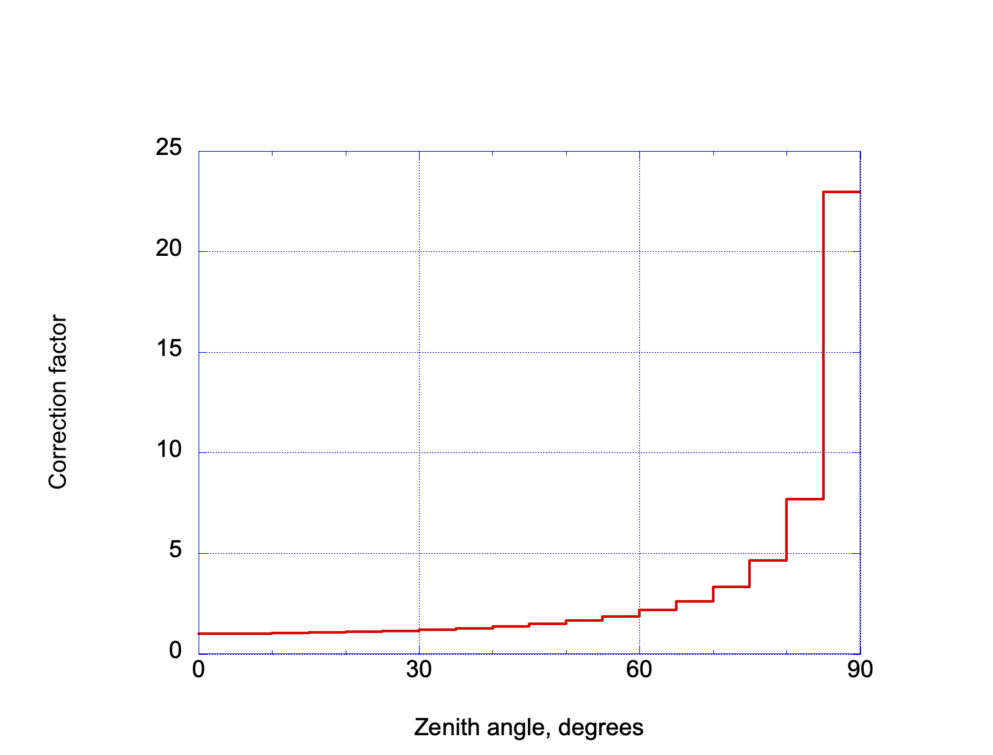
Correction factor
If we calculate fluxes $J(θ)$ from simulation counts $N$ between polar angles of $θ_{0}$ and $θ_{1}$, integrating the two expressions for $dN$ over the 5° bins of REDMoon, the ratio is the correction factor plotted above: $K=2{\left(\cos{θ_{0}−\cos{θ_{1}}}\right)}/{\left(\sin^{2}{θ_{1}−\sin^{2}{θ_{0}}}\right)}$.

Slide 5
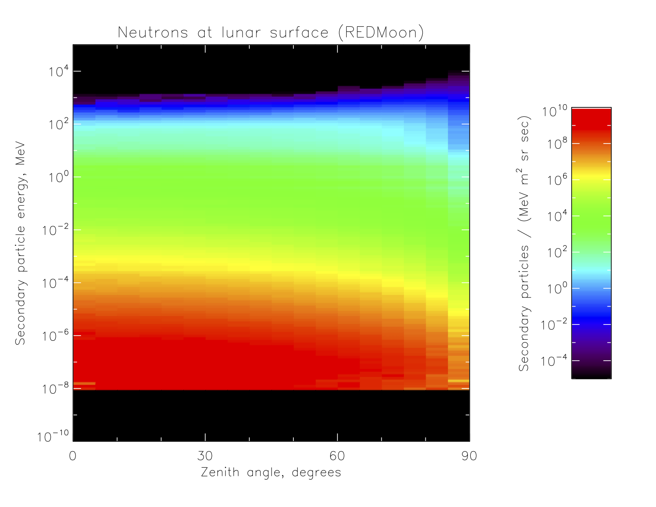
REDMoon neutrons (original)
These are the albedo neutrons from Figure 4 of Dobynde & Guo (2021), as tabulated for a solar minimum GCR spectrum. Note the significant fall-off toward the limb (90°), as well as the lower cut-off energy of 0.01 eV (black below indicates no data).

Slide 6
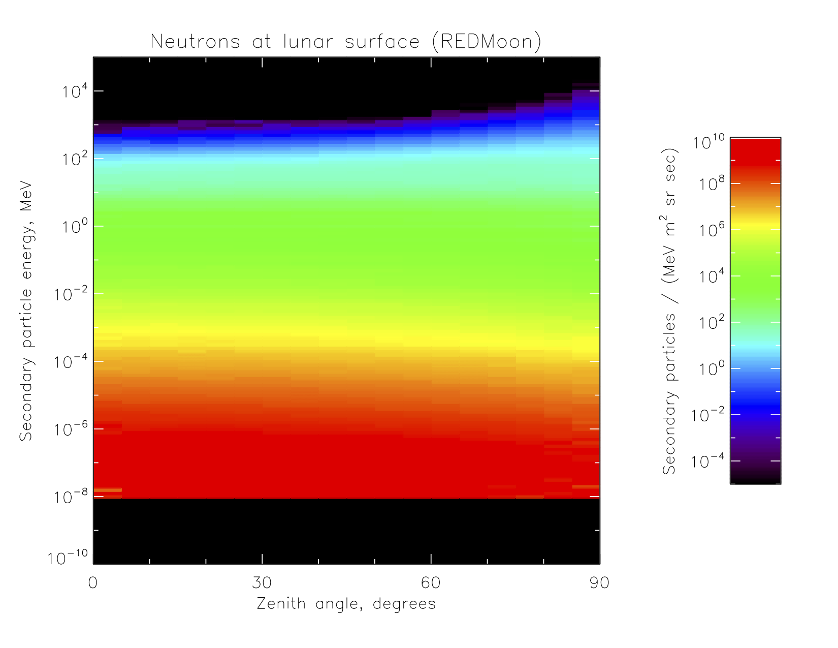
REDMoon neutrons (corrected)
Here is the energy-angle distribution for neutrons rising from the surface under a solar minimum GCR spectrum, with the correction factor on slide 4 applied. The spectrum hardens and intensifies toward the limb, as we are used to seeing in our simulations.

Slide 7
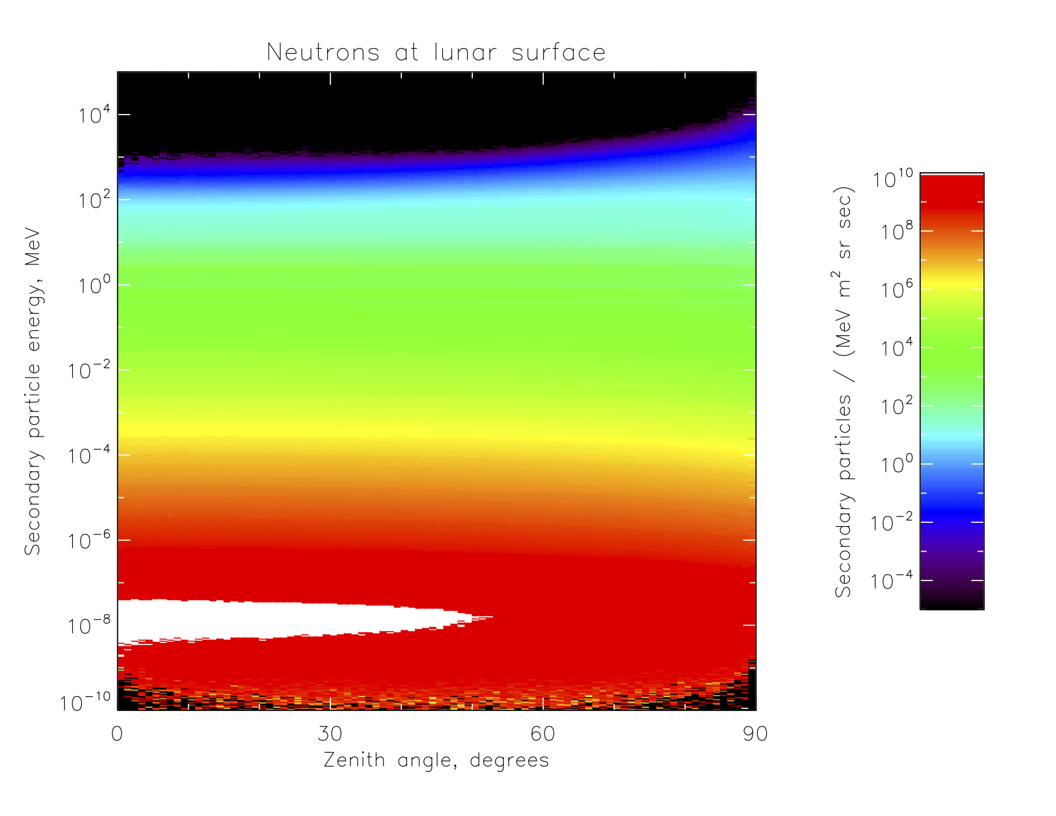
GLACE albedo neutrons
This is the plot from GLACE, using a solar-minimum GCR spectrum from Badhwar-O’Neill 2020 rather than 2014 as with REDMoon. The distributions are similar enough that I can run comparisons of spectra from this and the previous slide integrated over all angles.

Slide 8
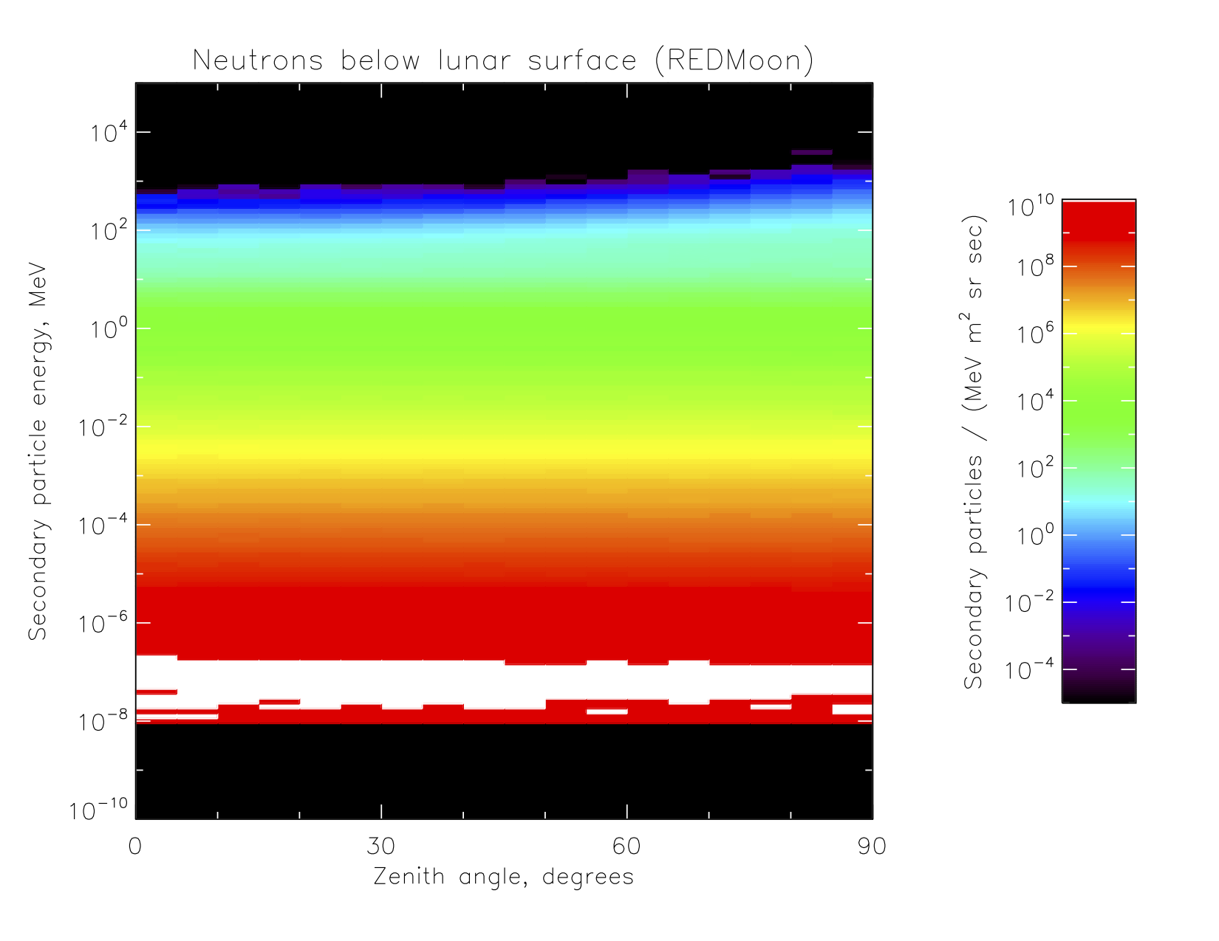
REDMoon neutrons at 50 cm
The REDMoon model plots particles going both up and down at the surface and at 50, 100, and 200 cm depth. They use a regolith density and composition different from those in GLACE; here are the corrected up-going neutrons at 50 cm depth, or 97.8 g/cm².

Slide 9
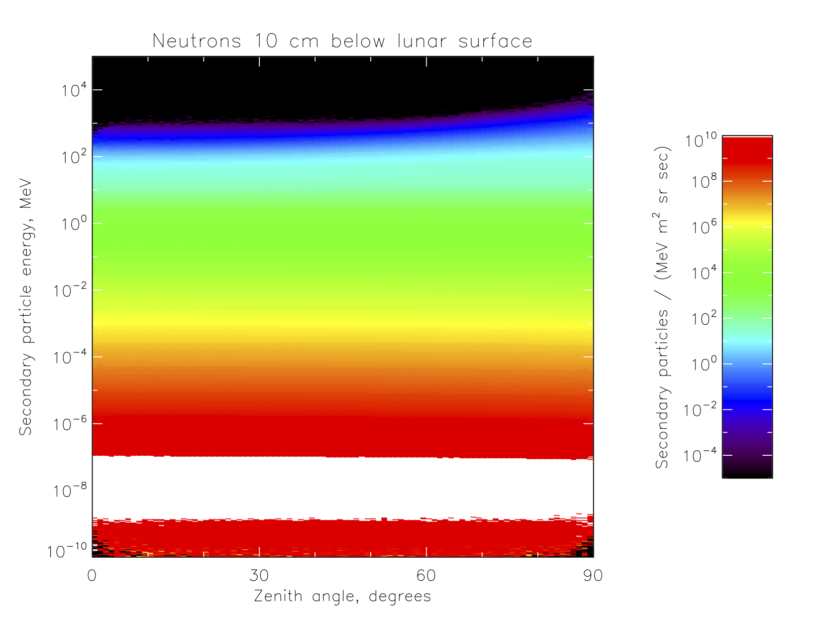
GLACE neutrons at 10 cm
GLACE, being focused on albedo, only includes one subsurface neutron distribution. For dry regolith, this is at 10 cm depth, or 30 g/cm². Comparing this vs. slide 7, we see the same trends as slide 8 vs. 6 for REDMoon: more lower- and fewer high-energy neutrons at depth than at the surface.

Slide 10
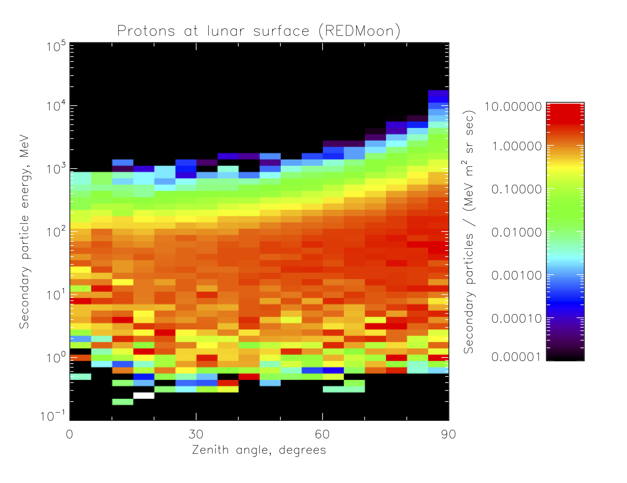
REDMoon albedo protons
These are the corrected albedo (surface) protons from REDMoon.

Slide 11
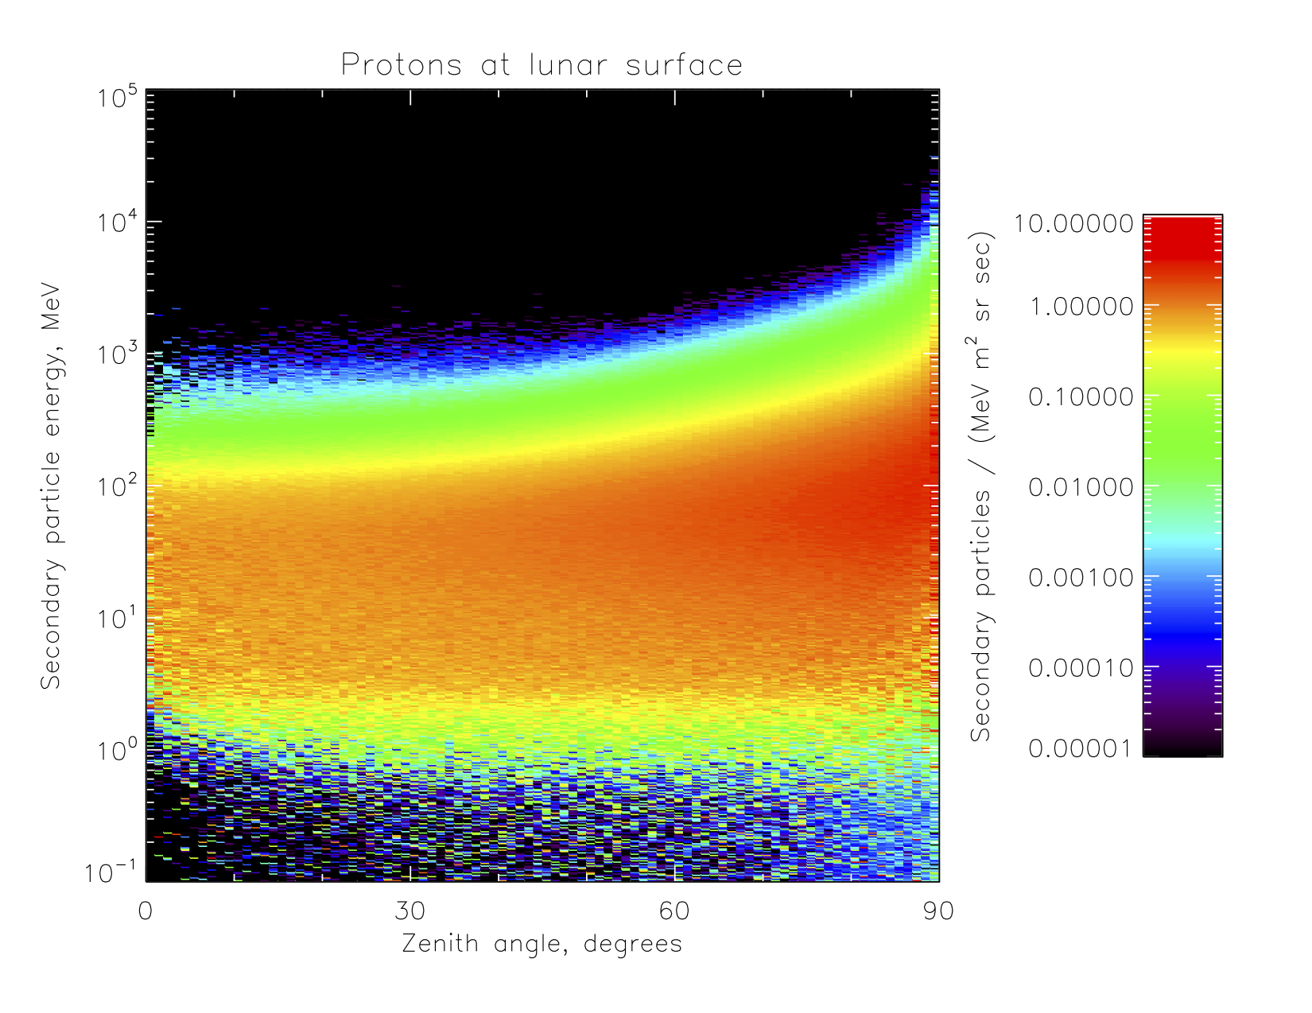
GLACE albedo protons
GLACE has better statistics and supports finer binning in both energy and angle, but the distributions here and on the previous slide are quite similar in amplitude and trends, notably the falloff around 1 MeV and the shape of the intensification toward the limb.

Slide 12
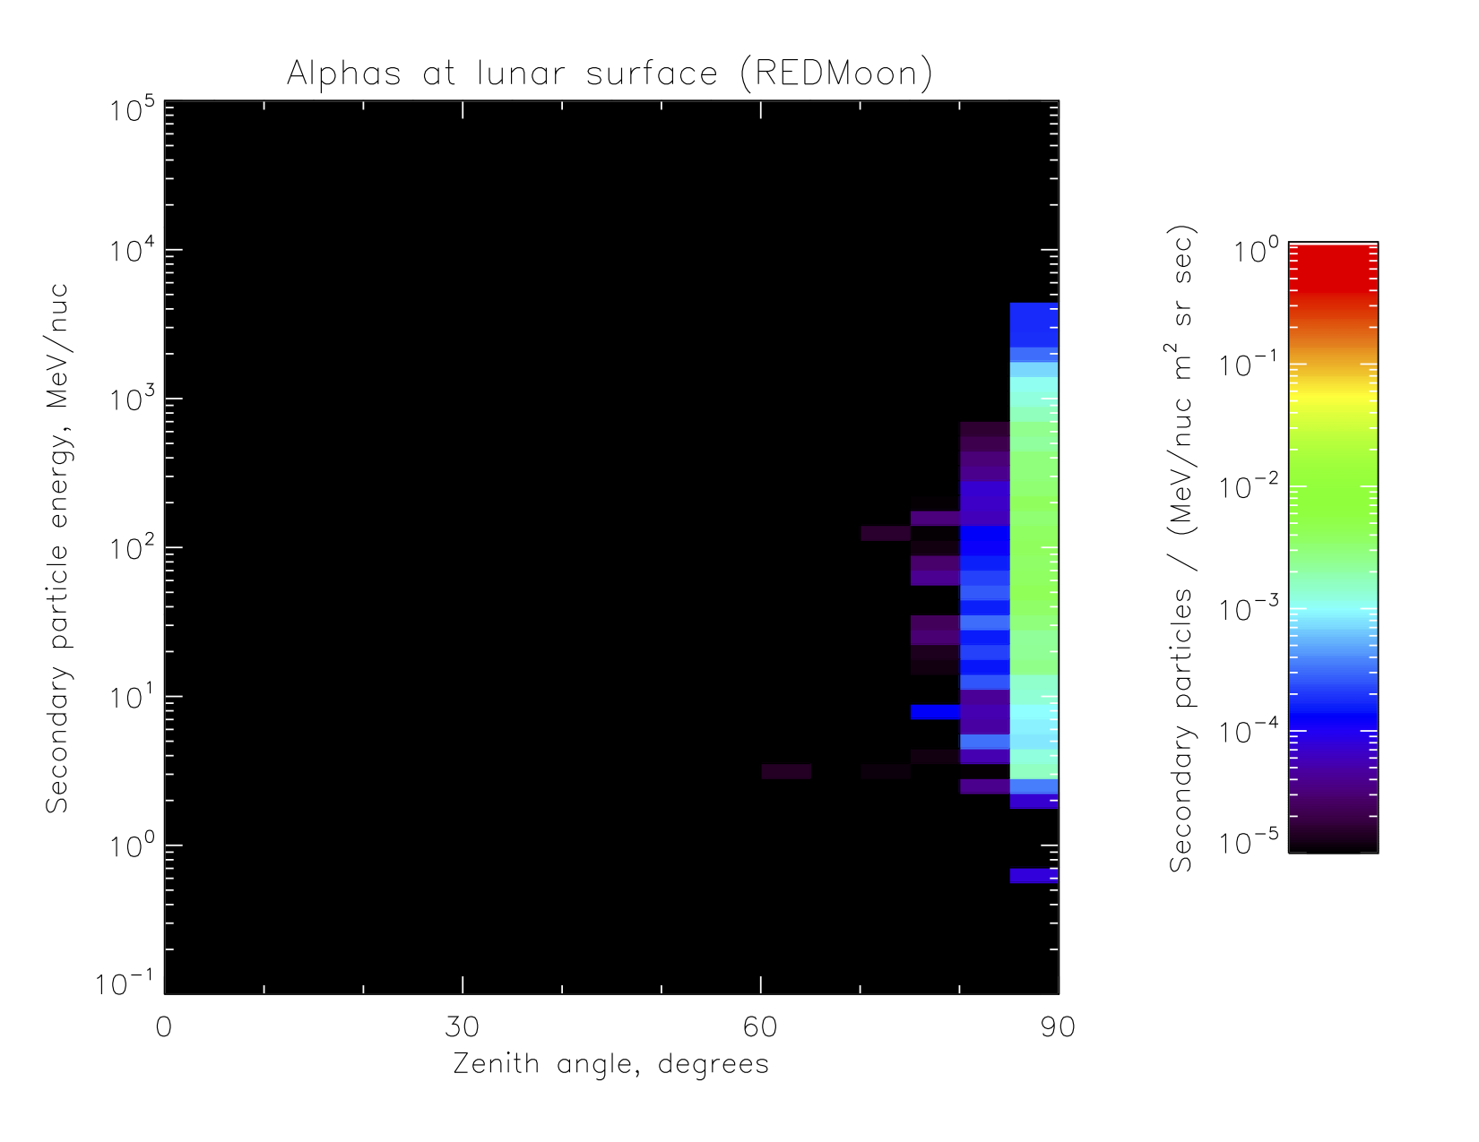
REDMoon albedo alphas
These are the corrected albedo alphas from REDMoon.

Slide 13
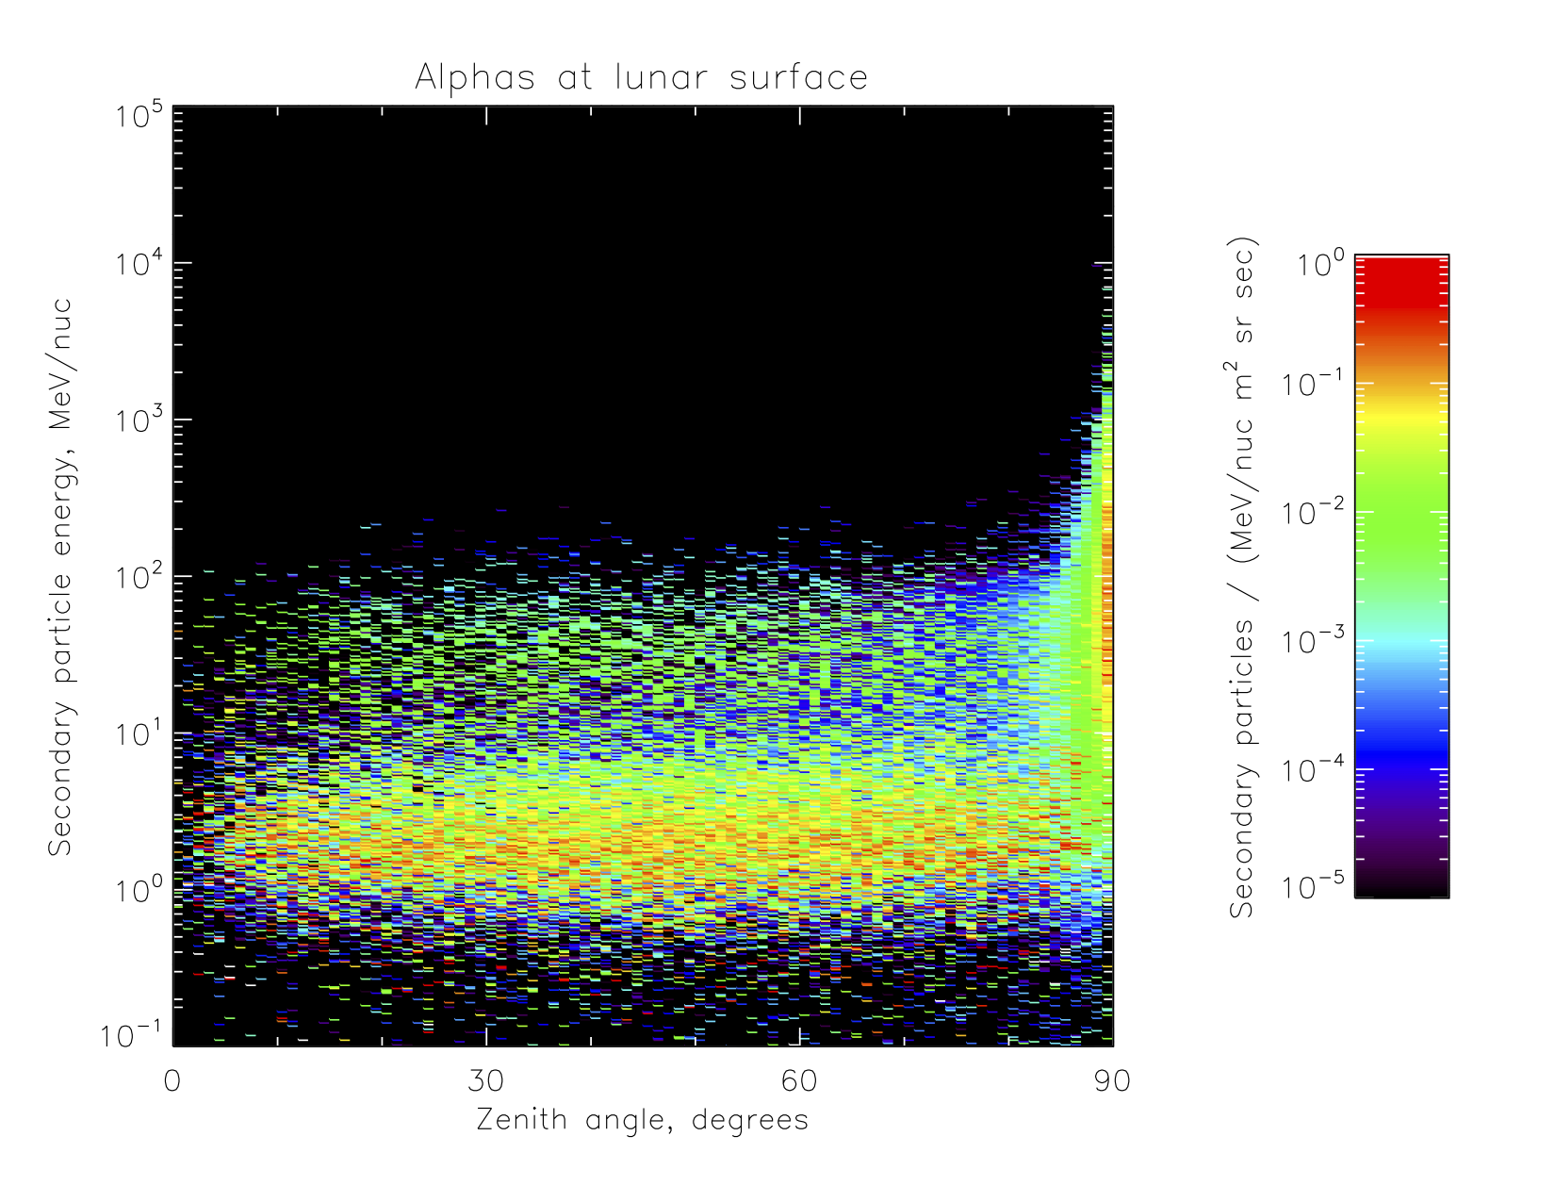
GLACE albedo alphas
These are the albedo alphas from GLACE. The near-horizontal “shrapnel” might just about match up with that from REDMoon on the previous slide (given the difference in bin widths), but the physics lists in GLACE clearly produce more disintegration alphas. I’ll use Fahad’s 2022 paper to argue that we are closer to the truth, or at least to the consensus.

Slide 14
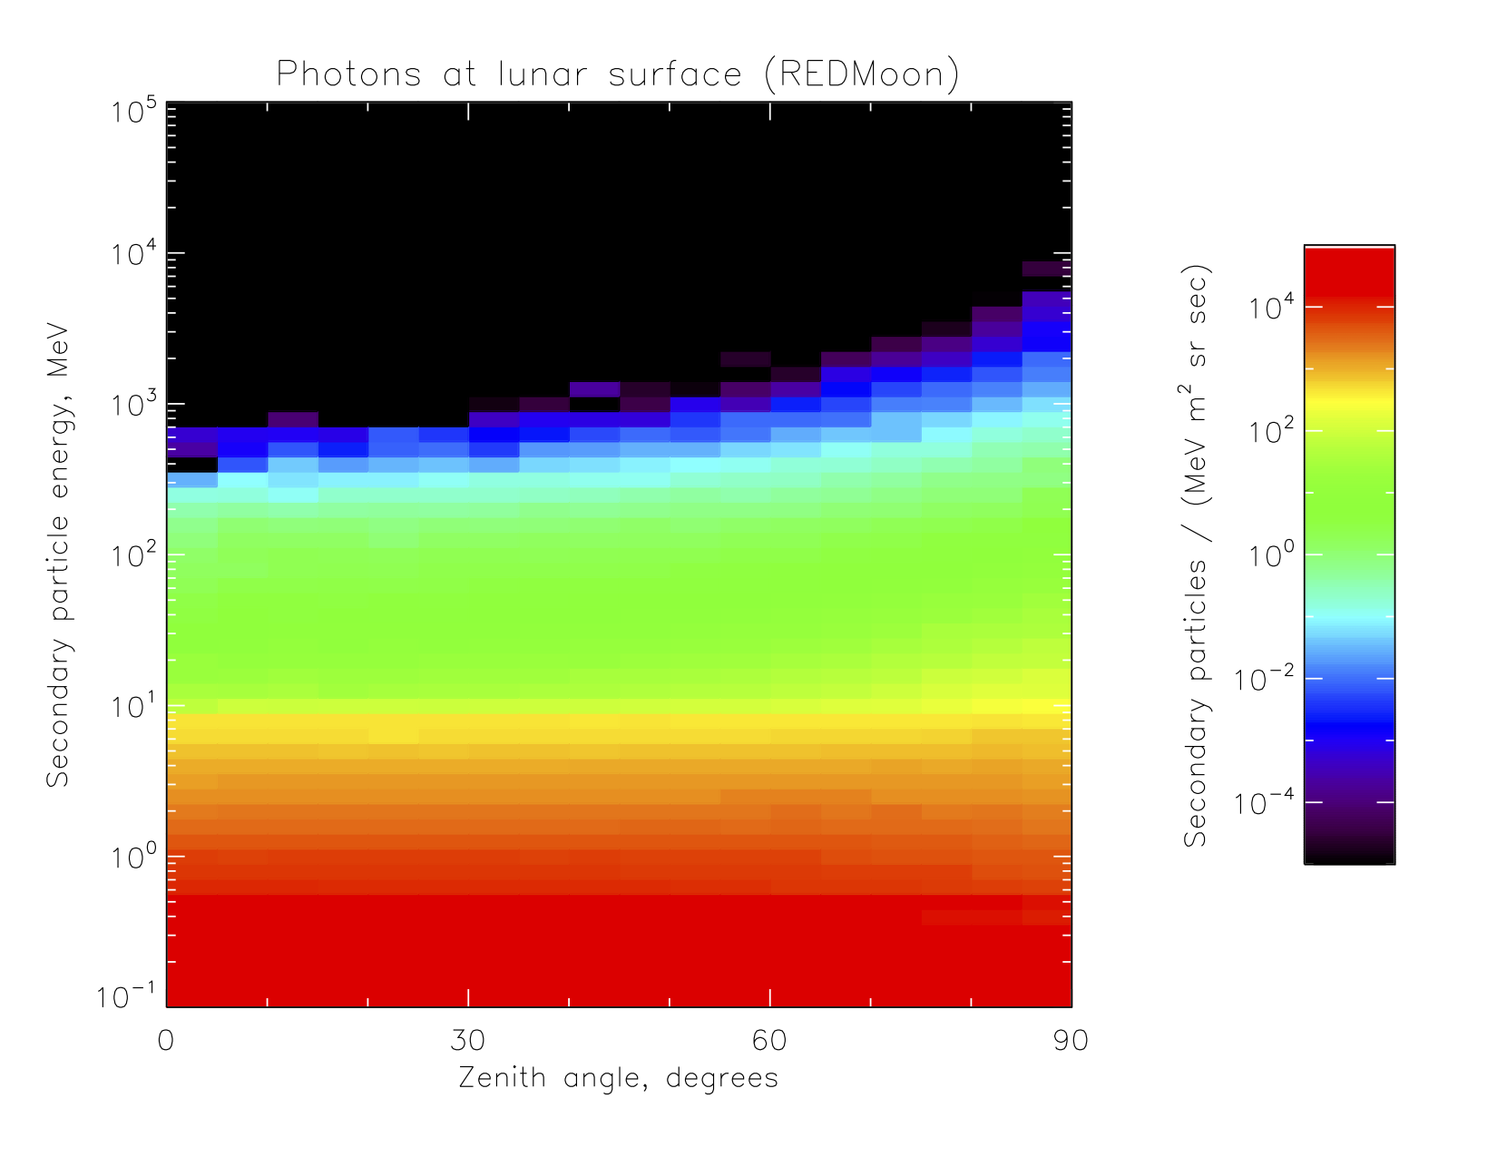
REDMoon albedo photons
These are the corrected albedo photons from REDMoon.

Slide 15
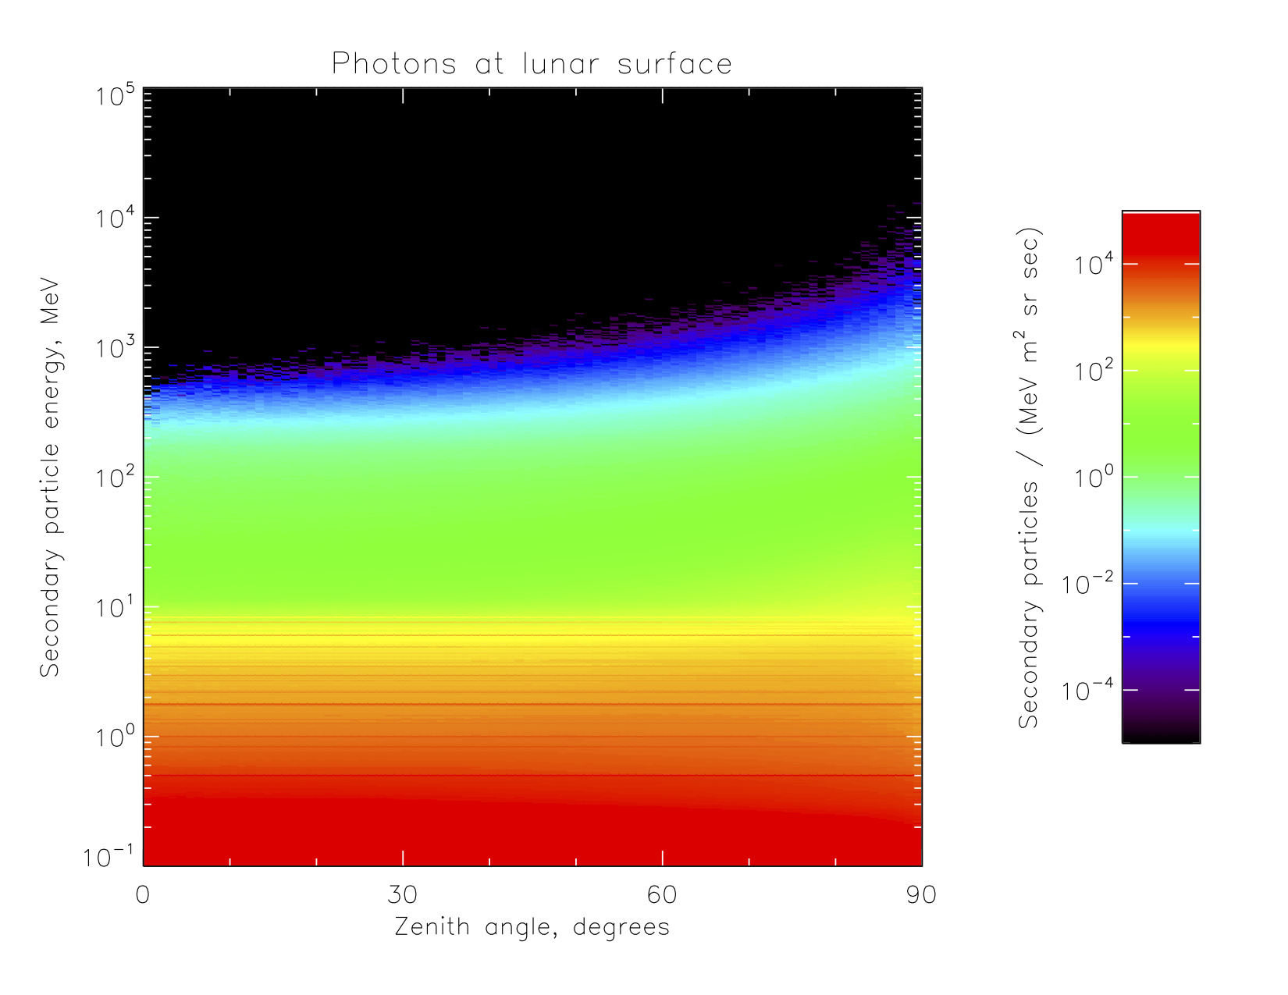
GLACE albedo photons
These are the albedo photons from GLACE. The results on this and the previous slide are very similar, with a bit more at ~1 MeV and below in the simulations from REDMoon.

Slide 16
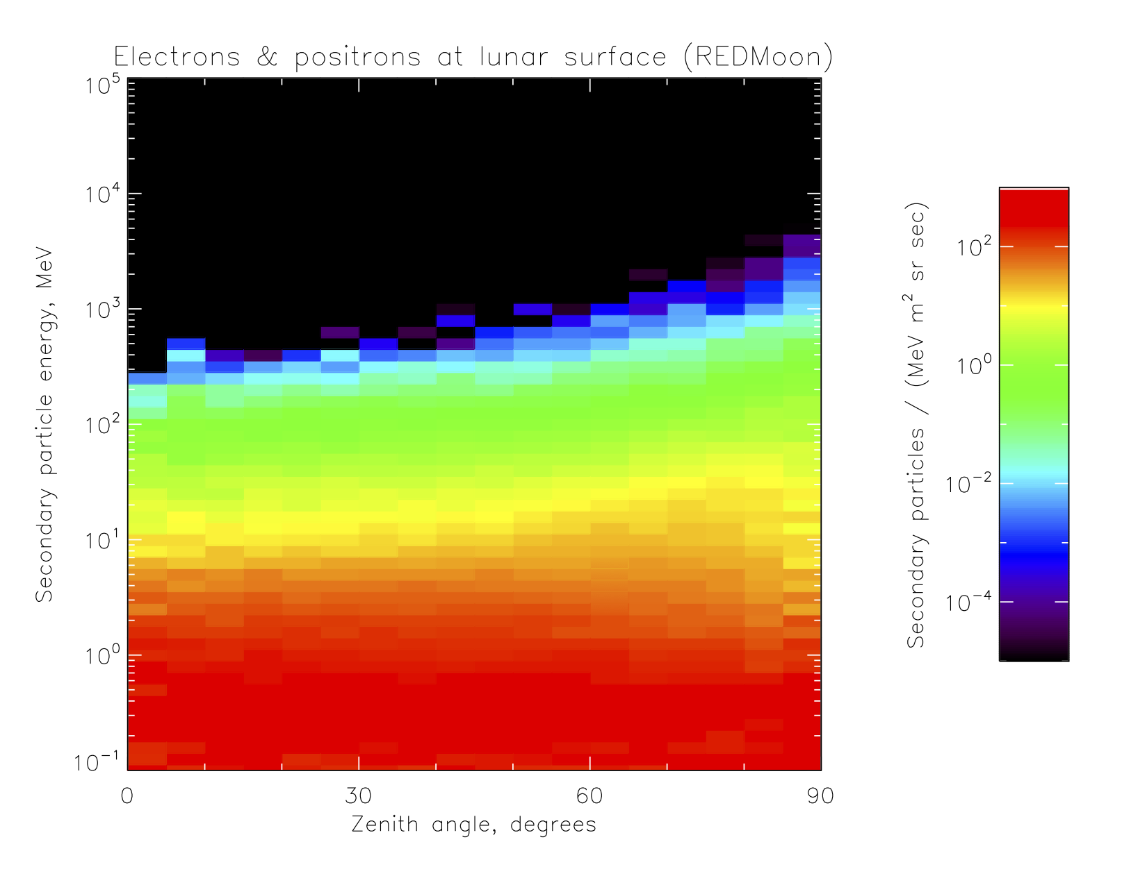
REDMoon albedo e+/e-
REDMoon reports the sum of electrons and positrons; these are the corrected albedo energy/angle distributions at the surface. Note that, even after correction, there is a falloff toward 90° around 1s to 10s of MeV.

Slide 17
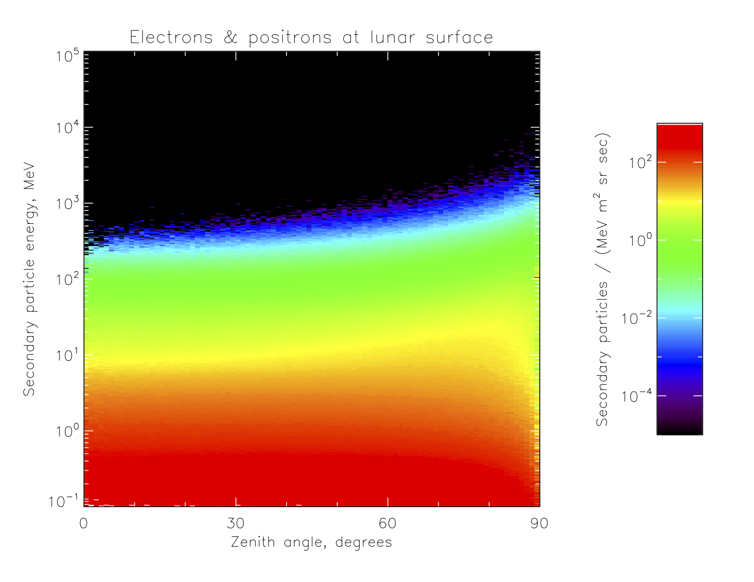
GLACE albedo e+/e-
I summed the GLACE calculations of electrons and positrons for this figure. It shows the same falloff toward the limb as the previous slide.

Slide 18
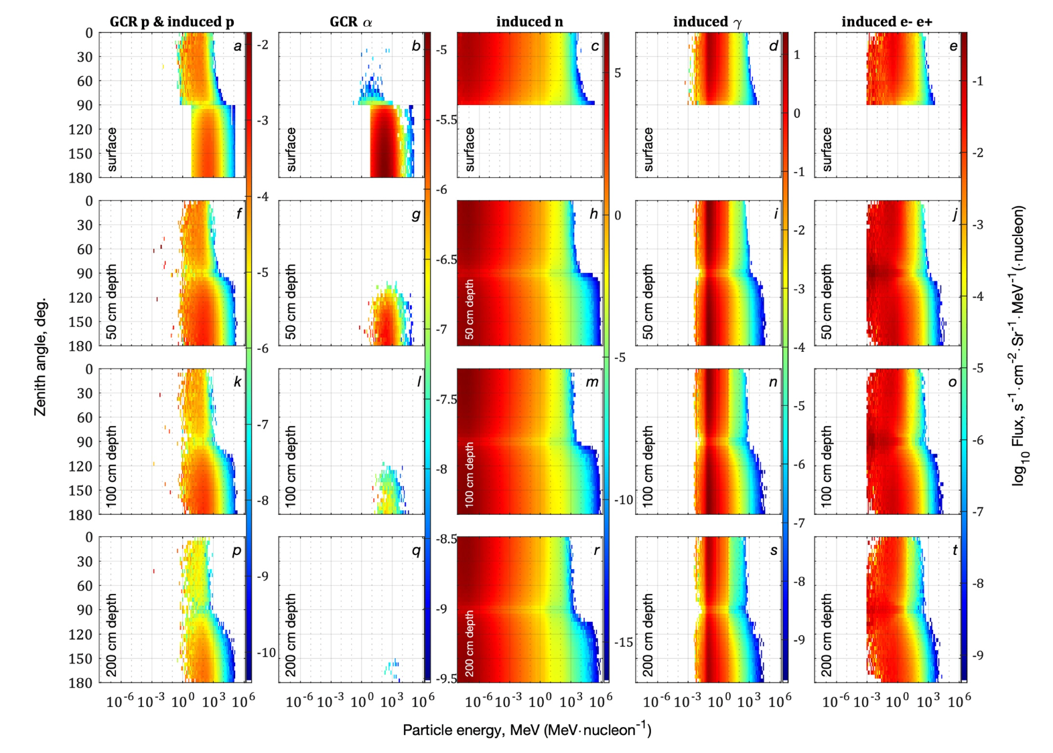
Figure 4 from Dobynde & Guo
This is Figure 4 of the REDMoon paper. Slide 5 shows the upper half of panel c rotated 90°; other slides show the upper halves of panels a-e and h with corrections. Note that the lower halves of a and b, showing downgoing particles, fall off toward 90° for protons and alphas as do the upper halves; this means they tally an anisotropic flux of primary GCRs at the surface, in contradiction of their model description. They say in the paper that they are “working on building a user-friendly online platform” around their model; I’d like to alert them to the need for correction before that (and our paper) go live. How shall I proceed?

