Slide 1
CRaTER Anomaly In Early January 2024
Mark Looper
January 12, 2024

Slide 2
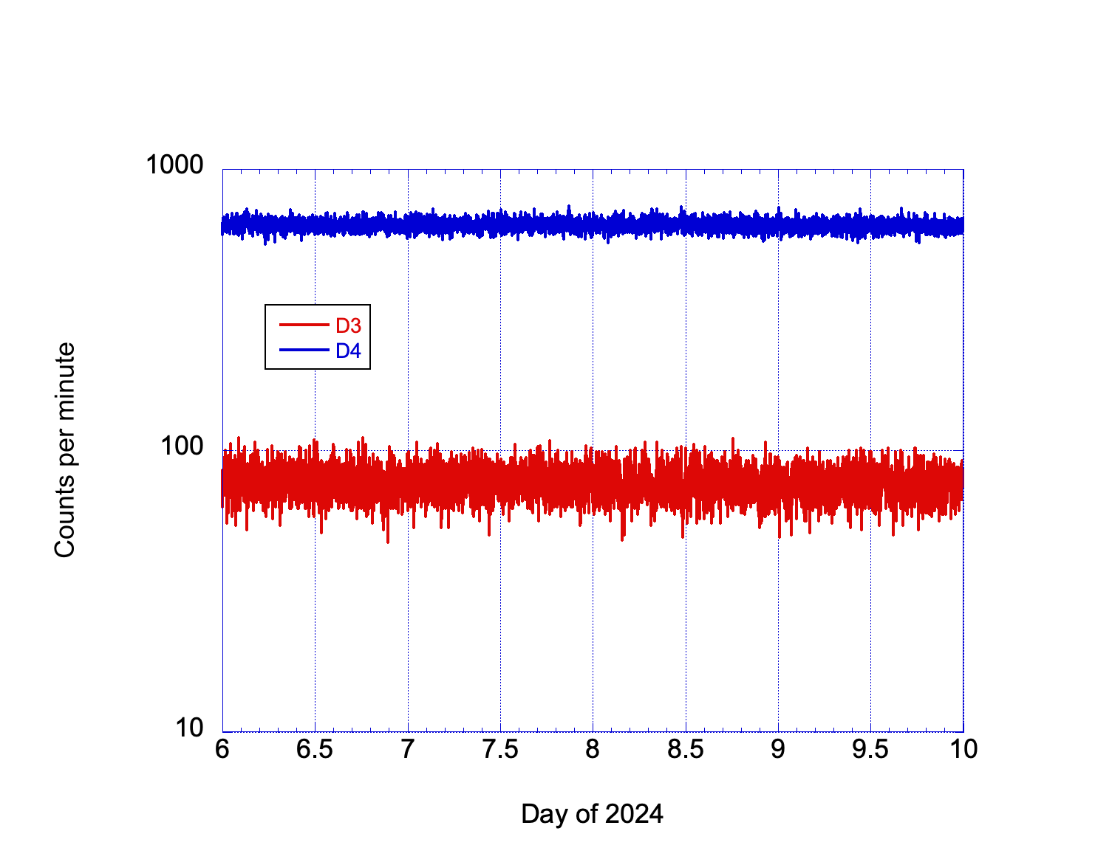
This is a quick look at the CRaTER rates from January 6 to 9, 2024, presenting 1-minute averages of the singles rates. This was on the downleg of a modest-sized SEP event; D3 and D4 don’t appear to have come off the cosmic-ray baseline during the entire period.

Slide 3
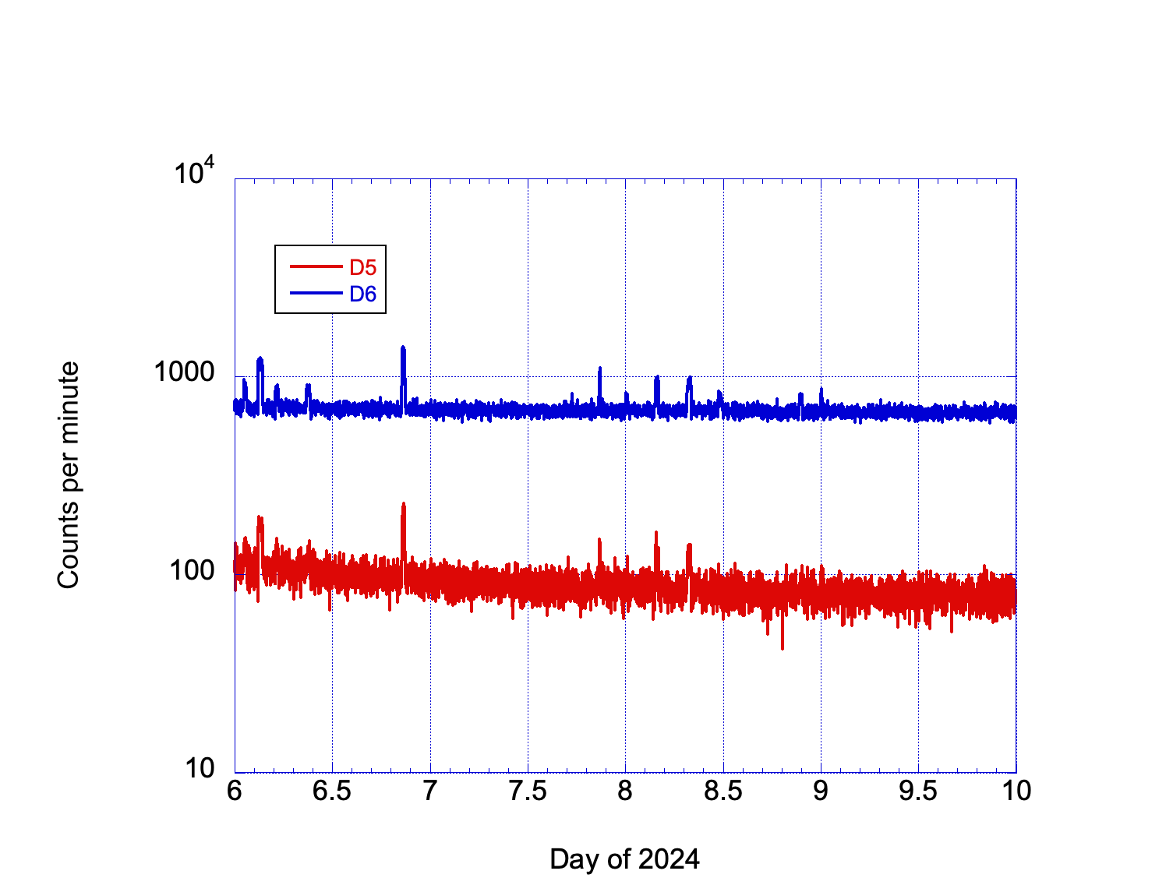
D5 shows a small decline during the period, and maybe D6 does a little bit as well, perhaps due to penetrating solar protons. However, even before the anomaly that we discussed (starting late on day 7), there are odd spikes in both detectors’ countrates.

Slide 4
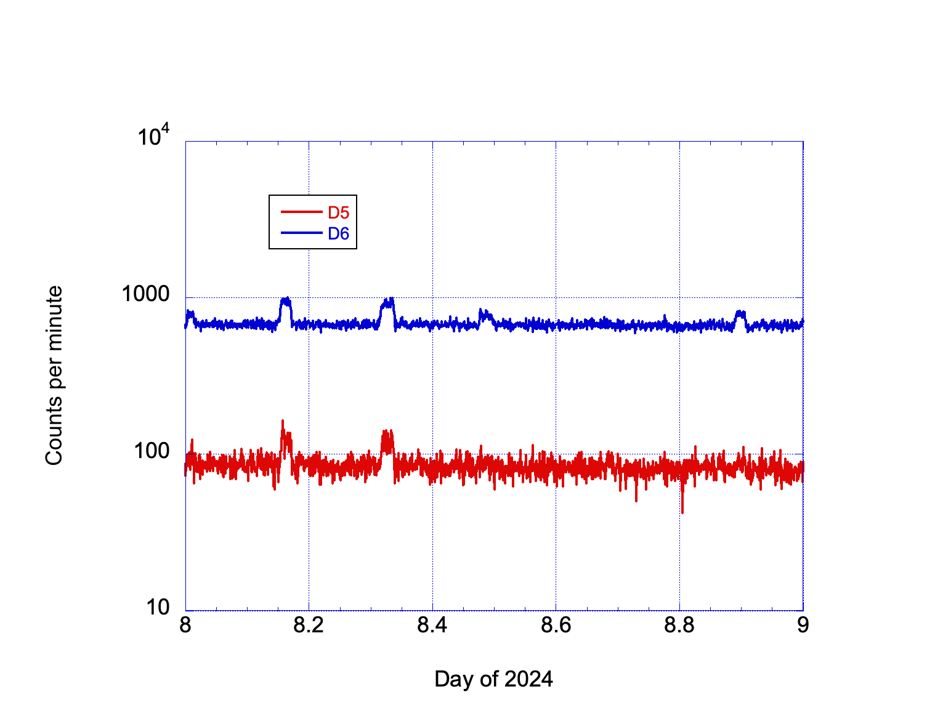
Here we zoom in on D5 and D6 countrates from day 8. These steps up are not from calibration; that last occurred on day 4, and it would have affected all detectors anyway. The spikes on the previous plot resolve into modest (x2) steps up and back down, in some cases seen in both detectors; each is around an hour long. I will have to go back and see if these occur earlier, and if so whether they affect the coincidence rates/events.

Slide 5
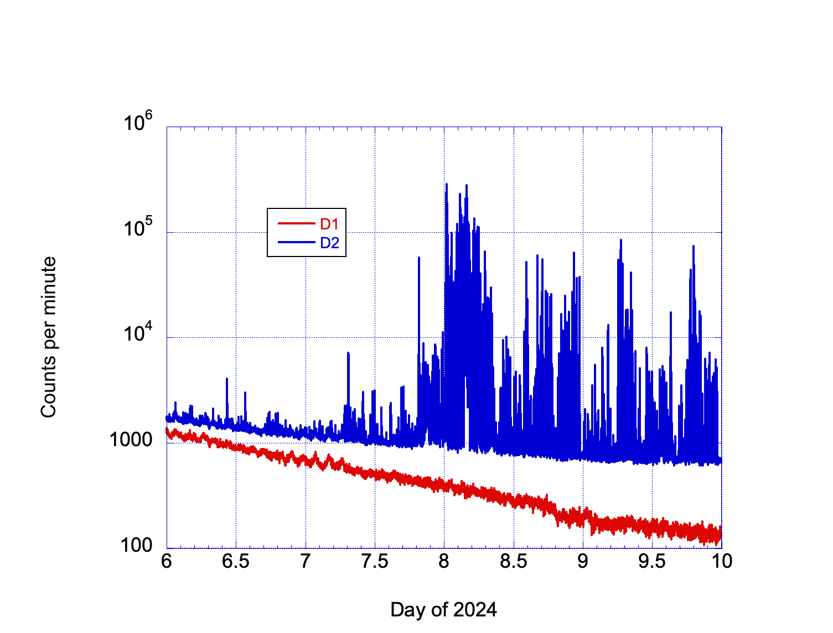
This is the plot of D1 and D2 for the whole period, and while we see some fluctuations in D1 that are probably due to some orbital effect (thermal, altitude, …), there are indeed some large spikes of countrates in D2, which greatly increased in amplitude toward the end of day 8. Again, I need to go back through the data and see if this kind of behavior is common or if it affects the coincidence rates and events that I have been using.

Slide 6
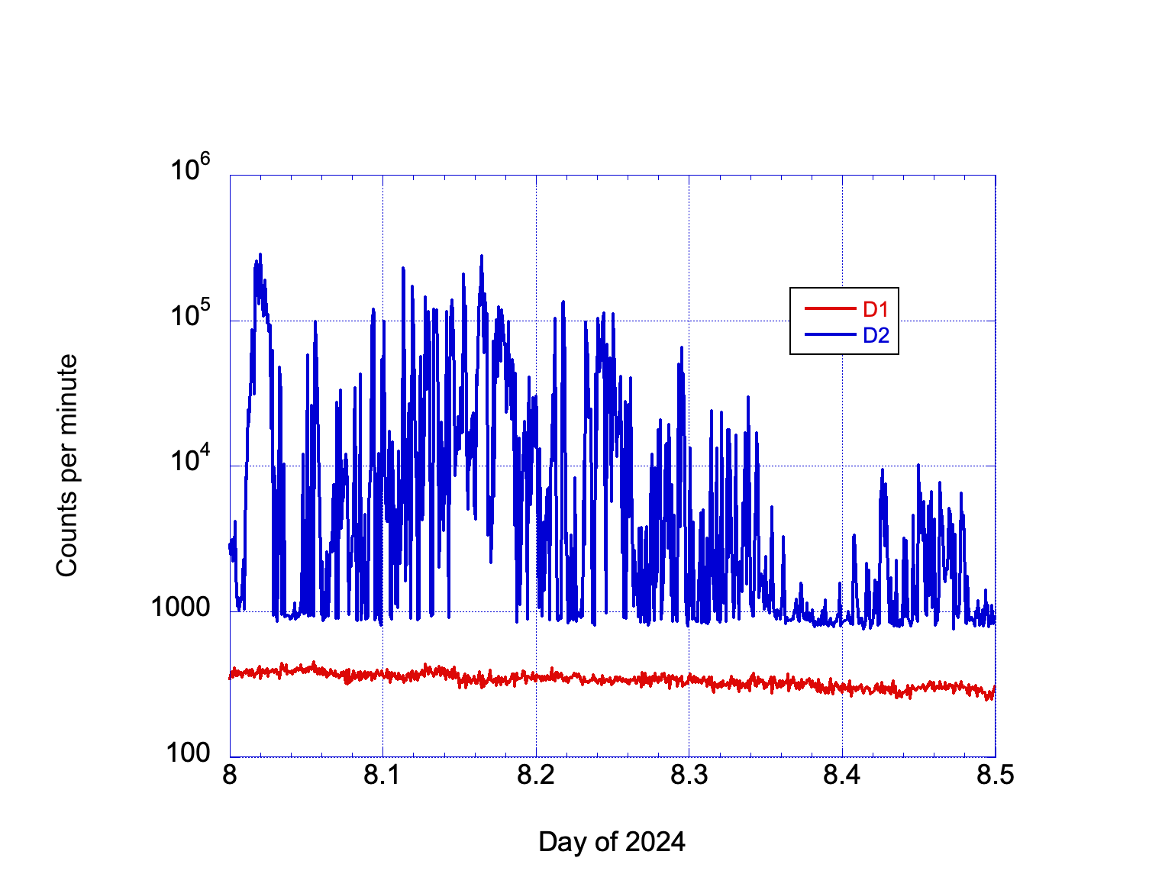
Here we zoom in on the first half of day 8 from the previous plot. There are some contiguous rises that last an hour or more, notably the highest one at the very start of day 8, but in general there is a lot of spikiness, with the countrate dropping back to the cosmic-ray baseline before jumping back up a hundredfold. Remember these are counts per minute, so not enough to induce deadtime, but I hope they don’t indicate a rise in PHA noise for D2. The spacecraft is a decade and a half old…

