Slide 1
“Storyboard” and Outline for Space Weather Paper on GCR LET Spectra
Mark Looper
March 10, 2020
Revised March 13, 2020

Slide 2
Figures and outline
I have been putting together the narrative and figures for the paper I intend to submit to Space Weather about background corrections in CRaTER GCR LET spectra over time.
Subject to co-authors’ and team members’ comments, these figures are intended to be final. Changes from our 3/11 telecon are noted in red.
Again, this should have been in the proceedings issue for the May ASEC; the topic was also covered in our poster at Fall AGU.

Slide 3
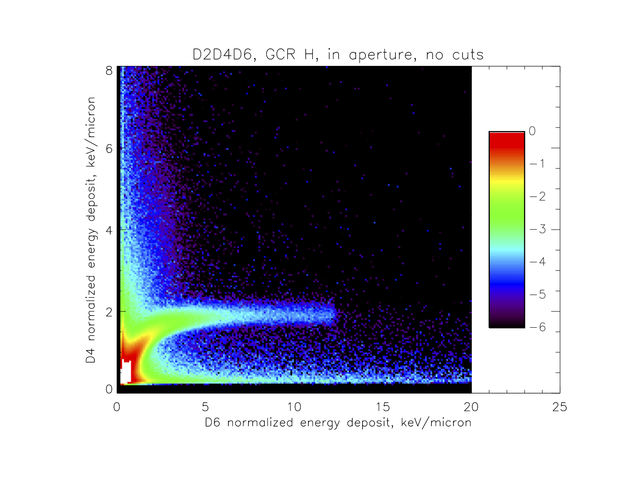
p+
(a)
p+
D3/4
D3/4
D5/6
D1/2
D5/6
D1/2
GCR protons
High-Z fragments into D5/6
Figure 1a plots simulated proton events, showing events on proton track and with high D6 energy deposits. I will verbally describe CRaTER, so this schematic is the only sensor diagram I’ll show. This and the next slide contain the modified plots I mentioned on the telecon (with colorscale); I also, per our discussions, settled on Figure 1a and 1b rather than 1 and 2, etc.

Slide 4
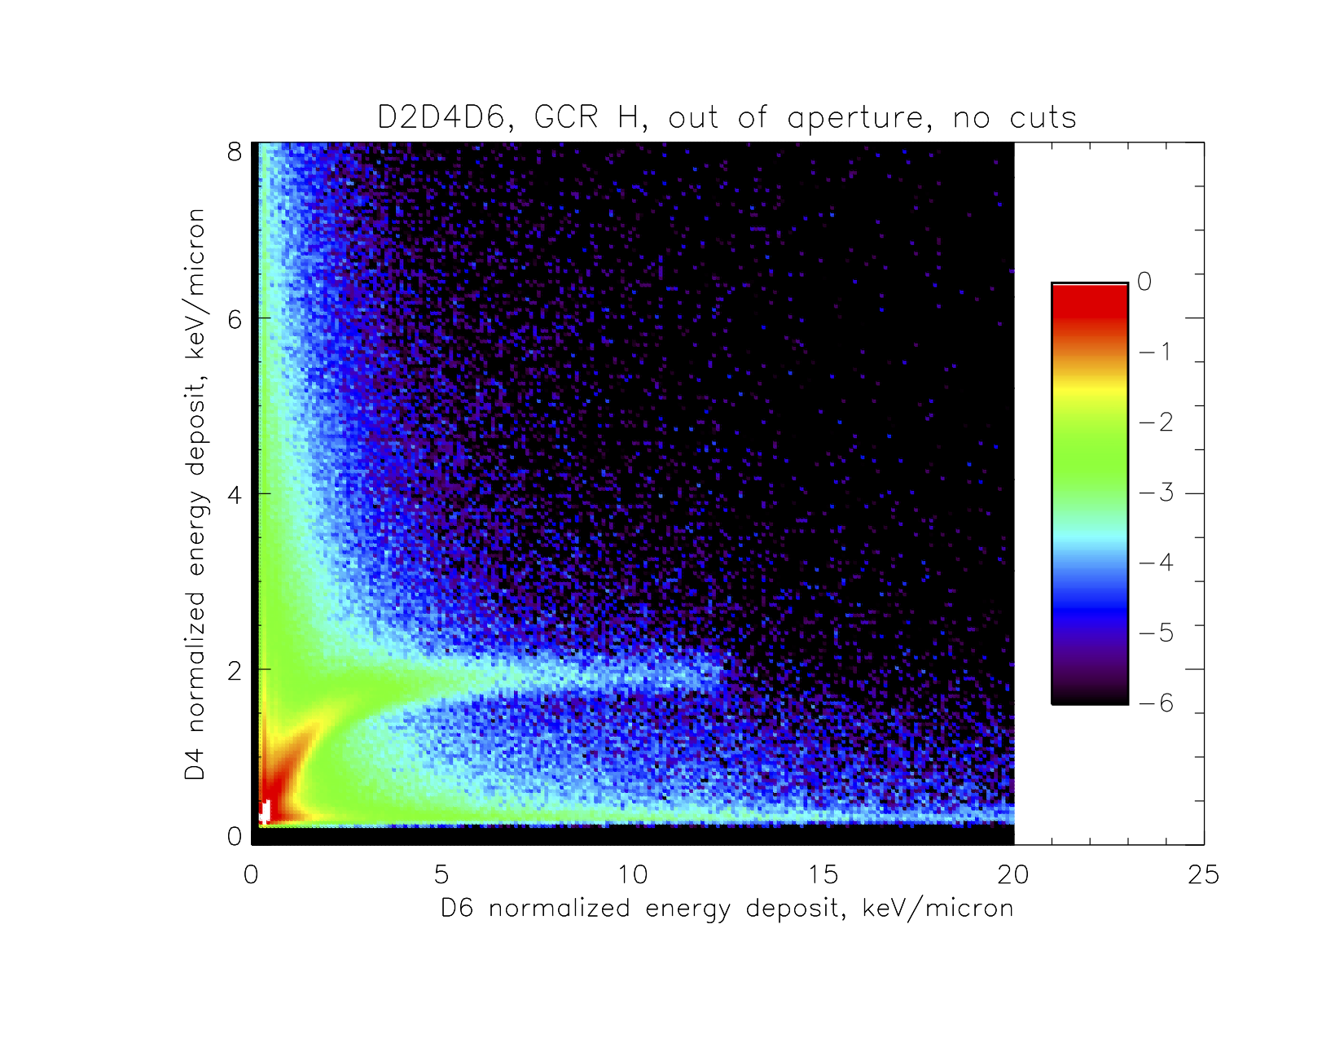
(b)
e-
D1/2
D3/4
D5/6
p+
Primaries missing D2
Primaries missing D2/4
Figure 1b shows the same for events outside the aperture. Illustrates how these events can mimic in-aperture events (which are desirable because they can be quantified with a well-defined 0.605 cm² sr geometry factor and small secant factors through the detectors).

Slide 5
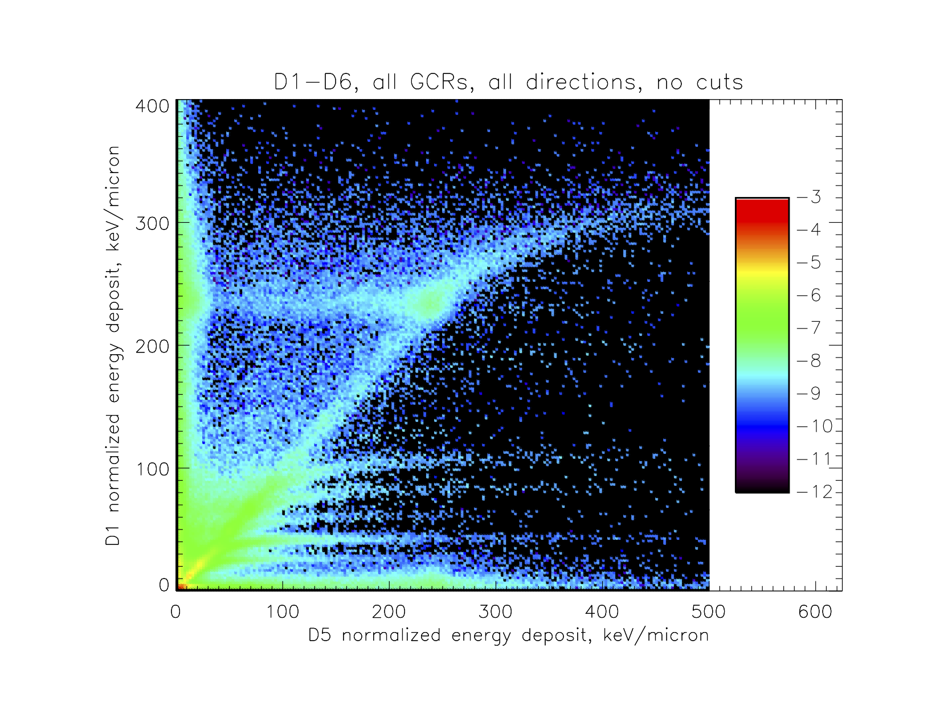
Lower-energy Fe
Fragmentation
Relativistic Fe
I added Figure 2 (and Figure 7 below) per discussions on the telecon. This plot shows a simulated thin-detector cross-plot, to indicate the contributions to LET from heavy ions. The text will draw attention to the relativistic blob for Fe at about 240 keV/micron on both axes, to the track going to the right from it, to the nuclear-fragmentation track to the left, and to the “scruff” enhanced along both axes at the location of the blob. I will then note that the blobs of all GCR elements below Fe make up the diagonal, plus their tracks.

Slide 6
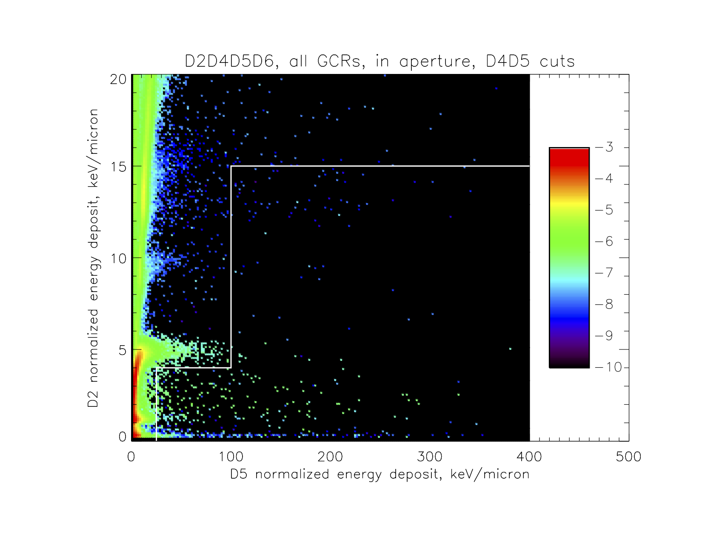
(a)
With three pulse heights, we can selectively reject background. Figure 3a shows D2 vs. D5 pulse heights for events in aperture with large (> 1.7 MeV) D4 pulse heights. If they came in the front, either they are ions traveling through the stack and so should have large D2 pulse heights, or else they are from fragmentation upstream of D4 (per figure 1) and the shower should stop before reaching D5/D6 and not be a triples event. Thus there should be few triples events with low D2 pulse heights, as seen below white line here.

Slide 7
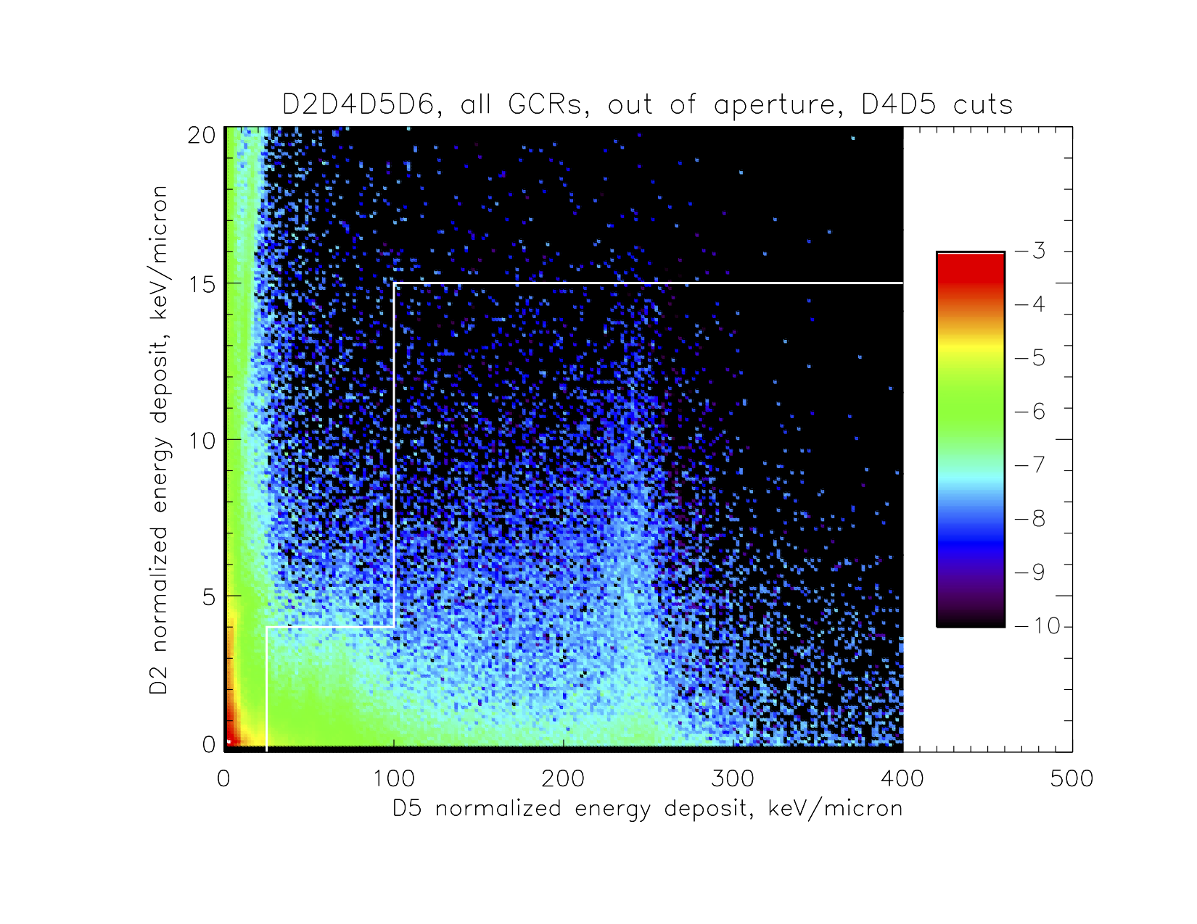
(b)
Figure 3b shows D2 vs. D5 events for simulated particles out of aperture with large D4 pulse heights. These can be side-crossing ions with big D4 and D5/D6 pulse heights but low D2 pulse heights due to a delta ray, so the area below the white line is populated here. Discarding events meeting these criteria gets rid of a lot of background and very little foreground. We devised multiple cuts based on logic like this in all detector pairs, which will be spelled out (IF D4 > 1.7 AND D5 < 100…) in an appendix.

Slide 8
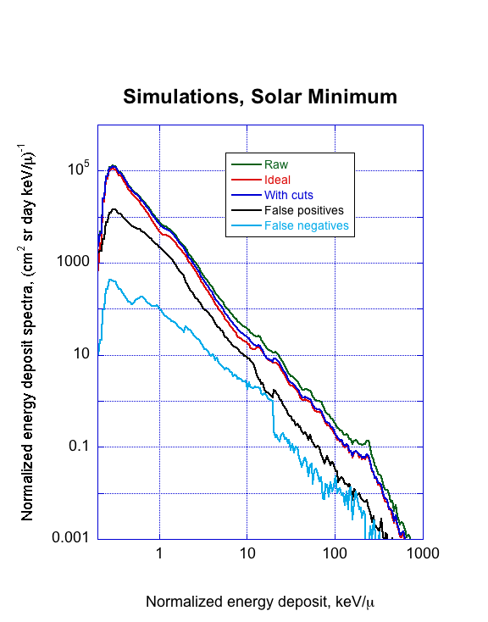
Figure 4a shows how the cuts affect the spectrum for solar minimum conditions (Badhwar-O’Neill 2010 model, Φ = 417 MV), same as in previous simulated colorscale plots. “Ideal” spectrum is if we could count only particles coming in the forward acceptance cone, “with cuts” is, well, with the cuts applied. Difference is due to small amount of “false negatives” where in-aperture events are rejected, and larger amount of “false positives” where events that should be rejected are instead accepted. Biggest error is some tens of percent around several keV/micron; overall effectiveness of cuts is good. I added “Raw” trace to show that even at worst LET the cuts remove most background, and rearranged colors.
(a)

Slide 9
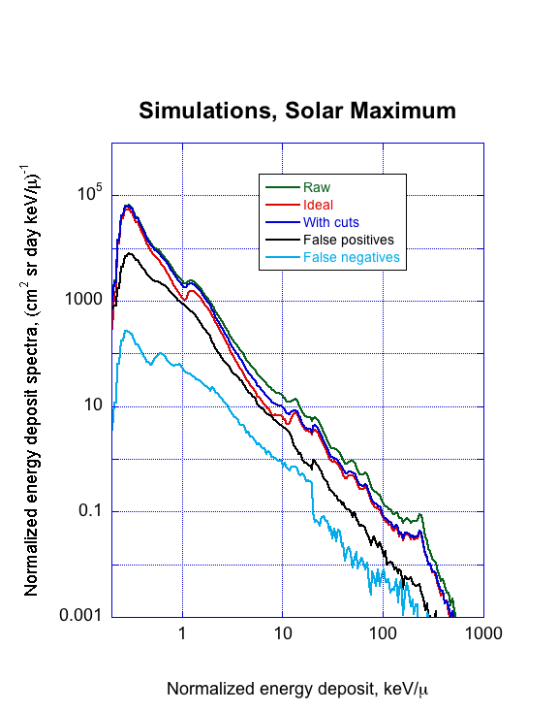
Figure 4b shows the same for high solar maximum modulation conditions (Badhwar-O’Neill 2010 model, Φ = 1000 MV). False positives are a larger fraction, up to 50% of the signal at about 8 keV/micron. This background is mostly due to high-energy side-penetrating particles that are modulated less by solar activity, and so one would expect a greater contribution at solar maximum when the foreground signal is reduced to a greater degree. Still, as seen in next figure, cuts make a big improvement. Same revisions as Figure 4a (I also cut off at 0.2 keV/μ instead of 0.1 to stretch the lines a bit). Dark blue curve (from previous plot) is now the same as on the next plot, simulations with cuts.
(b)

Slide 10
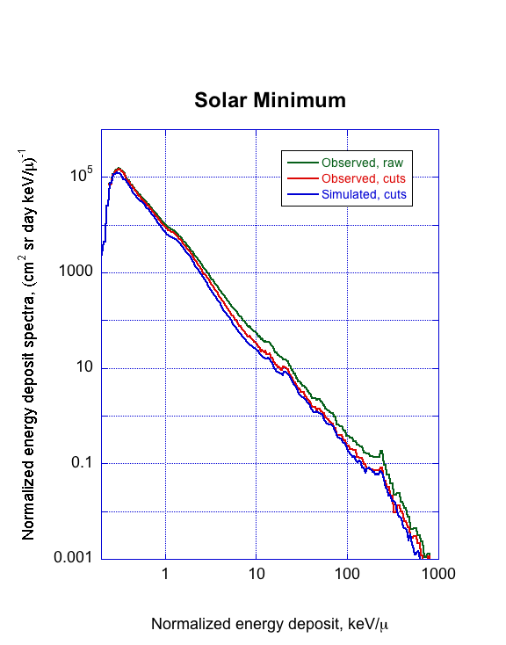
Figure 5 compares observed and simulated spectra for the first six months of the mission, during the deep solar minimum. Red is “raw” observed spectrum with no cuts, and blue is as observed after cuts are applied; green is simulated spectrum with cuts as in Figure 5. Considering that the agreement of model and observations depends not only on the Geant4 simulations but also on the input GCR spectrum models, we are confident that these cuts will perform as designed for real as well as simulated data. Again, changed lower X-axis limit and rotated colors so blue curve matches previous plots.

Slide 11
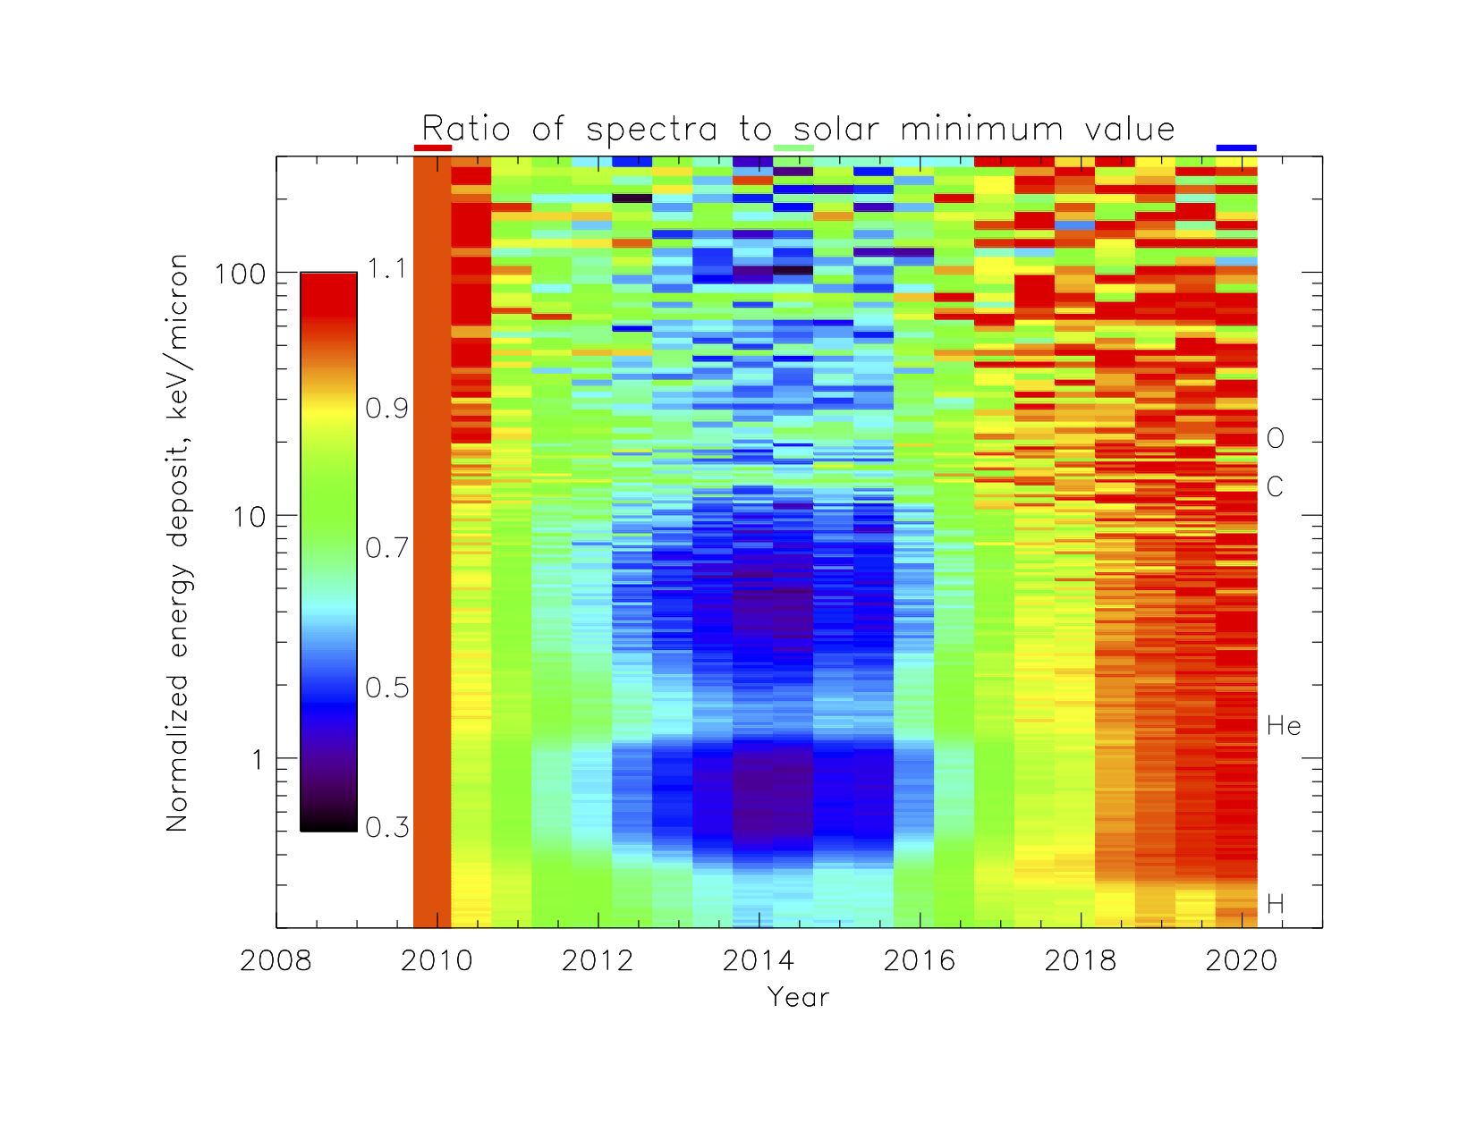
Figure 6 is the “payoff,” showing the changes in LET spectra over a complete solar activity cycle, normalized to the “observed, cuts” spectrum in the previous figure. As expected, MIP peaks of elements as labeled, being due to the highest energies, are modulated less than the lower-energy, higher-LET particles between the peaks. -70% holes (purple) at solar maximum should be a little deeper due to residual background; however, the modulation is twice what is seen in the raw spectrum. Now goes to 2020/065, no white.

Slide 12
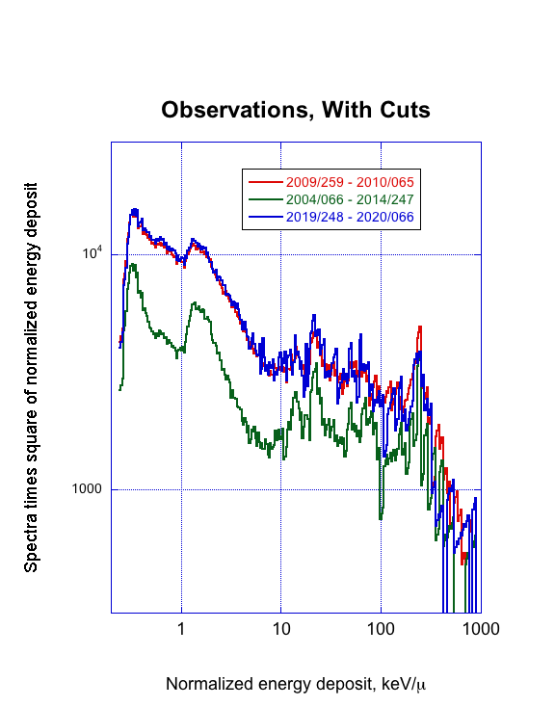
Figure 7 is the other additional figure that we discussed on the telecon. Again, I matched colors – the red curve here is the same data as the red “observed, cuts” trace on Figure 5, but multipled by the square of the normalized energy deposit to compress the dynamic range so the differences can be more easily seen. These three spectra correspond to the periods indicated with the red, green, and blue bars above the plot in Figure 6; you can see that the latest spectrum is actually a hair higher (where statistics permit the comparison) than that at the beginning of the mission.

