Slide 1
“Storyboard” and Outline for Space Weather Paper on GCR LET Spectra
Mark Looper
March 10, 2020

Slide 2
Figures and outline
I have been putting together the narrative and figures for the paper I intend to submit to Space Weather about background corrections in CRaTER GCR LET spectra over time.
Subject to co-authors’ and team members’ comments, these figures are intended to be final, except the first two (I need to merge graphics into better colorscale plots that I have made).
Again, this should have been in the proceedings issue for the May ASEC; also covered at Fall AGU.

Slide 3
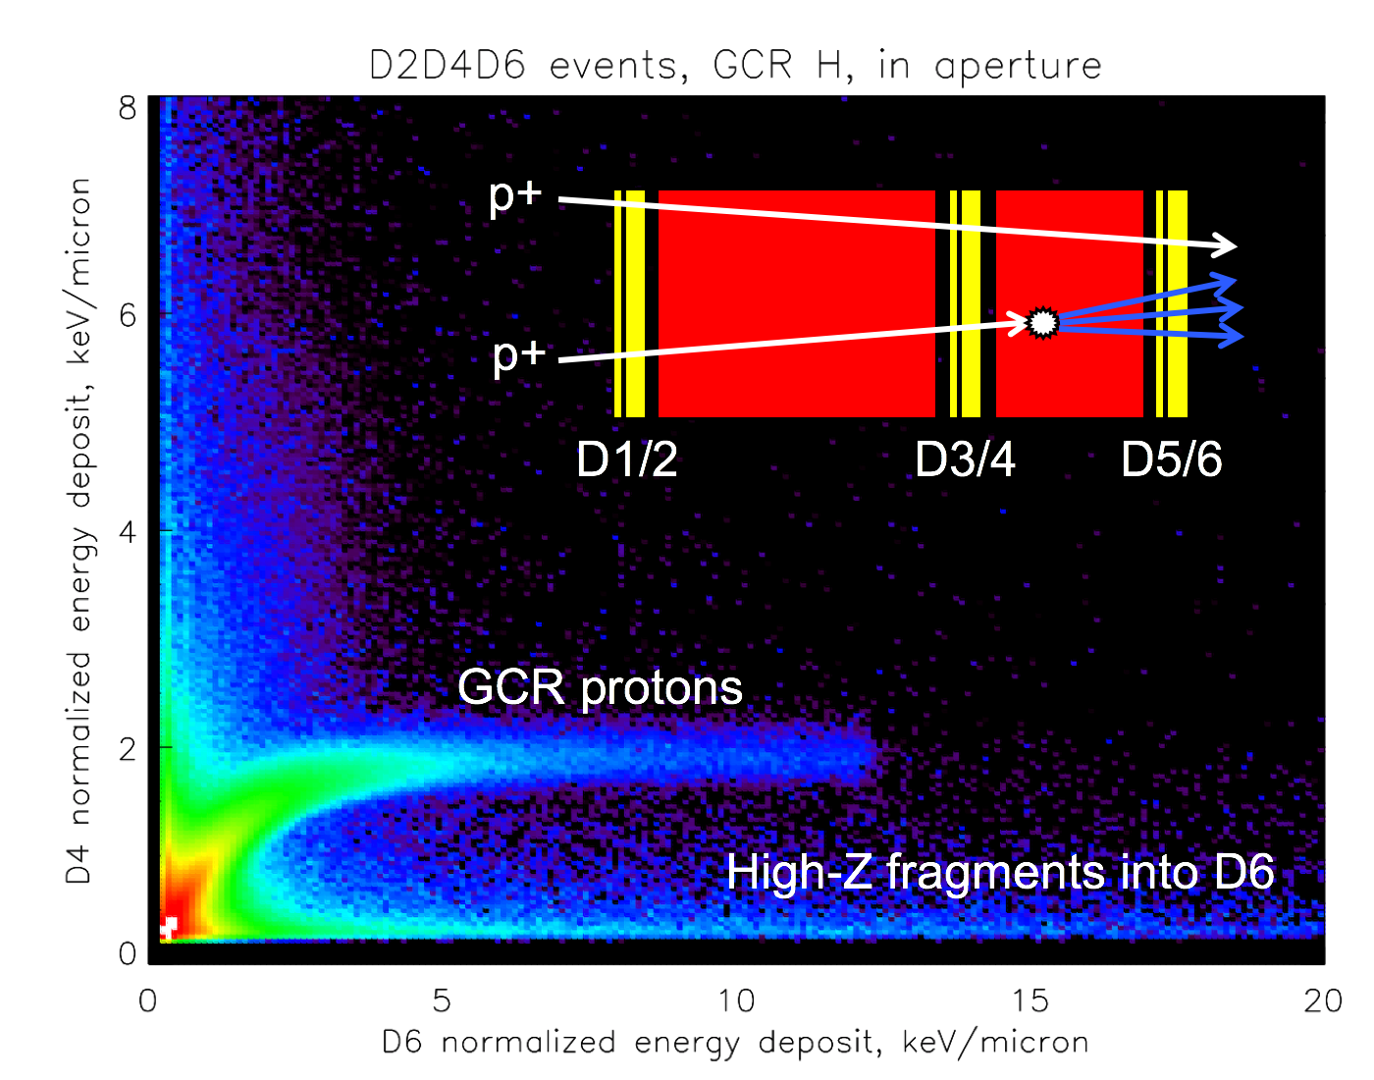
Figure 1 (or 1a) plots simulated proton events, showing events on proton track and with high D6 energy deposits. I will verbally describe CRaTER, so this schematic is the only sensor diagram I’ll show. I have a better plot, with colorscale (like Figures 3 & 4), but need to merge the labels and diagram into it while keeping high resolution. A small task, just one I haven’t finished yet (as of late the evening before the telecon).

Slide 4
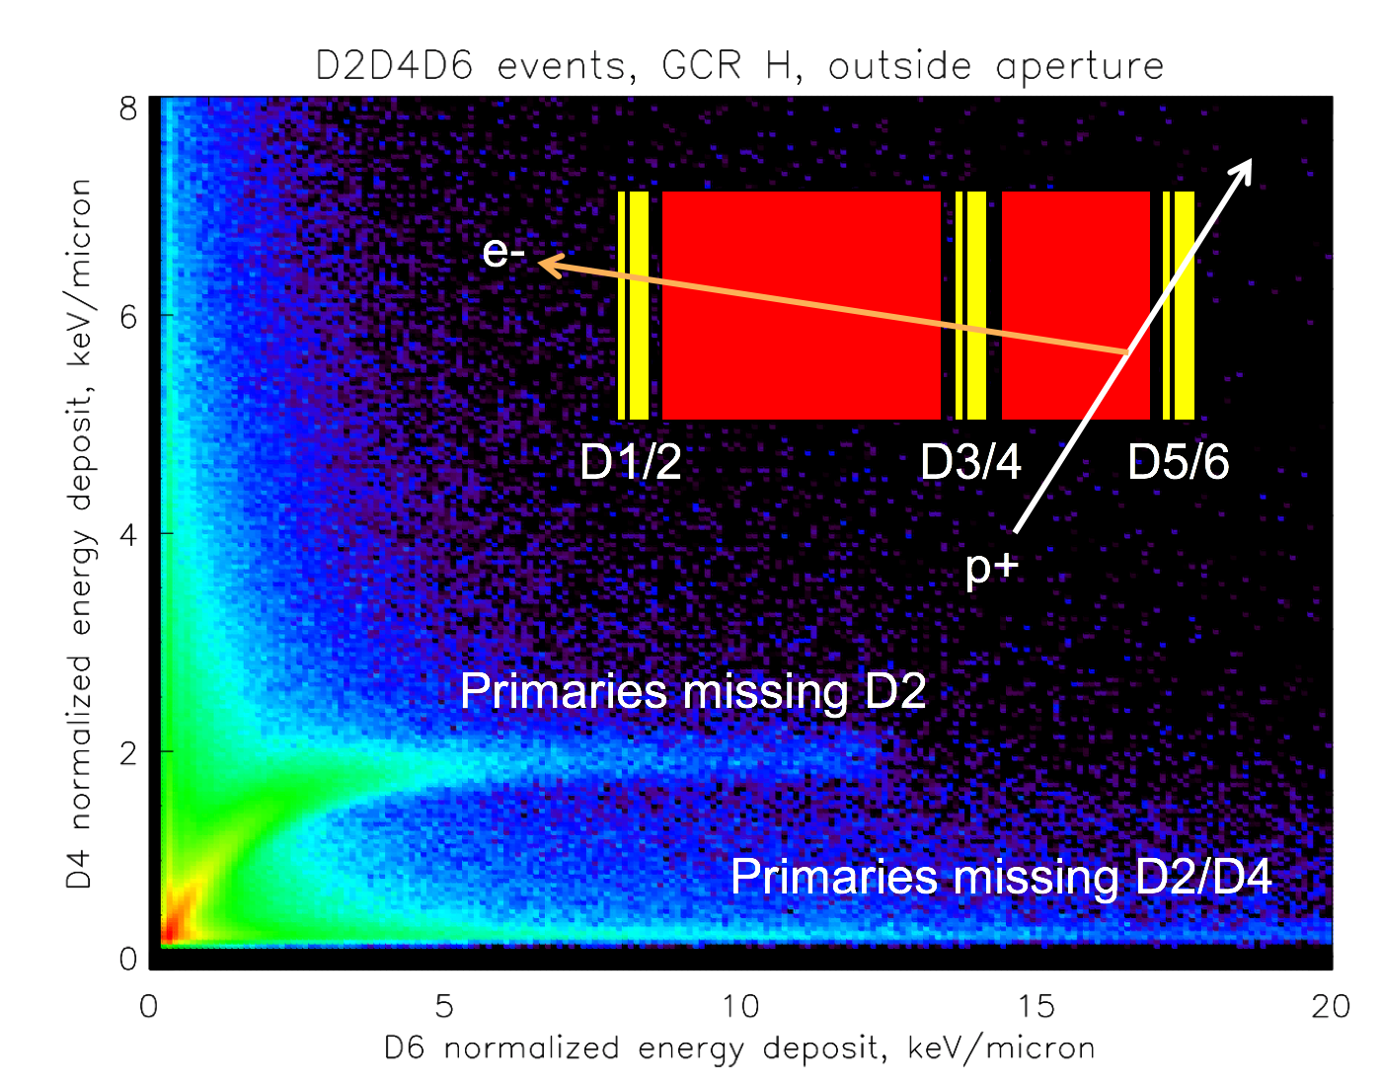
Figure 2 (or 1b) showing the same for events outside the aperture. Illustrates how these events can mimic in-aperture events (which are desirable because they can be quantified with a well-defined 0.605 cm² sr geometry factor and small secant factors through the detectors).

Slide 5
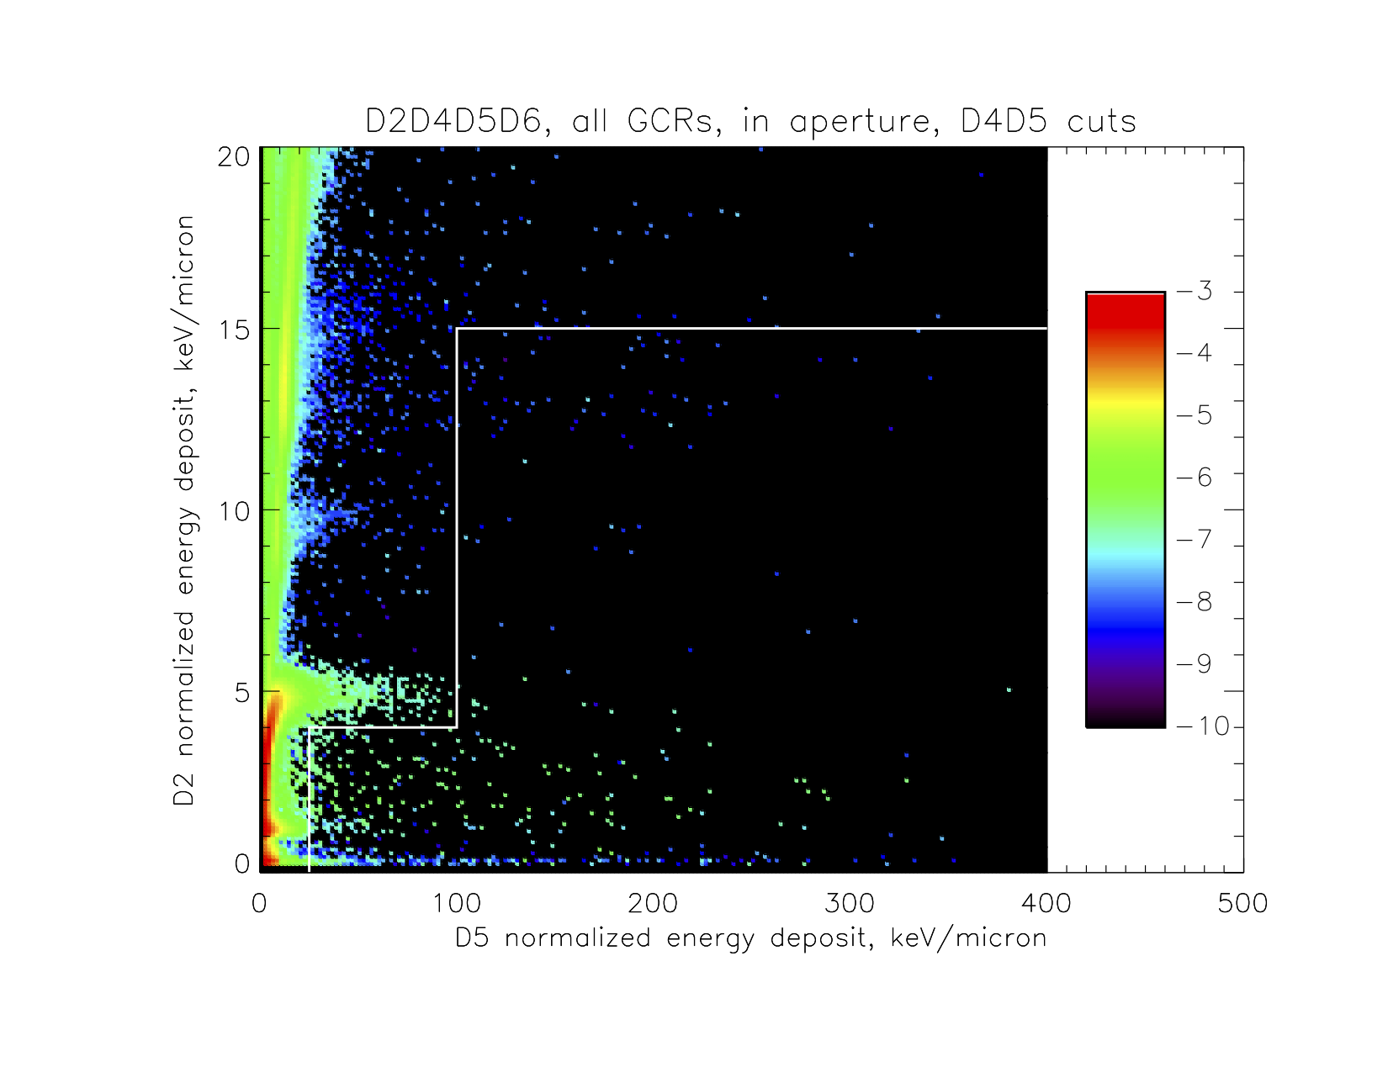
With three pulse heights, we can selectively reject background. Figure 3 (or 2a) shows D2 vs. D5 pulse heights for events in aperture with large (> 1.7 MeV) D4 pulse heights. If they came in the front, either they are ions traveling through the stack and so should have large D2 pulse heights, or else they are from fragmentation upstream of D4 (per figure 1) and the shower should stop before reaching D5/D6 and not be a triples event. Thus there should be few triples events with low D2 pulse heights, as seen below white line here.

Slide 6
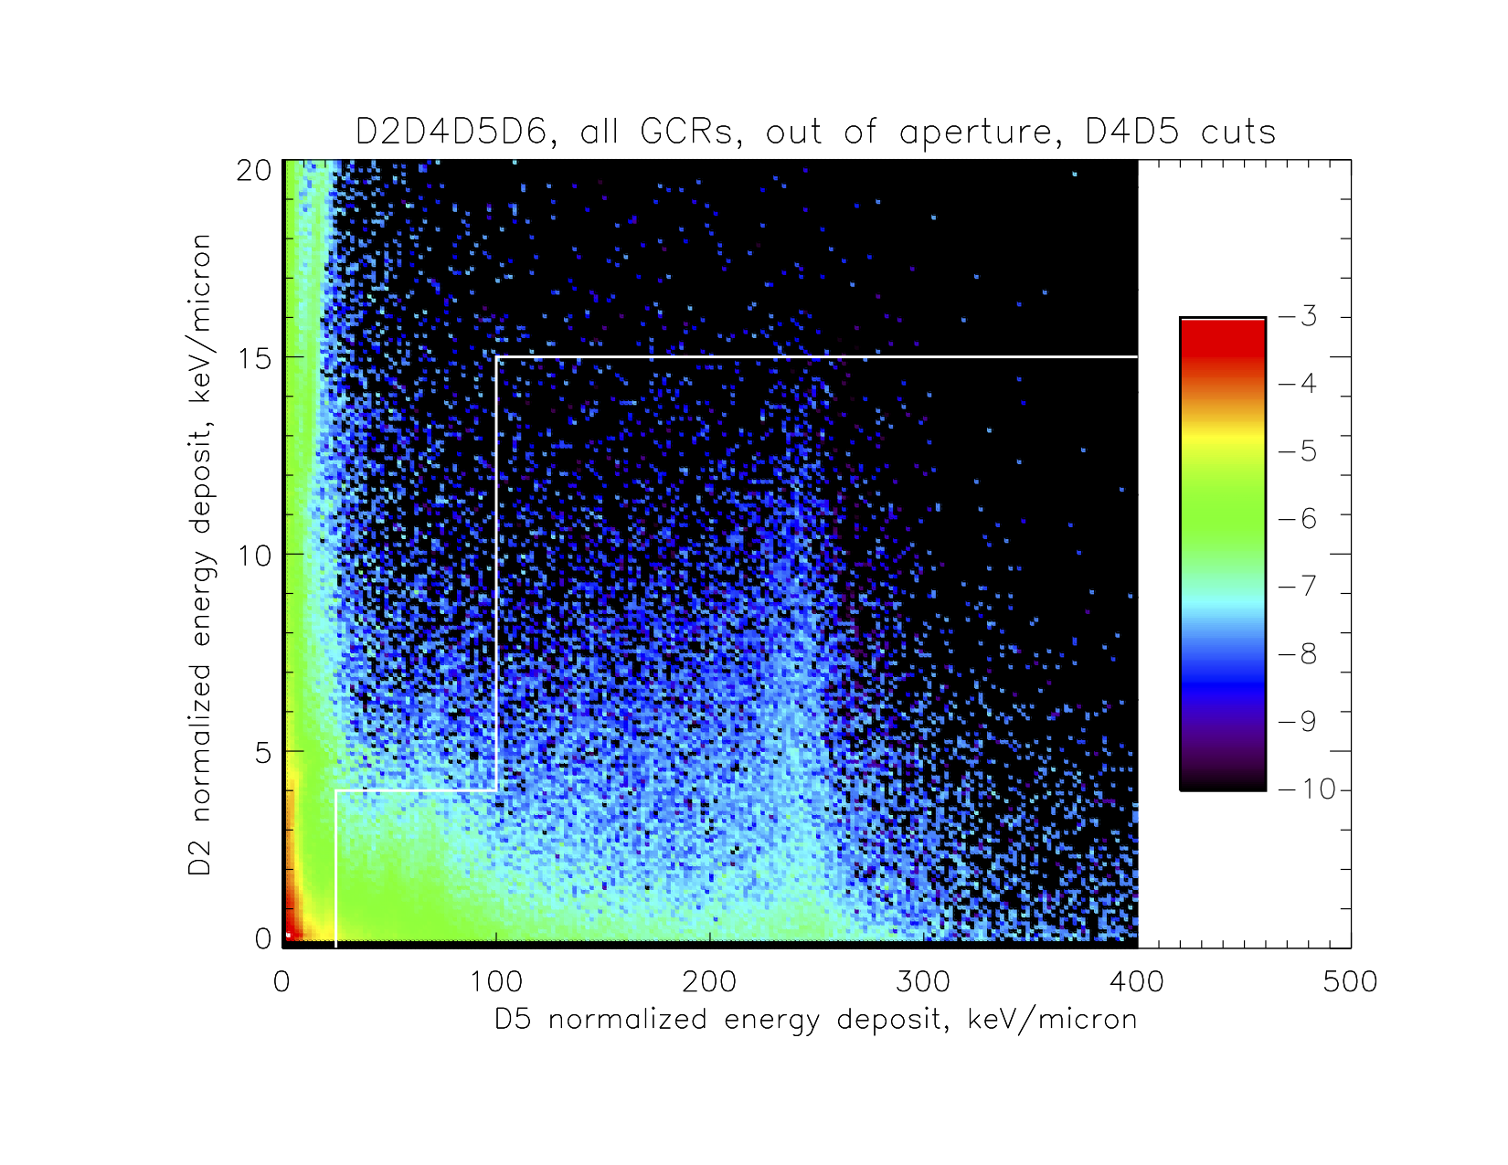
Figure 4 (or 2b) shows D2 vs. D5 events for simulated particles out of aperture with large D4 pulse heights. These can be side-crossing ions with big D4 and D5/D6 pulse heights but low D2 pulse heights due to a delta ray, so the area below the white line is populated here. Discarding events meeting these criteria gets rid of a lot of background and very little foreground. We devised multiple cuts based on logic like this in all detector pairs, which will be spelled out (IF D4 > 1.7 AND D5 < 100…) in an appendix.

Slide 7
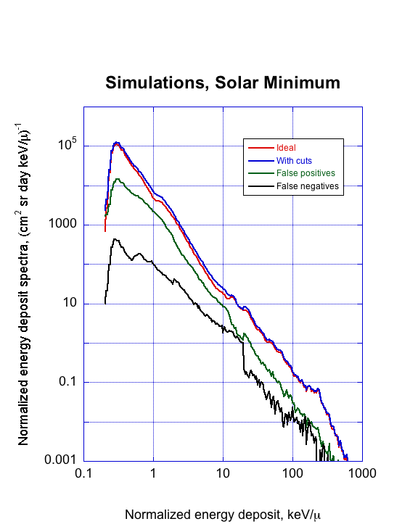
Figure 5 (or 3a) shows how the cuts affect the spectrum for solar minimum conditions (Badhwar-O’Neill 2010 model, Φ = 417 MV), same as in previous simulated colorscale plots. “Ideal” spectrum is if we could count only particles coming in the forward acceptance cone, “with cuts” is, well, with the cuts applied. Difference is due to small amount of “false negatives” where in-aperture events are rejected, and larger amount of “false positives” where events that should be rejected are instead accepted. Biggest error is some tens of percent around several keV/micron; overall effectiveness of cuts is good.

Slide 8
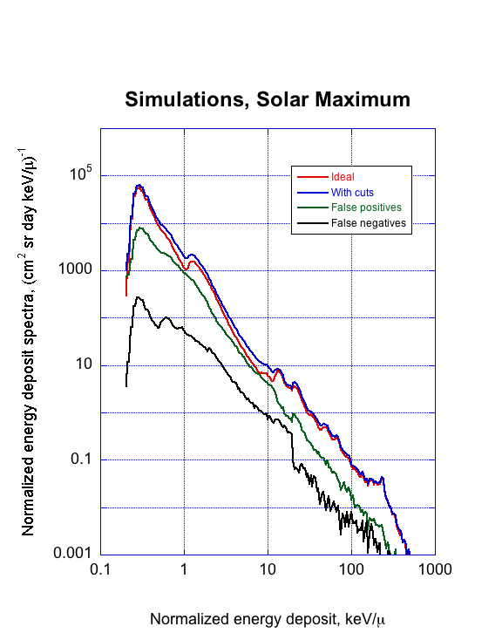
Figure 6 (or 3b) shows the same for high solar maximum modulation conditions (Badhwar-O’Neill 2010 model, Φ = 1000 MV). False positives are a larger fraction, up to 50% of the signal at about 8 keV/micron. This background is mostly due to high-energy side-penetrating particles that are modulated less by solar activity, and so one would expect a greater contribution at solar maximum when the foreground signal is reduced to a greater degree. Still, as seen in next figure, cuts make a big improvement.

Slide 9
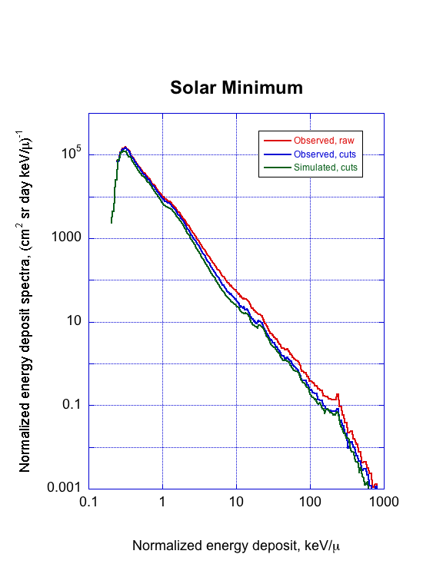
Figure 7 (or 4) compares observed and simulated spectra for the first six months of the mission, during the deep solar minimum. Red is “raw” observed spectrum with no cuts, and blue is as observed after cuts are applied; green is simulated spectrum with cuts as in Figure 5. Considering that the agreement of model and observations depends not only on the Geant4 simulations but also on the input GCR spectrum models, we are confident that these cuts will perform as designed for real as well as simulated data.

Slide 10
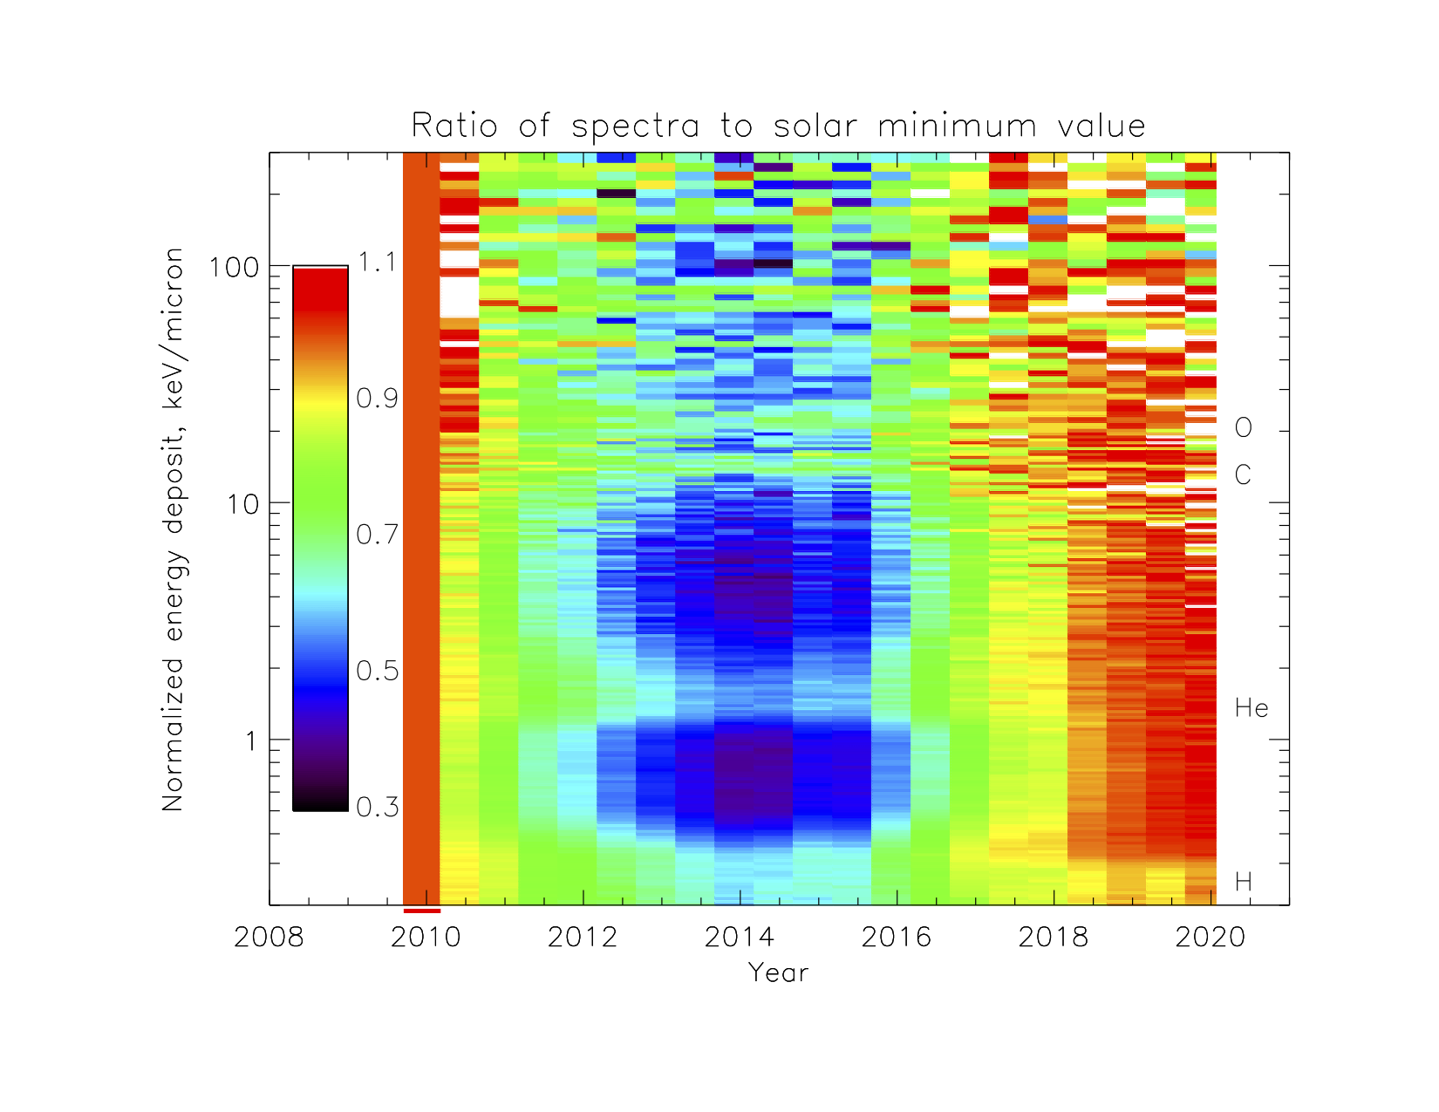
Figure 8 (or 5) is the “payoff,” showing the changes in LET spectra over a complete solar activity cycle, normalized to the “observed, cuts” spectrum in the previous figure. As expected, MIP peaks of elements as labeled, being due to the highest energies, are modulated less than the lower-energy, higher-LET particles between the peaks. -70% holes (purple) at solar maximum should be a little deeper due to residual background; however, the modulation is twice what is seen in the raw spectrum.

