Slide 1
Simulations of Low-Energy Protons in D4 and D2 With High D6 Energy Deposits
Mark Looper
July 30, 2019

Slide 2
Direction of high-energy protons
In file “albedo_mips.pdf” dated July 10, 2019, it was proposed that we could identify a subset of high-energy protons coming from the lunar surface by looking for a pattern of D2D4D6 triples pulse heights consistent with a nuclear interaction in D6 (large energy deposit) due to the high-energy primary plus D4 and D2 pulse heights consistent with a lower-energy secondary proton traversing those detectors.
Without a nuclear interaction and a low-energy secondary, pulse heights in D2, D4, and D6 are all about the same “minimum-ionizing” value, so we can’t tell if such “minimum-ionizing particles” (MIPs) went through the telescope from D2->D6 (GCRs) or D6->D2 (albedo).

Slide 3
Modeling the source of the signal
On the telecon that morning, I expressed concern about the extent to which such a signal would actually be attributable only to MIPs coming up from the moon. If high-energy protons coming in the side had any significant probability of causing energy deposits like this, then the much greater abundance of galactic cosmic rays would overwhelm any signal coming upward.
To address this, I simulated protons striking a simplified model of the D6 end of CRaTER, tracking energy deposits in D6 and protons coming out of the short piece of TEP so as to go through D4 & D2.

Slide 4
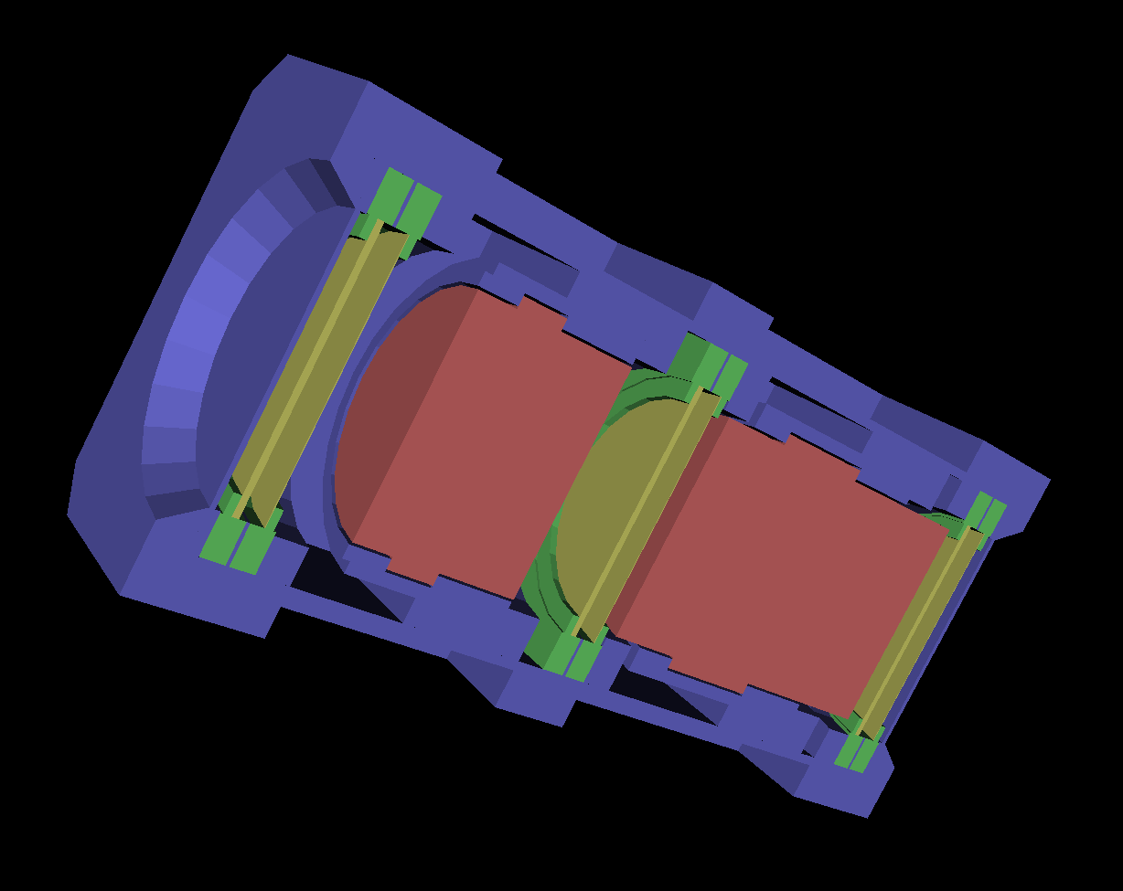
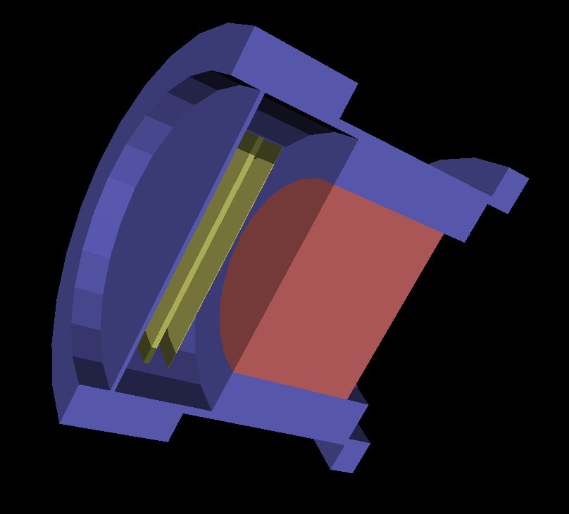
The larger image at left is a geometry dump (VRML2) of my Geant4 simulation of the CRaTER sensor head. For the present calculation, I modeled the shorter piece of TEP and the D6 end of the telescope, and the aluminum around them, with a simplified geometry having cylindrical symmetry as at lower left.
The cylindrical surface enclosing the geometry shown was isotropically illuminated, on the D6 window end and around the sides but not into the open end where D4 would sit.
To avoid ambiguity in the D4 and D2 energy-deposit signals, I tabulated events that produced a proton that would trigger those two detectors, rather than modeling the whole telescope and sorting through those energy deposits. I logged only events that resulted in a proton of 85 MeV or more (enough to reach D2 through the longer piece of TEP) exiting the open end of the simulation volume with a trajectory that would cause it to traverse D4 and then D2.

Slide 5
Identifying low-energy protons
In “albedo_mips.pdf,” particle events in the population of interest were identified by selecting D4 and D2 pulse heights consistent with lower-energy protons traveling from D4 to D2 (on the “swoosh”).
To separate this population from the GCR alpha population, only events with D2 PHA channel above 100 were considered. With ~22 keV channel widths in the thick detectors, this sets an upper limit on proton energy: protons exiting the simulation geometry on (extrapolated) trajectories passing through the positions of D4 and then D2 must be above 85 MeV to reach D2 at all through D4 and the long TEP piece, and below 100 MeV to have a large enough D2 pulse height.

Slide 6
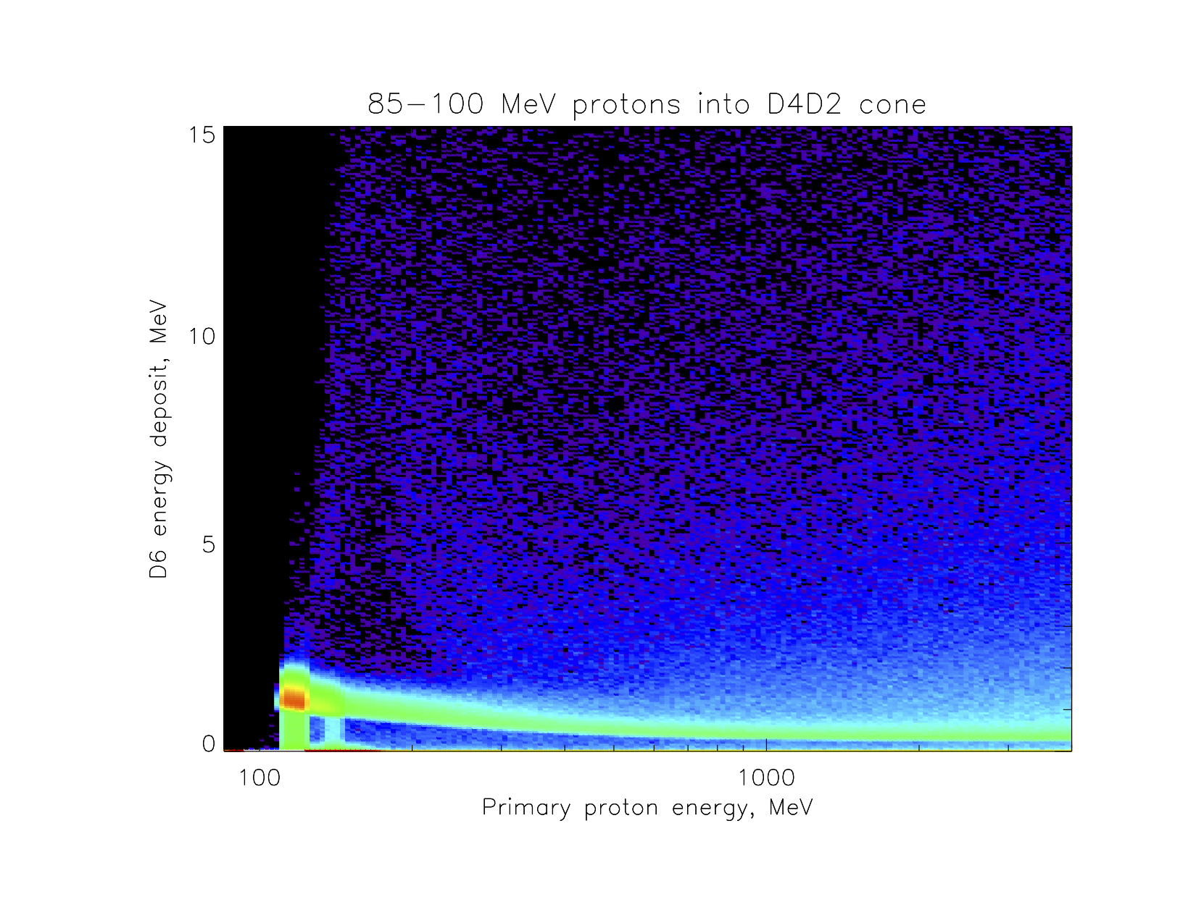
Here are the distributions of D6 energy deposits for all such events (out of 2x10⁸ at each primary proton energy), on a seven-decade logarithmic color scale. The orange blob is the nominal population: protons that traverse D6, then D4, then D2 without nuclear interactions. The green curved band off to the right from that blob is almost like the population of interest, with a high-energy proton giving a normal D6 energy deposit but then having a nuclear interaction in the TEP that sends an 85-100 MeV proton out the D4 end of the TEP. Requiring D6 energy deposit >2.2 MeV (about channel 100) rejects these.

Slide 7
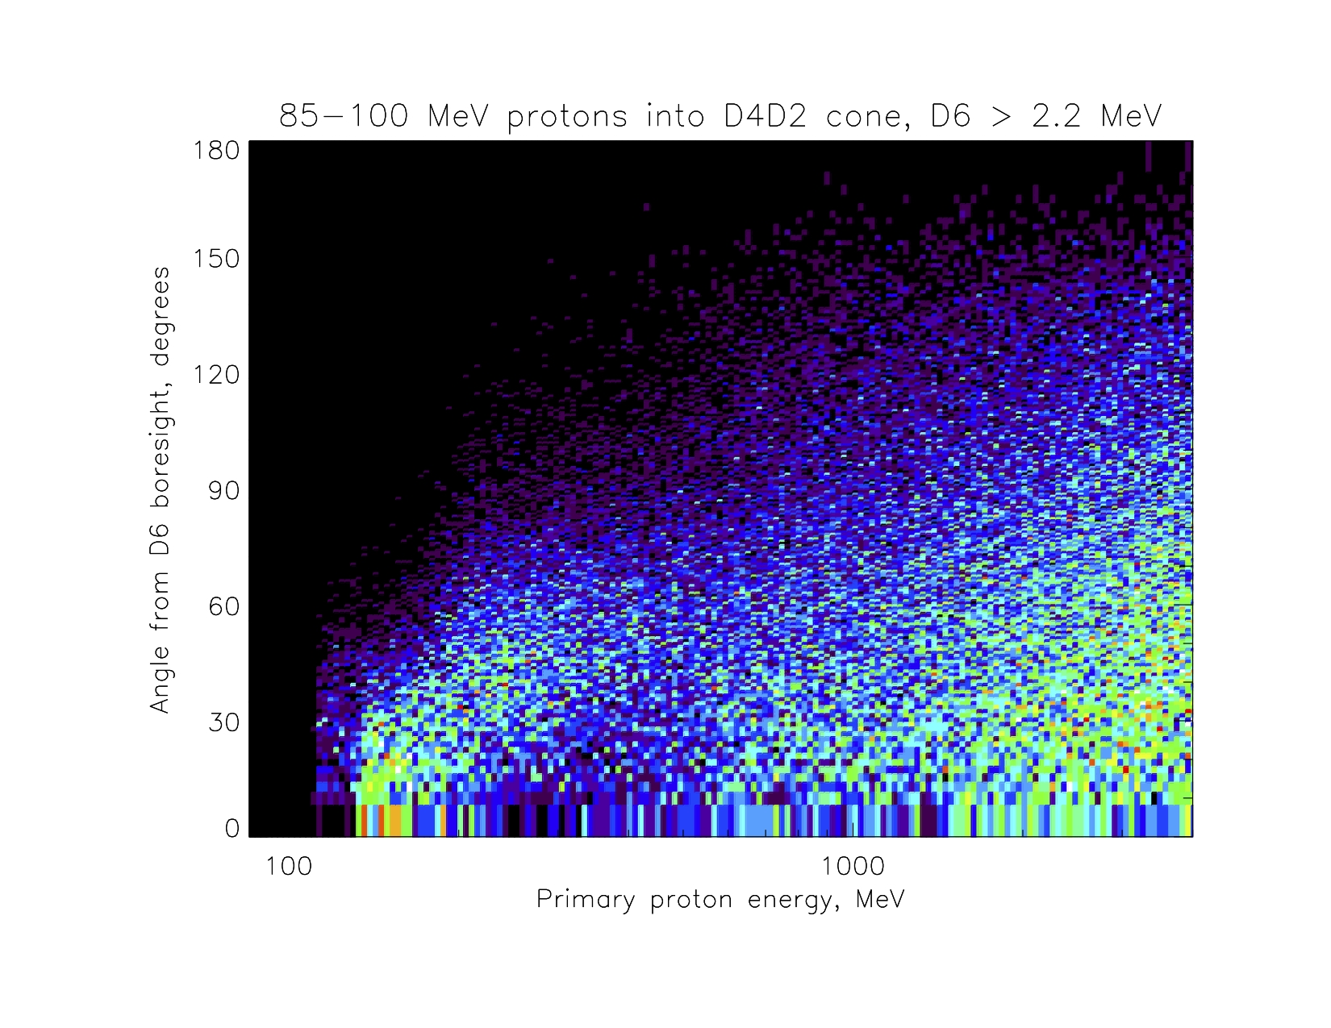
This is the angular distribution of the incident protons causing the pale blue curtain of events on the previous plot above the green curve that traces out dE/dx in D6. The color scale here is linear, with equal solid-angle bins, and from 0 to only 15 hits per bin (out of 2x10⁸ incident protons!). The number of hits denoted by the color is proportional to the effective area for these events from that direction. Plainly, there is plenty of response past the 76° off-nadir angle of the lunar limb at 50 km altitude, meaning that GCR protons will dominate the production of these events despite coming in from well off nadir.

Slide 8
Next steps?
This calculation was just intended to demonstrate the likelihood that there would be a large contribution of downward- and sideways-going protons to the candidate signal, so that it would not be a clean sample of upward-going (albedo) MIPs.
In real data analysis, we could not snip out protons going into the D4->D2 acceptance cone as here, but must identify them from D4 and D2 energy deposits.
There is some directional preference (<76° vs. >76°) on the previous slide. To see if this could be used to identify variations in an upward-going population, it would be necessary to calculate foreground (albedo) and background (GCR) contributions based on modeled responses like these, and see what the SNR looks like.

