Slide 1
Variations of GCR Albedo With Surface Tilt And Solar Modulation
Mark Looper
March 12, 2019

Slide 2
Last (I hope!) pieces of Geant4 paper
On my AGU poster, I showed the main substance of the paper I am in the process of writing about the Geant4 simulations of lunar albedo in the presence of hydrogen or water.
A discussion at the CRaTER/LEND joint meeting last year suggested to me a way to probe the effects of surface tilt, and after the telecon last week was canceled I decided to add to this report a summary of the effects of solar modulation.
This is getting bulky, but I think I need these two.

Slide 3
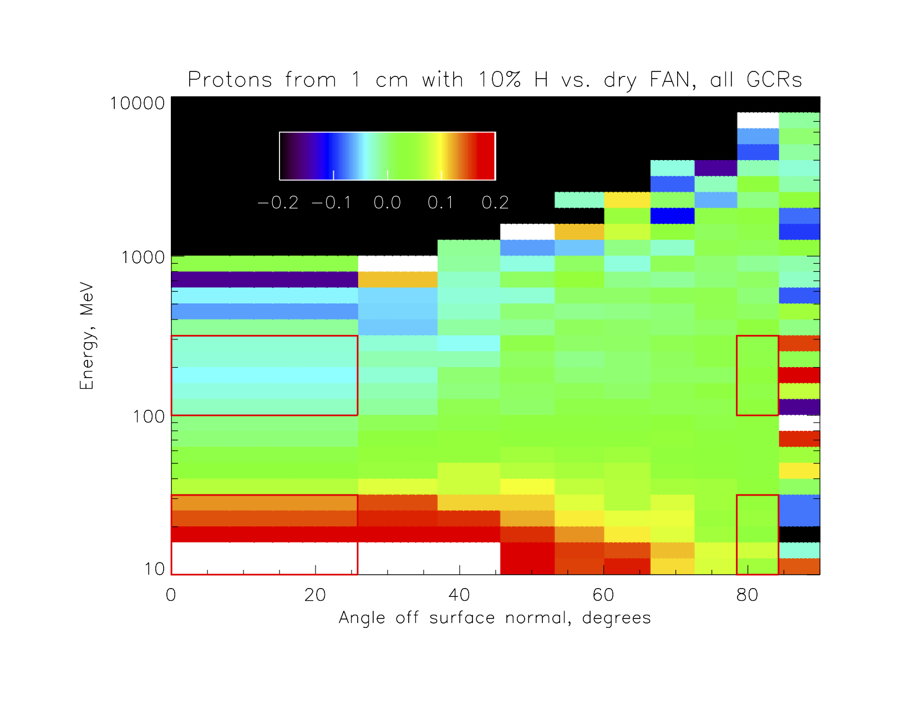
This figure and the next, from my AGU poster, show the quantities being compared in the line plots below that present comparisons over different ranges of parameter space. The four red boxes identify two energy bands, 10-32 MeV and 100-320 MeV for protons and 1/10 that for neutrons, and two angle bands near nadir-looking (left) and near the limb (right). The linear colorscale here is the fractional difference in proton flux vs. energy and angle for FAN topped by a 1 cm layer with 10% H by mass, vs. dry FAN.

Slide 4
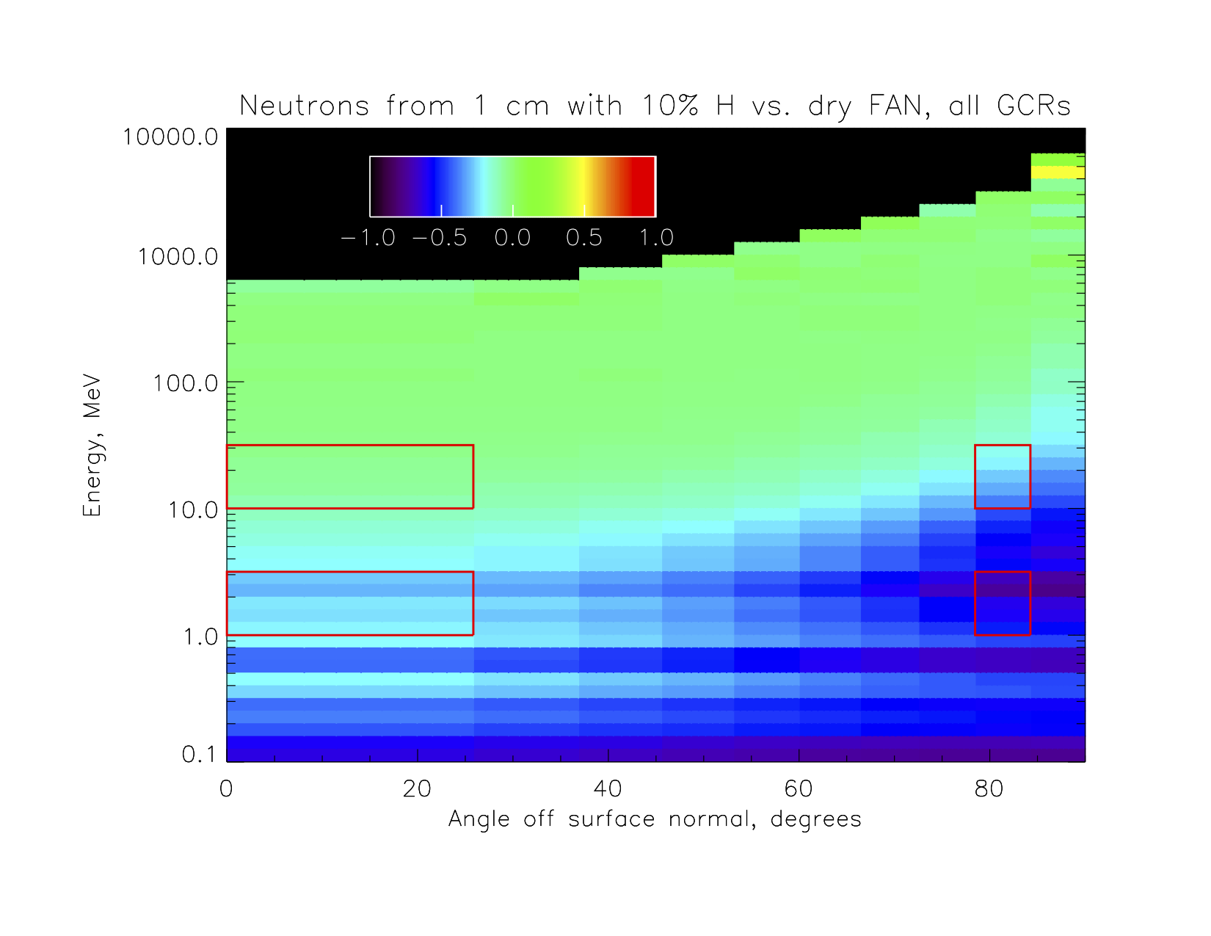
This is the corresponding plot for neutrons; all energies and angles are depleted by the presence of hydrogen, in contrast to the case for protons where different effects compete. I will probably put proton/neutron pairs of these energy-angle plots as a single figure, and four-pane “quad charts” with the line plots of results as single figures, so that the paper doesn’t have dozens of figures. Everything’s separate in this PPTX, though…

Slide 5
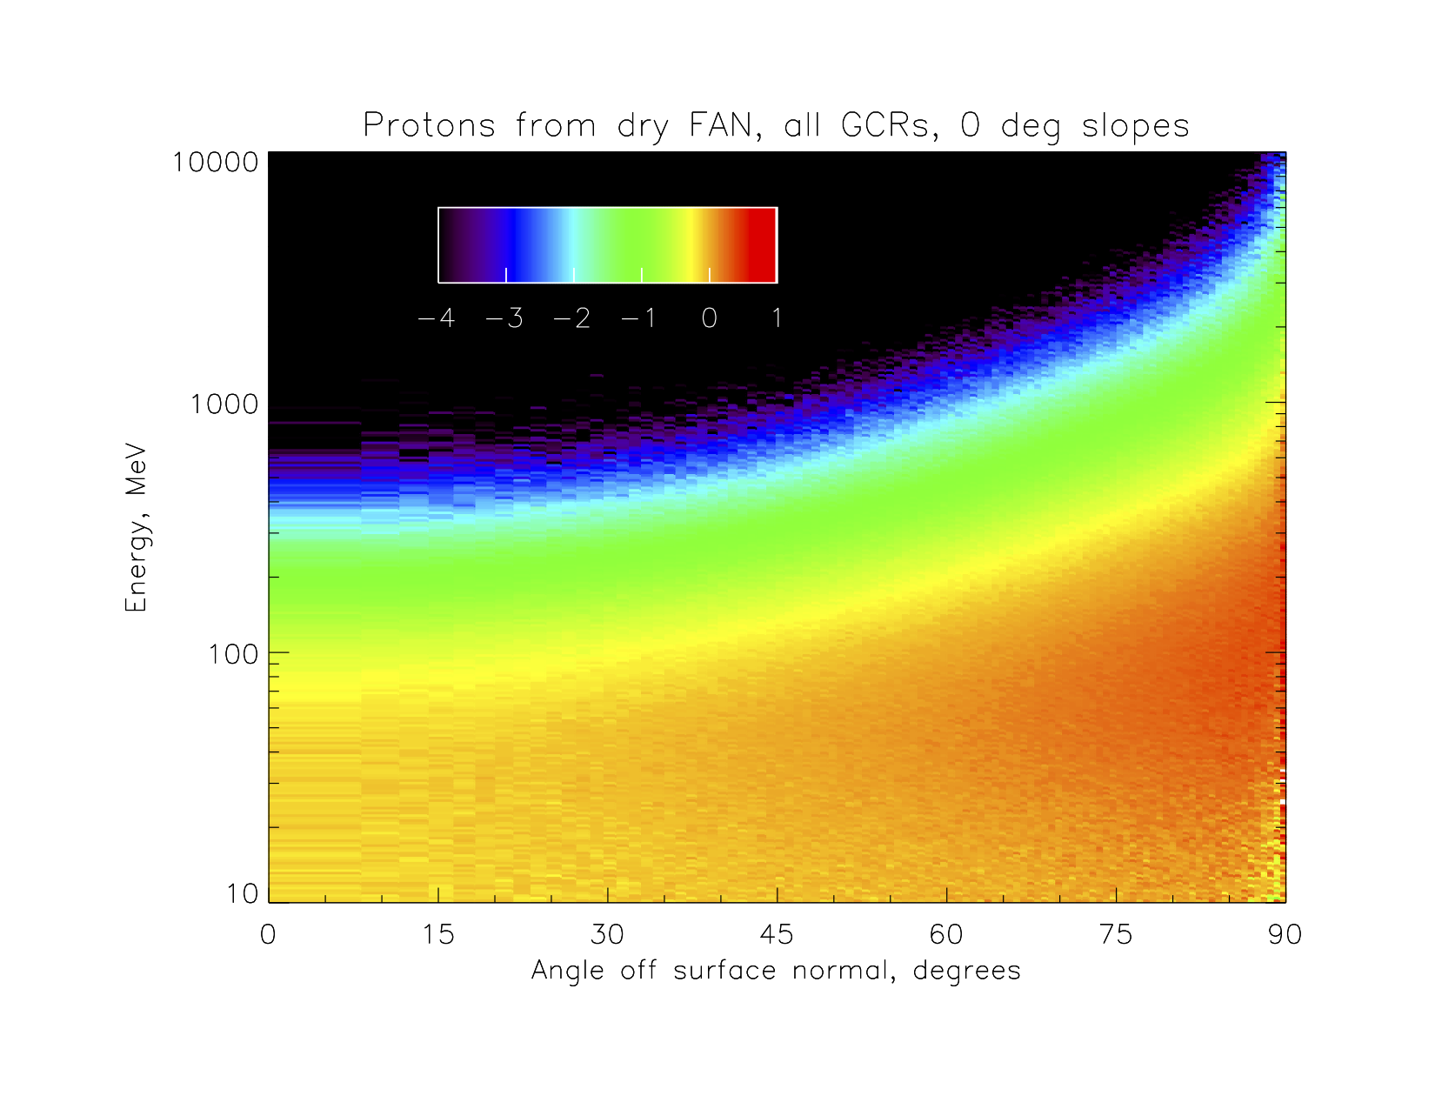
The AGU poster compared proton & neutron albedo fluxes for various hydrogenated configurations vs. dry FAN, for conditions appropriate to the deep solar minimum around LRO launch: Badhwar-O’Neill 2010 model, Φ = 417 MV. The next few slides compare the fluxes as the target surface tilts from level; I did this by tilting the coordinate, discarding all secondaries that either came out below horizontal or came from primaries blocked by the slope, then tilting the coordinate system back and averaging over all azimuths. This plot is the baseline for protons, level dry FAN illuminated isotropically by GCRs Z=1-28.

Slide 6
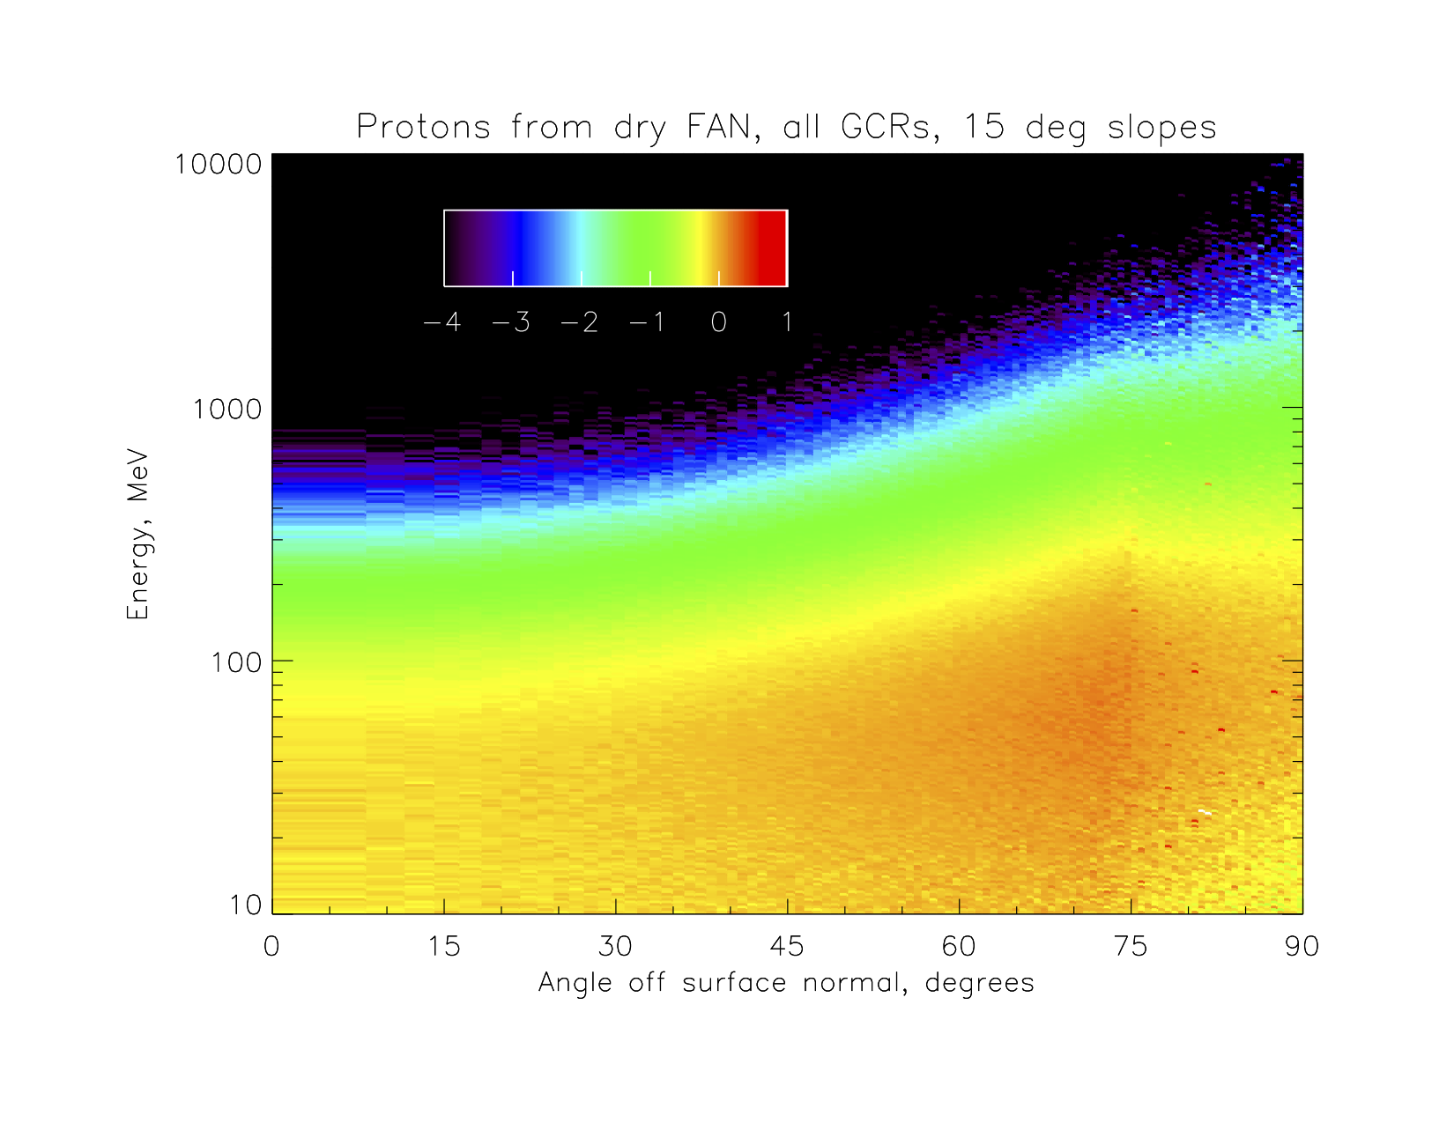
This is the same plot (colorscale is log of flux), for a 15° tilt. You can see that the overall intensity is diluted because of the blockage of primary particles by the uphill slope, and the higher intensity and energy toward the limb are reduced because these are mostly due to grazing primaries producing secondaries that come out at a grazing angle, and so they only are present across the slope. This method of calculation, by the way, implicitly assumes slopes are random in orientation but uniform over the distance GCRs travel into the regolith (~1 meter), and that secondaries launched downhill produce no tertiaries.

Slide 7
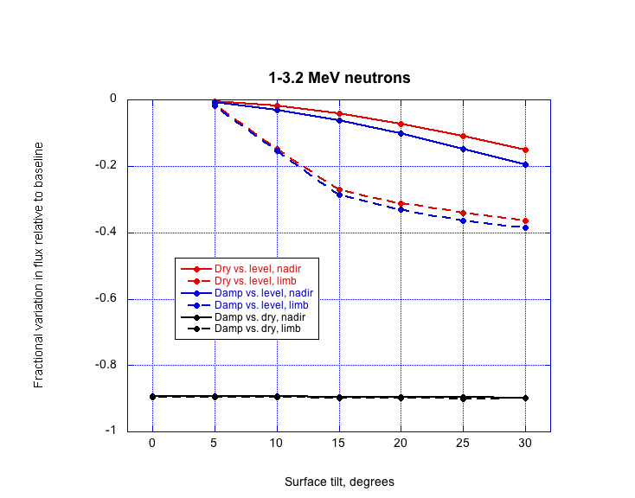
This and the next few plots compare results for the lower neutron energy channel. Solid lines are the nadir-looking angular bin on slide 3, dashed the limbward bin; colored lines compare fluxes at the given tilt vs. level, for dry FAN and for 10 cm of 10% H by weight (labeled “damp”). Black shows the ratio of damp to dry fluxes; it varies little with tilt, since the red and blue lines lie so close to one another.

Slide 8
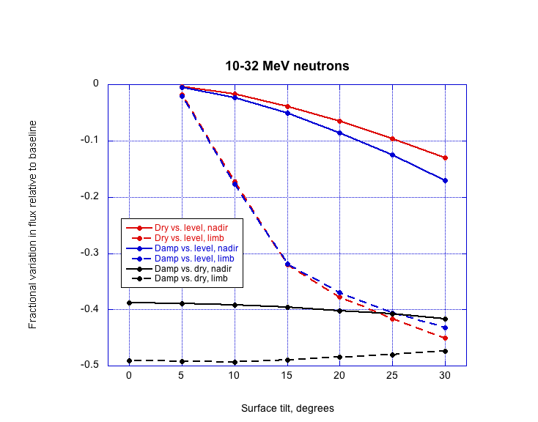
This is the same plot for the higher-energy neutron channel. The same conclusion holds: changing the tilt makes a big difference for a given composition, but damp and dry surfaces with the same tilt have nearly the same ratio of albedo fluxes regardless of what that tilt is. That is, ignoring the tilt of the surface is not going to bias conclusions about hydrogen content, as long as tilt is similar between dry and hydrogenated areas.

Slide 9
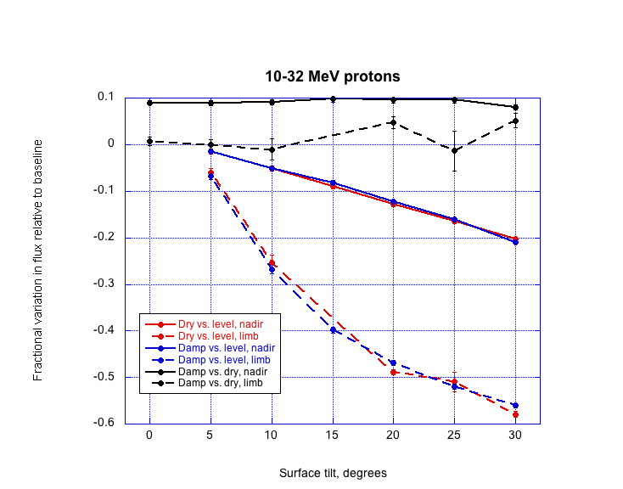
The same conclusions hold for the protons; here is the lower-energy proton channel, which is enhanced by the presence of hydrogen, at least toward the nadir-looking direction. (The missing 15° point for the dashed black curve has one outlier among the 20 random-number-generator seed cases and thus a big error bar; I’ll excise the outlier and plot the corrected point in the paper.)

Slide 10
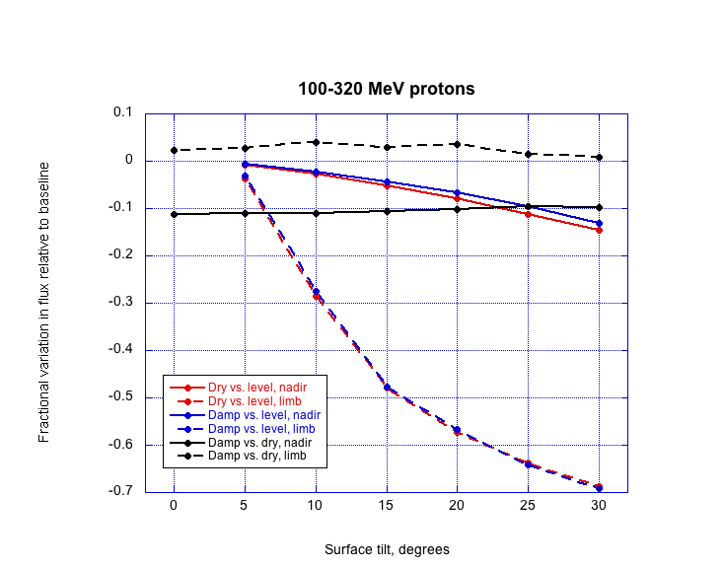
And here is the plot for the higher-energy proton channel, which is enhanced toward the limb and depleted toward the nadir (this is our classic model with enhancement of forward scattering vs. depression of isotropic nuclear disintegration). To be clear, error bars (here tiny) are statistical only; they represent the standard deviation of the estimate of the mean among results calculated with 20 different random-number-generator seeds.

Slide 11
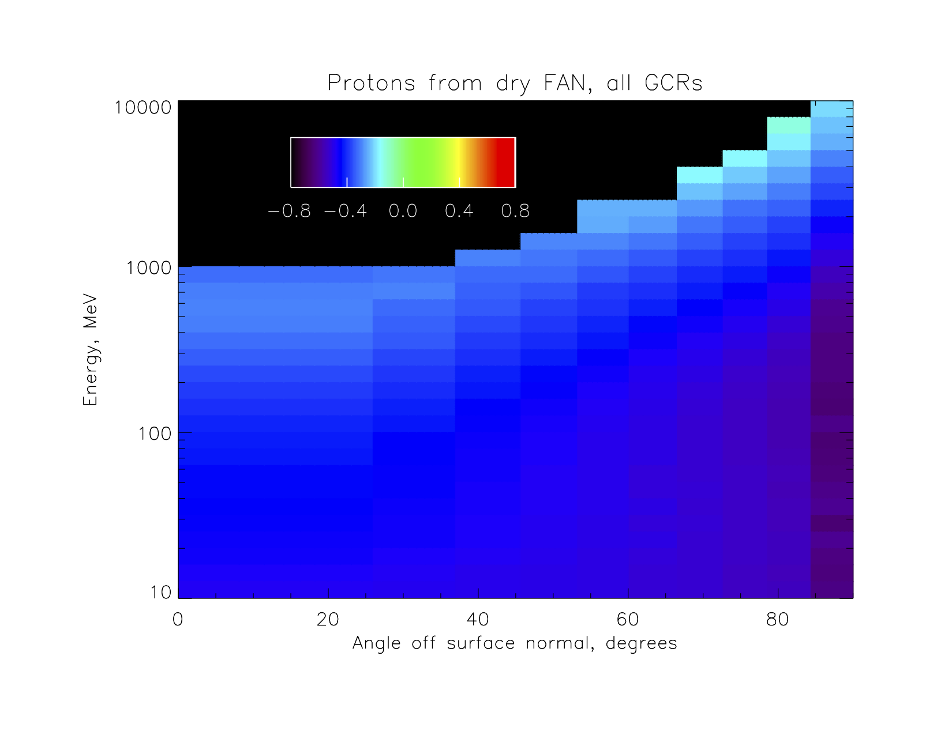
The situation is noticeably simpler for the comparison with solar modulation of the input GCR spectra. Here is a plot with linear color scale of the fractional difference between a plot as on slide 5 for the energy and angular distribution of albedo protons produced from dry FAN, with Φ = 1000 MV (strong solar maximum modulation) vs. Φ = 417 MV (deep solar minimum modulation).

Slide 12
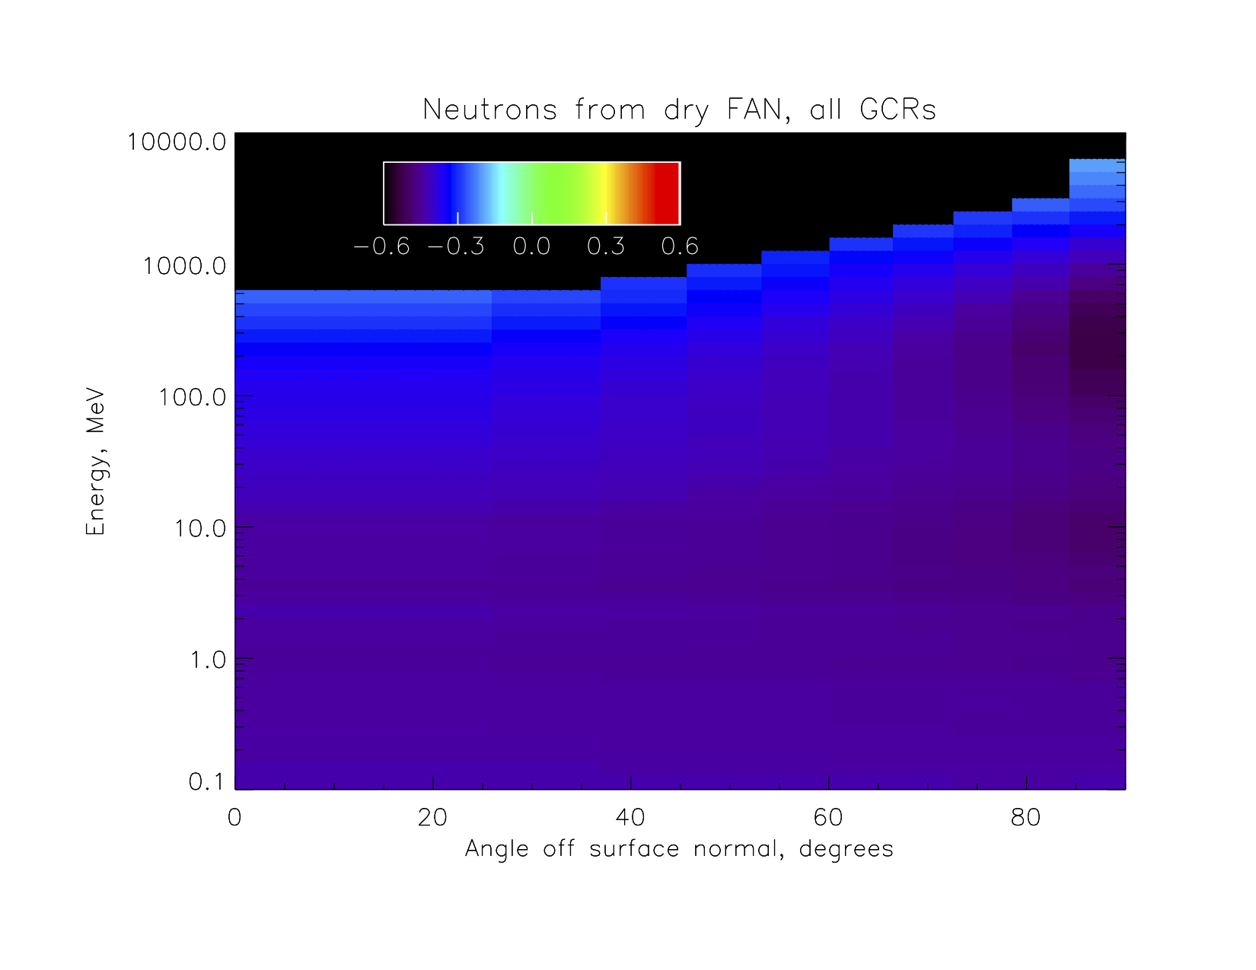
And here is the same plot for neutrons, for solar maximum vs. solar minimum modulated GCR spectra.

Slide 13
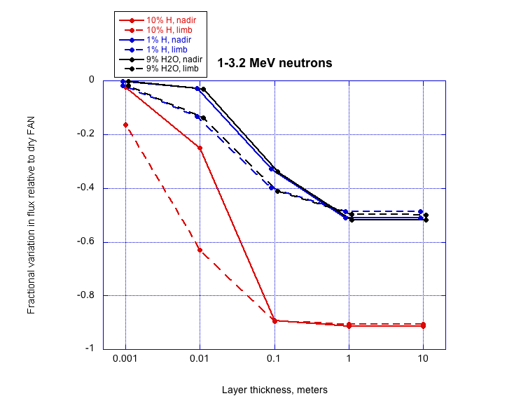
The last eight plots are in pairs, one each for Φ = 417 MV and for Φ = 1000 MV. The first of each pair is from my AGU poster; in the paper I will have collected the four (according to my current plan, anyway) into a single figure in the main section discussing effect of hydrogen or water in an upper layer. These plots show nadir (solid) and limb (dashed) angular bins, for different thicknesses of upper layer with different hydrogenation.

Slide 14
This is the solar maximum plot for the lower-energy neutron channel. Toggling back and forth, it can be seen that the ratios change very little at any point on these plots. That is, the pattern of depletion as in slide 12 applies to all hydrogenation geometries to a good approximation, in addition to the dry FAN for which that figure was actually plotted.

Slide 15
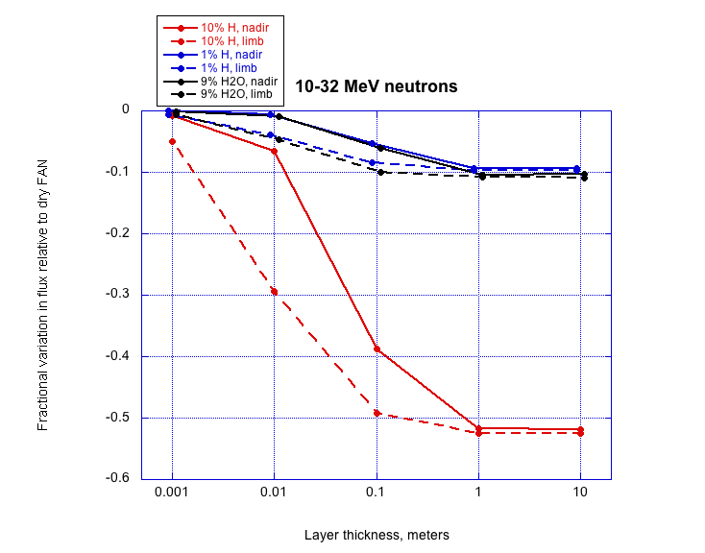
Higher-energy neutron channel, solar minimum.

Slide 16
Higher-energy neutron channel, solar maximum.

Slide 17
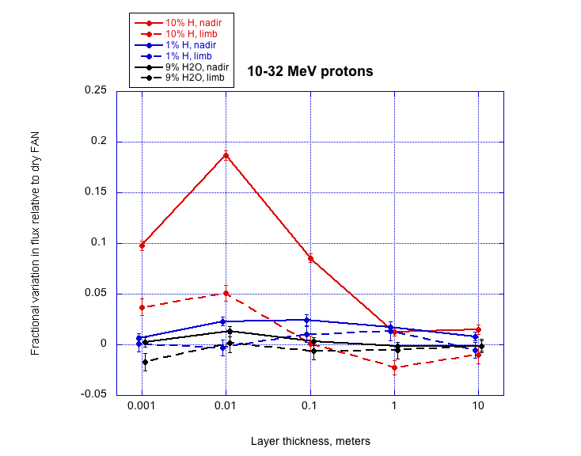
Lower-energy proton channel, solar minimum.

Slide 18
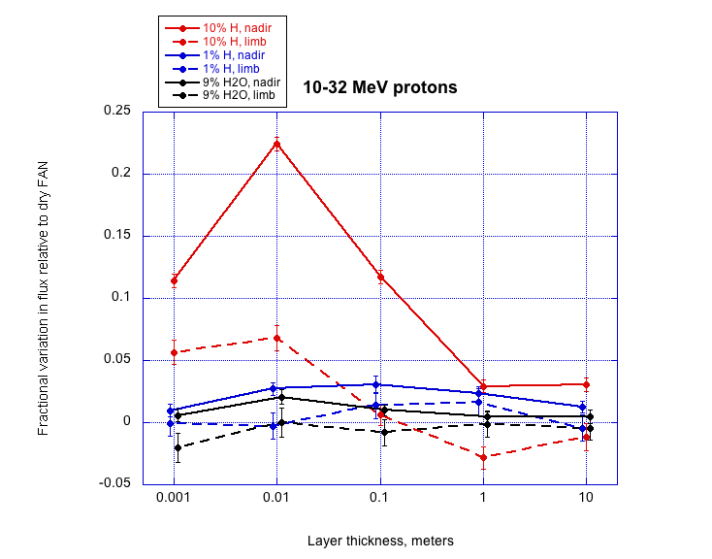
Lower-energy proton channel, solar maximum. The protons show similar patterns between the two modulation levels, but the changes due to the presence of hydrogen are somewhat enhanced for solar maximum whereas there was little difference for neutrons.

Slide 19
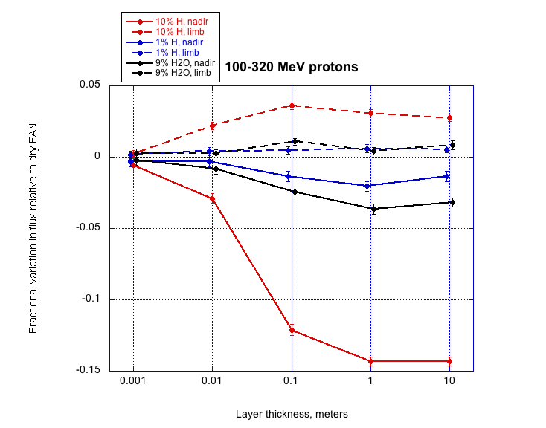
Higher-energy proton channel, solar minimum.

Slide 20
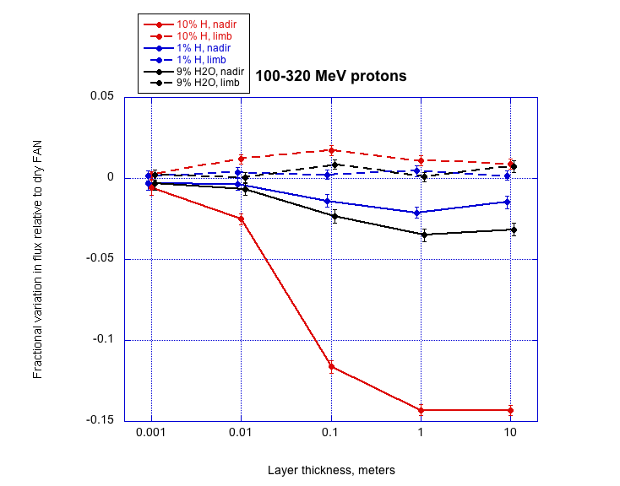
Higher-energy proton channel, solar maximum. In contrast to the lower-energy protons, the effect of hydrogenation is reduced for solar maximum modulation. It makes sense that the protons show more effect of modulation than the neutrons, since the latter are produced mostly at greater depths from the higher-energy (less-modulated) primary GCRs; I need to think some more about why the protons differ between the energies.

Slide 21
Other things I plan to add
I will show a plot, or maybe a pair for solar minimum and maximum, of the angle-integrated spectra of all albedo particle species, and plots of Joe Mazur’s ASEC 2017 comparisons with other sensors’ gamma and neutron measurements of the moon. I will also include an update of my old comparison of simulated protons and neutrons at the bottom and top of an upper hydrogenated layer, to illustrate the “tertiary” proton mechanism.
I don’t plan to include any CRaTER data in this paper; I will refer to our previous papers for context, but the purpose of this one is just to get the conclusions from the whole set of simulations, rather than the partial ones heretofore reported, into the literature.
As I remarked earlier, I want to include a brief appendix about the normalization of albedo simulations, to help ensure that all of us working on that topic are comparing “apples to apples” when looking at each others’ results.

Slide 22
More things to add, God forbid?
I think the reason for the varying effect of solar modulation vs. albedo proton energy lies in the different distributions of primary GCR energies responsible for albedo in dry vs. hydrogenated surface; a plot of this primary energy response could help bolster any explanations given.
There has been discussion of a desiccated surface layer above hydrogenated bulk regolith; I don’t want to run months’ more simulations, but my previous set included information on albedo-particle source depths, and I could approximate a desiccated top layer by discarding particles produced at shallower depths from a simulation of solid damp regolith (to 10+ meters).

