Slide 3
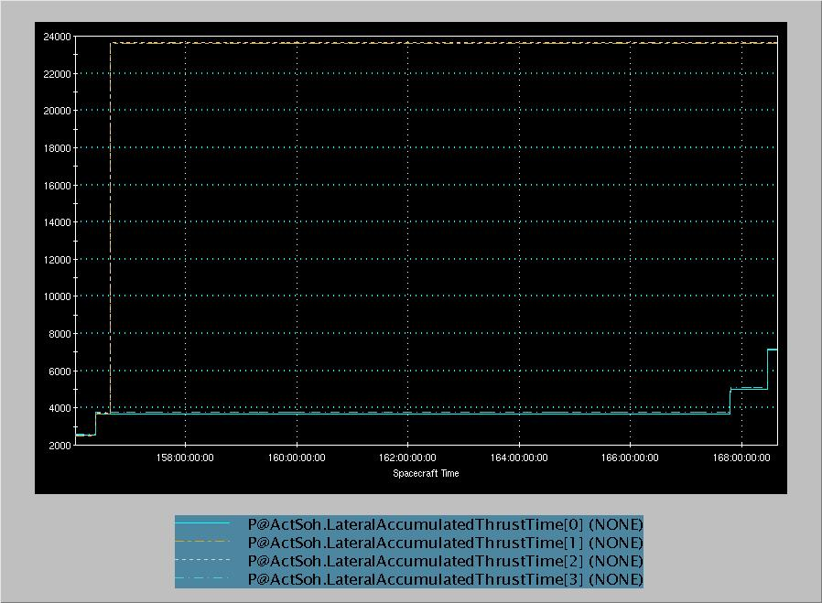
Re-point
Spin-up
ADV1
ADV2
ADV3

Slide 4
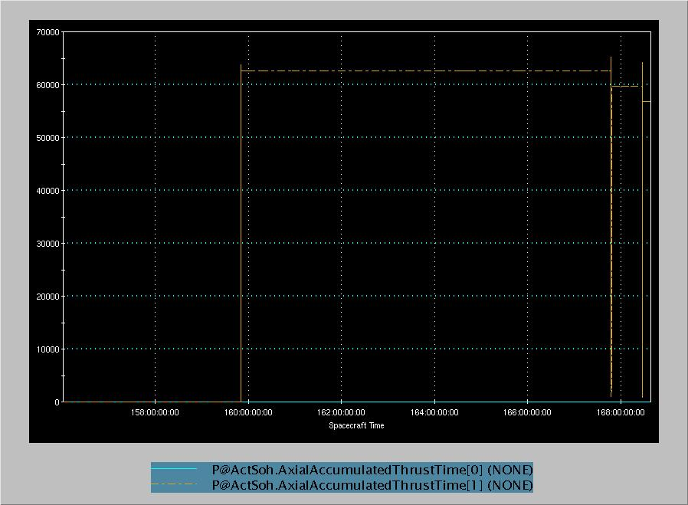
Re-point
Spin-up
ADV1
ADV2
ADV3

Slide 5
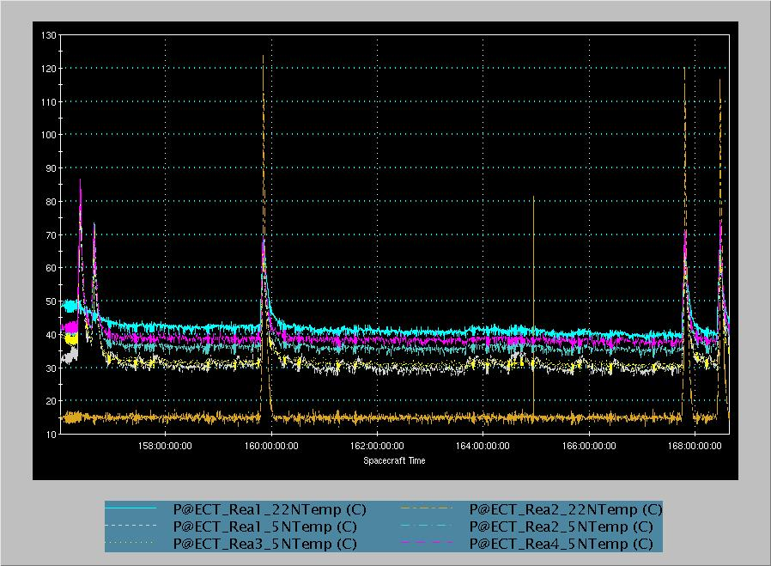
Re-point
Spin-up
ADV1
ADV2
ADV3

Slide 6
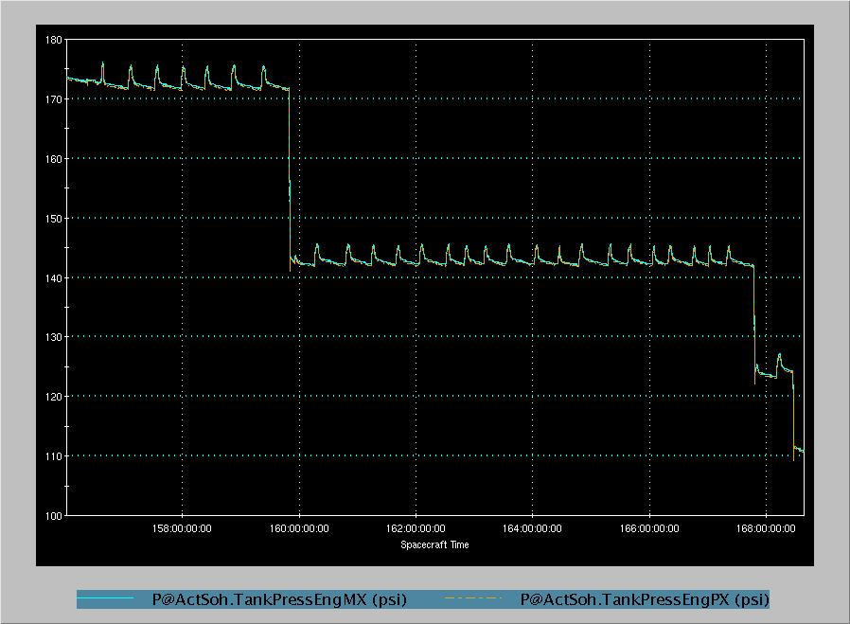
Re-point
Spin-up
ADV1
ADV2
ADV3
See Next Slide

Slide 7
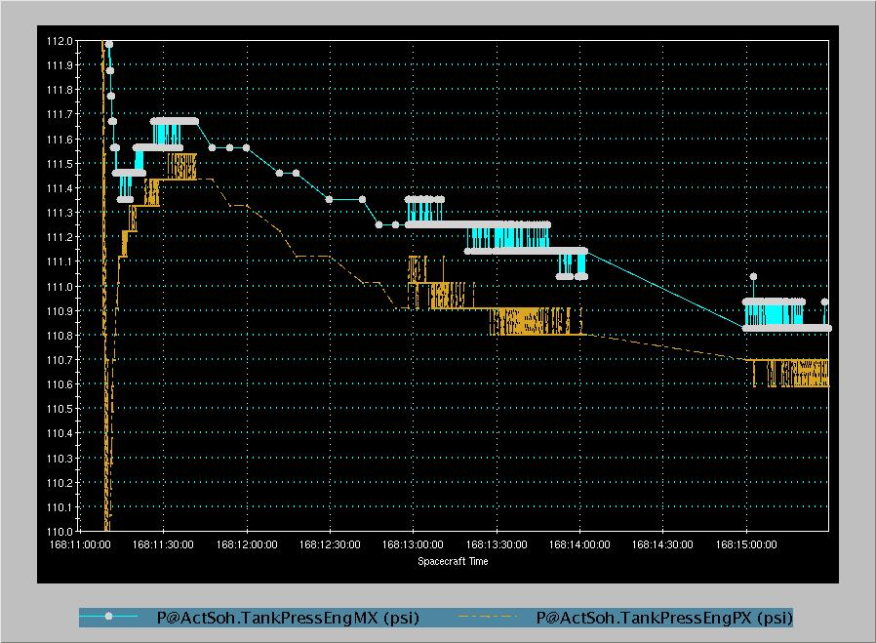

Slide 8
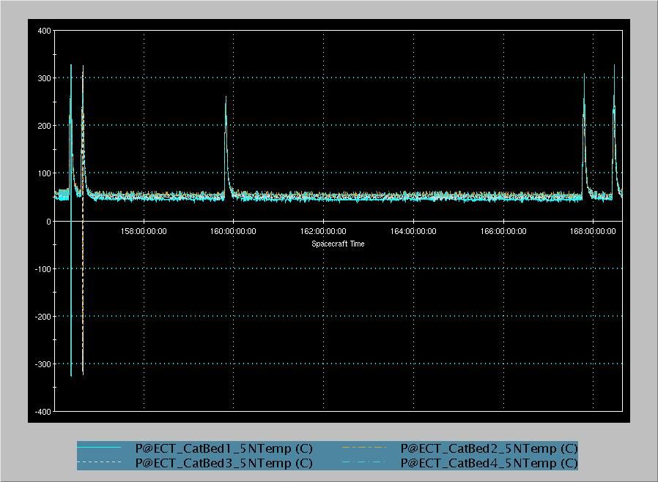
Re-point
Spin-up
ADV1
ADV2
ADV3

Slide 9
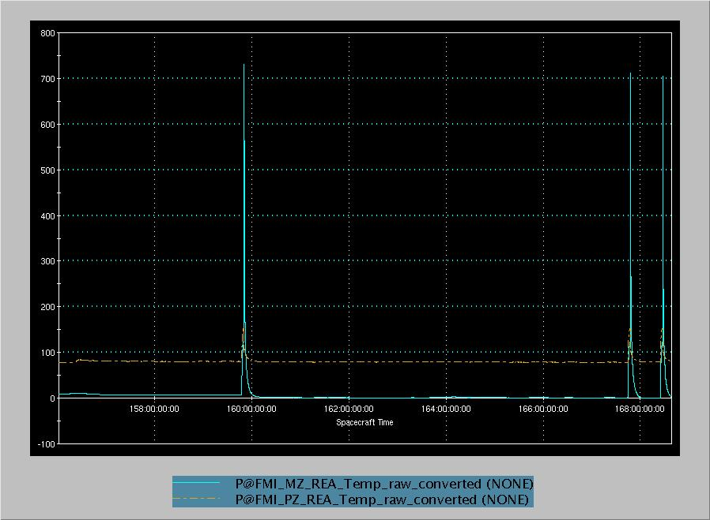
Re-point
Spin-up
ADV1
ADV2
ADV3

Slide 10
Re-point
Spin-up
ADV1
ADV2
ADV3

Slide 11
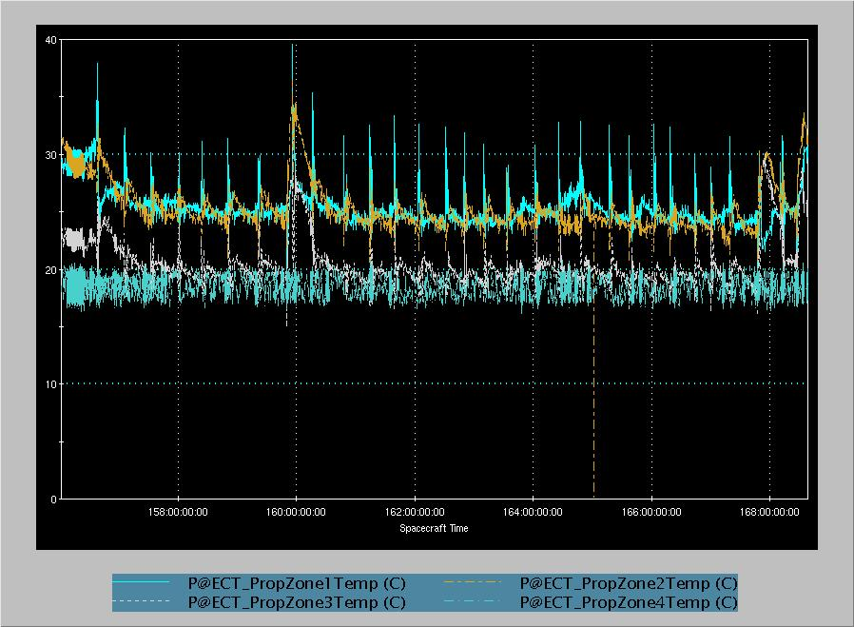
Re-point
Spin-up
ADV1
ADV2
ADV3

Slide 12
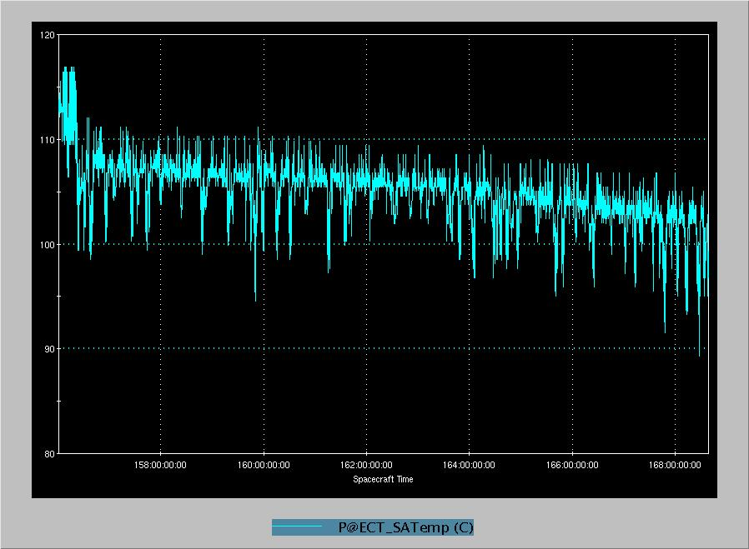
Re-point
Spin-up
ADV1
ADV2
ADV3

Slide 13
Re-point
Spin-up
ADV1
ADV2
ADV3

Slide 14
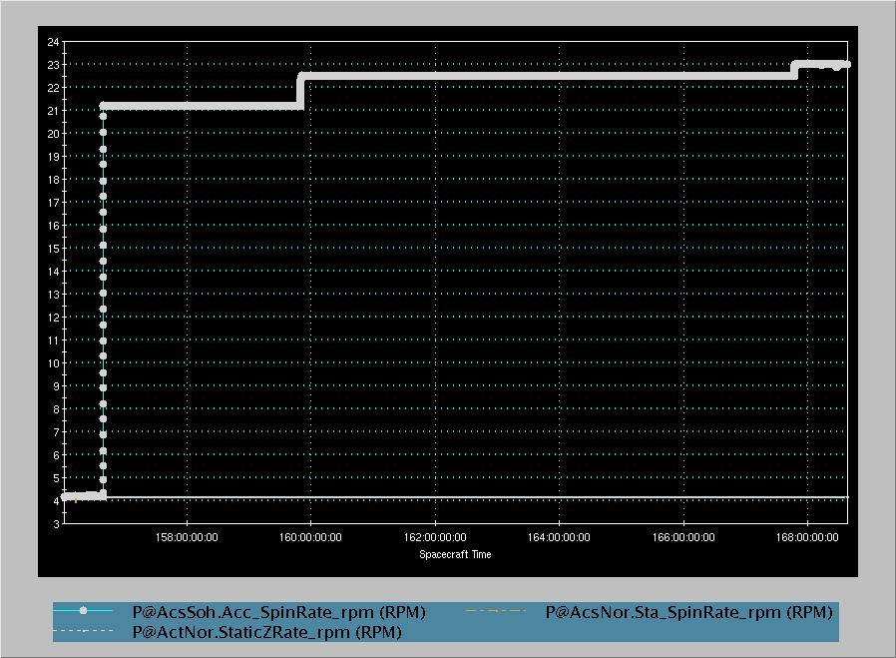
Re-point
Spin-up
ADV1
ADV2
ADV3
See Next Slide

Slide 15
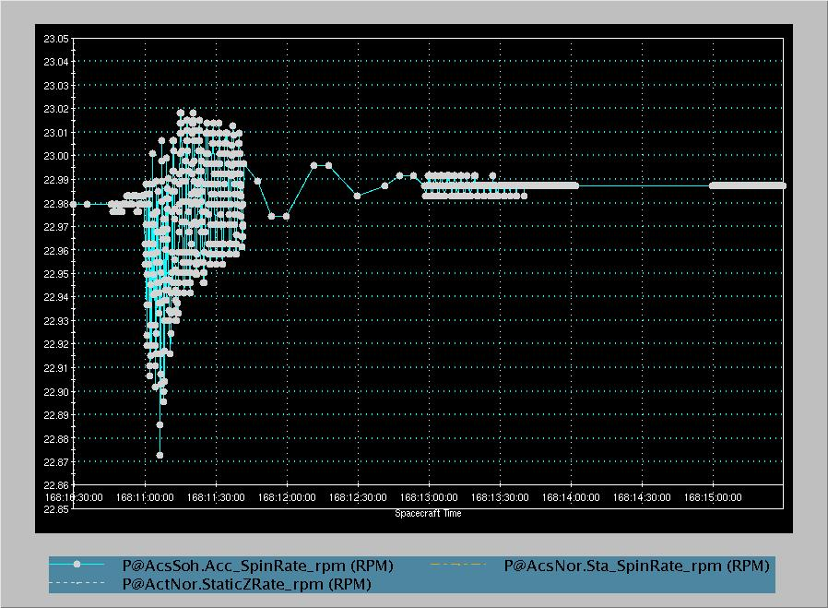

Slide 16
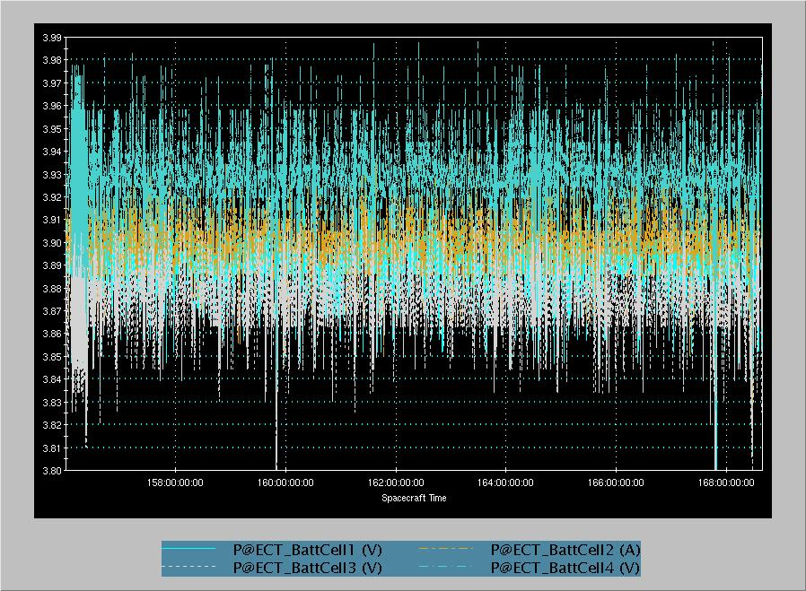
Re-point
Spin-up
ADV1
ADV2
ADV3

Slide 17
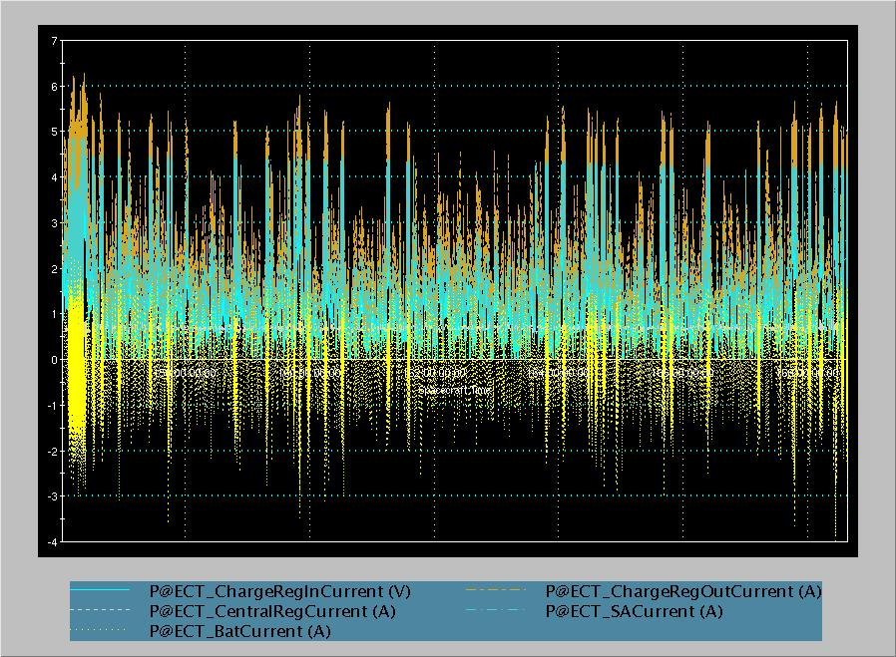
Re-point
Spin-up
ADV1
ADV2
ADV3

