Slide 1
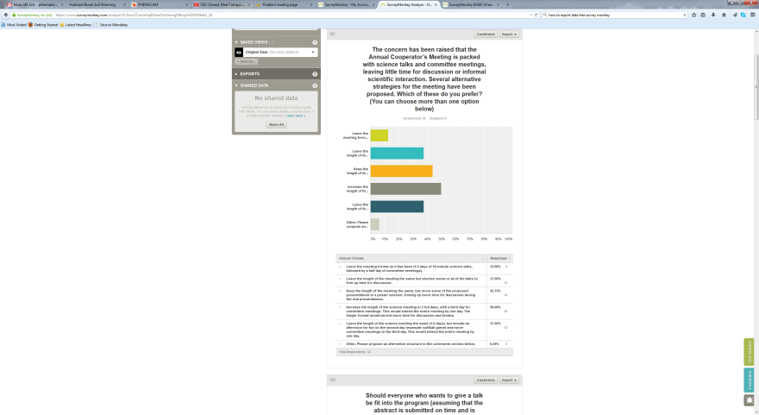
Question 1
Hubbard Brook Annual Cooperators Meeting Structure Survey Results
(Survey open Jan 13-23, 2015)

Slide 2
Question 2

Slide 3
Question 3

Slide 4
Question 4

Slide 5
Question 5

Slide 6
Question 6

Slide 7
Question 7

Slide 8
Question 8

Slide 9
Question 9
Name (optional):
Lindsey
Joel Blum
David Sleeper
Adam Wild
Ruth Yanai
Christopher Hansen
Mary Martin
Amey
Winsor Lowe
Michele
John Campbell
Andrew Richardson
Geoff Wilson
Emily Bernhardt
Pam Templer
Chris Johnson

Slide 10
Question 10
Please provide comments below. (14 responses)
I support a poster session in the barn with drinks, food and entertainment. I suggest something in addition to the dance - games, photo competition, something else that will draw more people in. The dance is beginning to include a select few but not everyone participates.
HBRF is committed to continue to work with HBES scientists and HBEF personnel to make Cooperators' Week as successful as possible.
The Cooperators' meeting provides a unique forum where all participants - undergrad to PI - have the same stage for collegial exchange. This spirit should be preserved.
Nice job! Thanks for doing this.
Some talks draw more questions and feedback than others and we can't predict which talks that will be so I like the idea of adding a discussion period at the end of each session.
Some talks, e.g. by students who have not yet started to work on their project, could be best presented in the 2 or 4 min time slots. This would help streamline the program.
I think everyone should be able to present, but we could strongly encourage people who are not presenting results from HB to use the poster session. It seems like there are many proposal-like talks that would fit better as posters, leaving more time in the talks for new findings.
You did not ask about the barn dance and dinner. Without Suzanne to coordinate, will this event be dropped?
Generally I think the quality of talks is reasonably high, and it is important to give students the opportunity to present work. I worry that a selection process would focus on accepting talks by the PIs, which would be unfortunate.
One idea is to extend the meetings to two full days with day 3 for committee meetings and day four for COS. The two full days could still include 1.5 days of talks with added time for discussion and then 0.25 days for poster sessions with another 0.25 days for group fun event. Perhaps re-invent the softball game type event with whiffle ball, ultimate frisbee, and lawn games.
I like the keynote address but we really need to decide who the audience is. Is it the Hubbard Brook supporters who are invited to stick around after the HBRF board dinner, or is it the research community? I don't have much of an opinion, but it seems like the supporters get left in the dust even with fairly general, broadly appealing talks that are at an appropriate level for even our undergrads. The keynote is a fine idea, but it hasn't always really worked and is a lot of work on the back end to pull off. I guess I think we should probably aim for the supporter community but then draw the talks from senior level Hubbard Brook people with the aim of a general talk about a topic that is active at Hubbard Brook. HIstory, context, current works, etc..... This would be easier to get the speakers and hit both the donor audience and the younger researchers who often lack the bigger picture of the work at Hubbard Brook. It wouldn't kill the other senior people to hear it, either.
Hi, its probably not really fair for me to comment since i haven't been to one of these for more than a decade but I loved these meetings as a HBEF PhD student. Very few places make the effort for you to hear about all of the work being done. I do think it would be great to have variable formats for presentations, where people could either give a "BIG IDEA OR STIMULATING QUESTION" 2 minute talk (perhaps as a recruitment tool for an evening or ad hoc discussion group) or the more traditional 8 minute talk with time to get into a bit more of the nitty gritty. New students might give a 2 or even 1 minute advertisement as a talk to advertise their poster in a session where they might actually get more useful and intensive feedback. The HBEF meeting is such a great opportunity to add context to your individual work and its worth finding every possible way to catalyze new connections and foster intense interaction where people can match up disparate data in pursuit of challenging interdisciplinary questions. I hope to get to the meeting this year.
I prefer the option of 6 min talks with 4 min for questions.
If the meeting were expanded to two more-or-less full days, the committee meetings could be scheduled in conjunction with the COS meeting, which could be slightly shortened.

